Slide 1
Generating LoKI event data for LiNDA
  McStas LoKI instr file taken from bitbucket
  LoKI detector > 1M pixels (2.5x2.5 mm for all 9 panels),
  100% McStas detector efficiency
  SANS_Benchmark2.comp as scattering sample
  Neutron count rate: > 21.000 / second (spheres)
  McStas_EFU generate event list for the NeXusFileStreamer
  Event data for 305 seconds (5min 5sec)
  Use the NexusFileStreamer to send event data
  Data captured in Mantid and reduced
  Reduced data analyzed with SasView/Bumps
EFU
Kafka
Mantid
SasView
Results

Slide 2
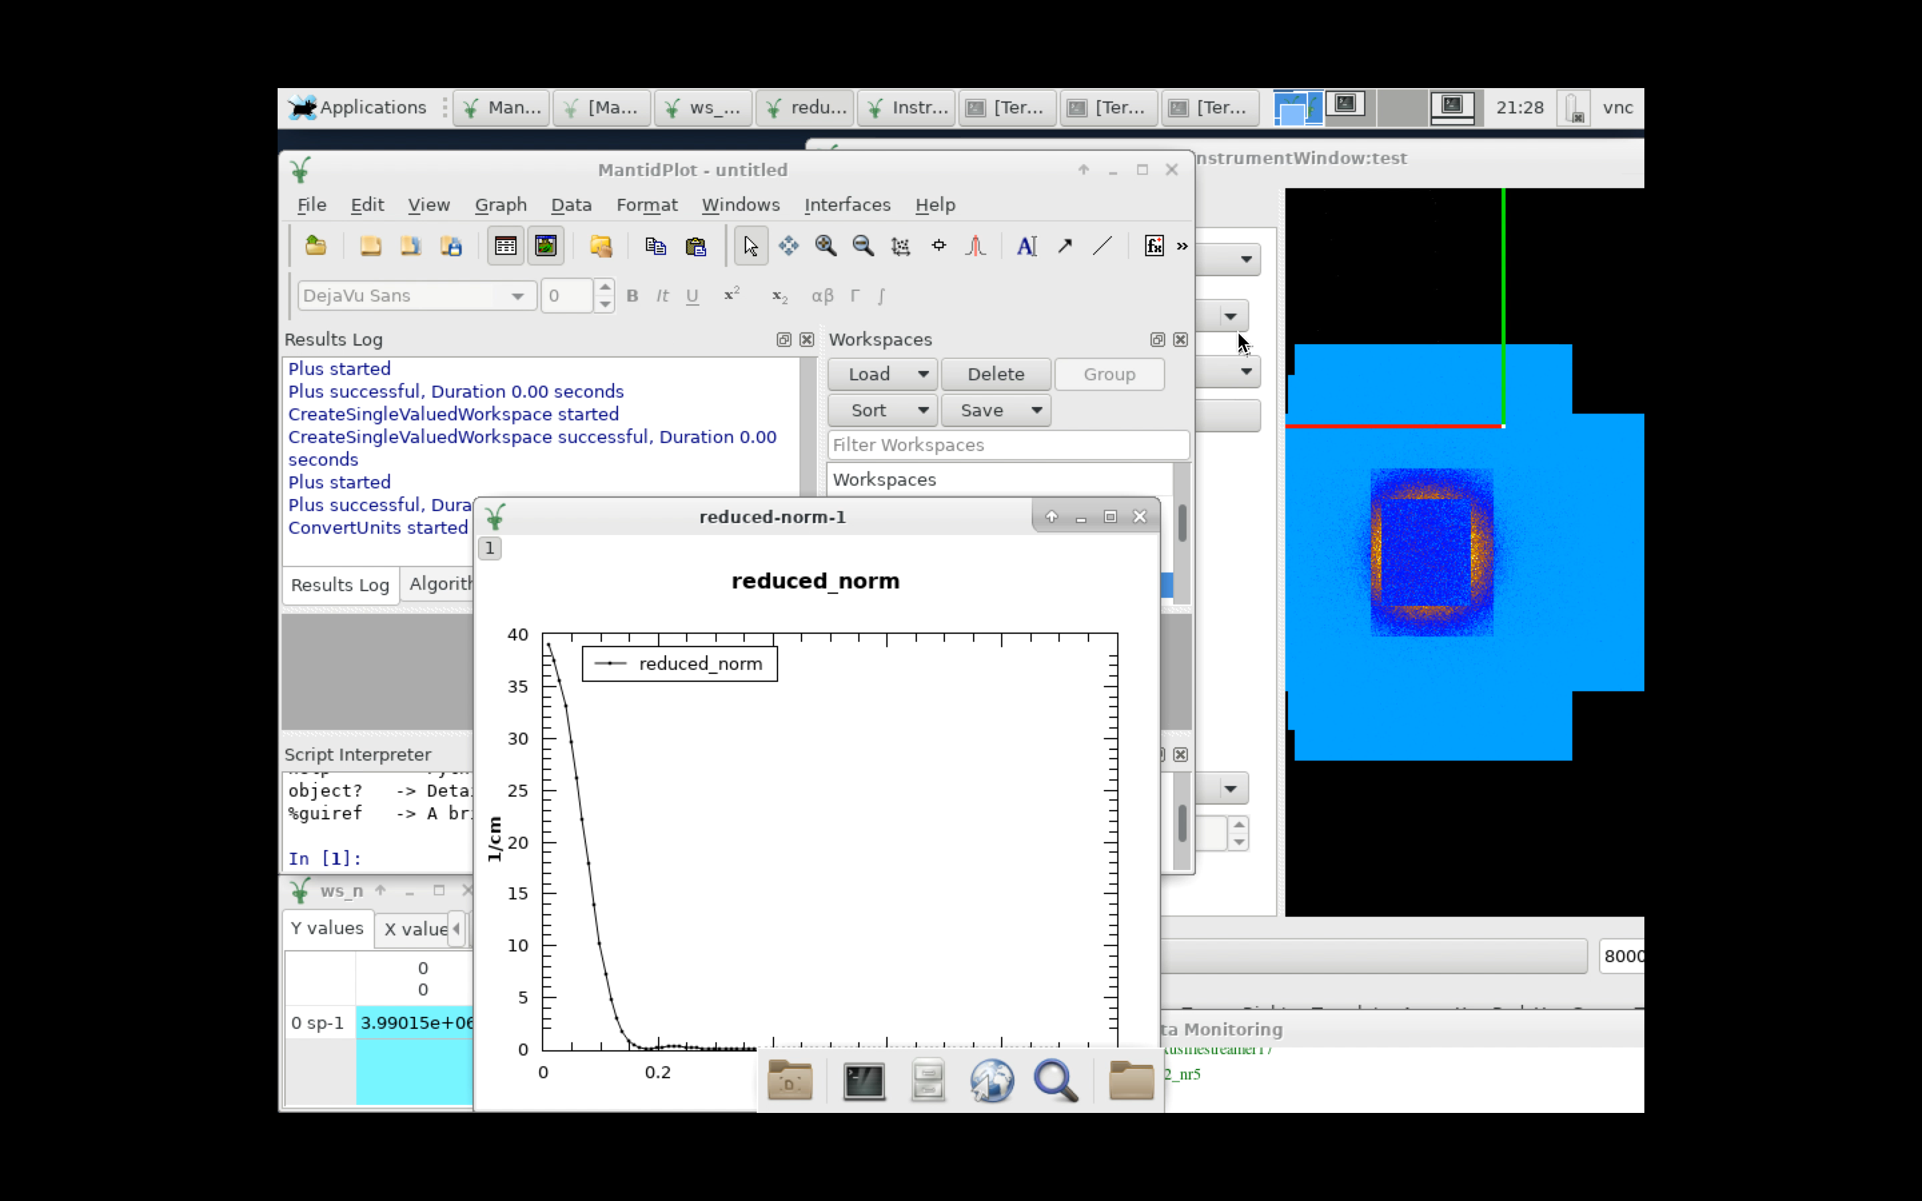
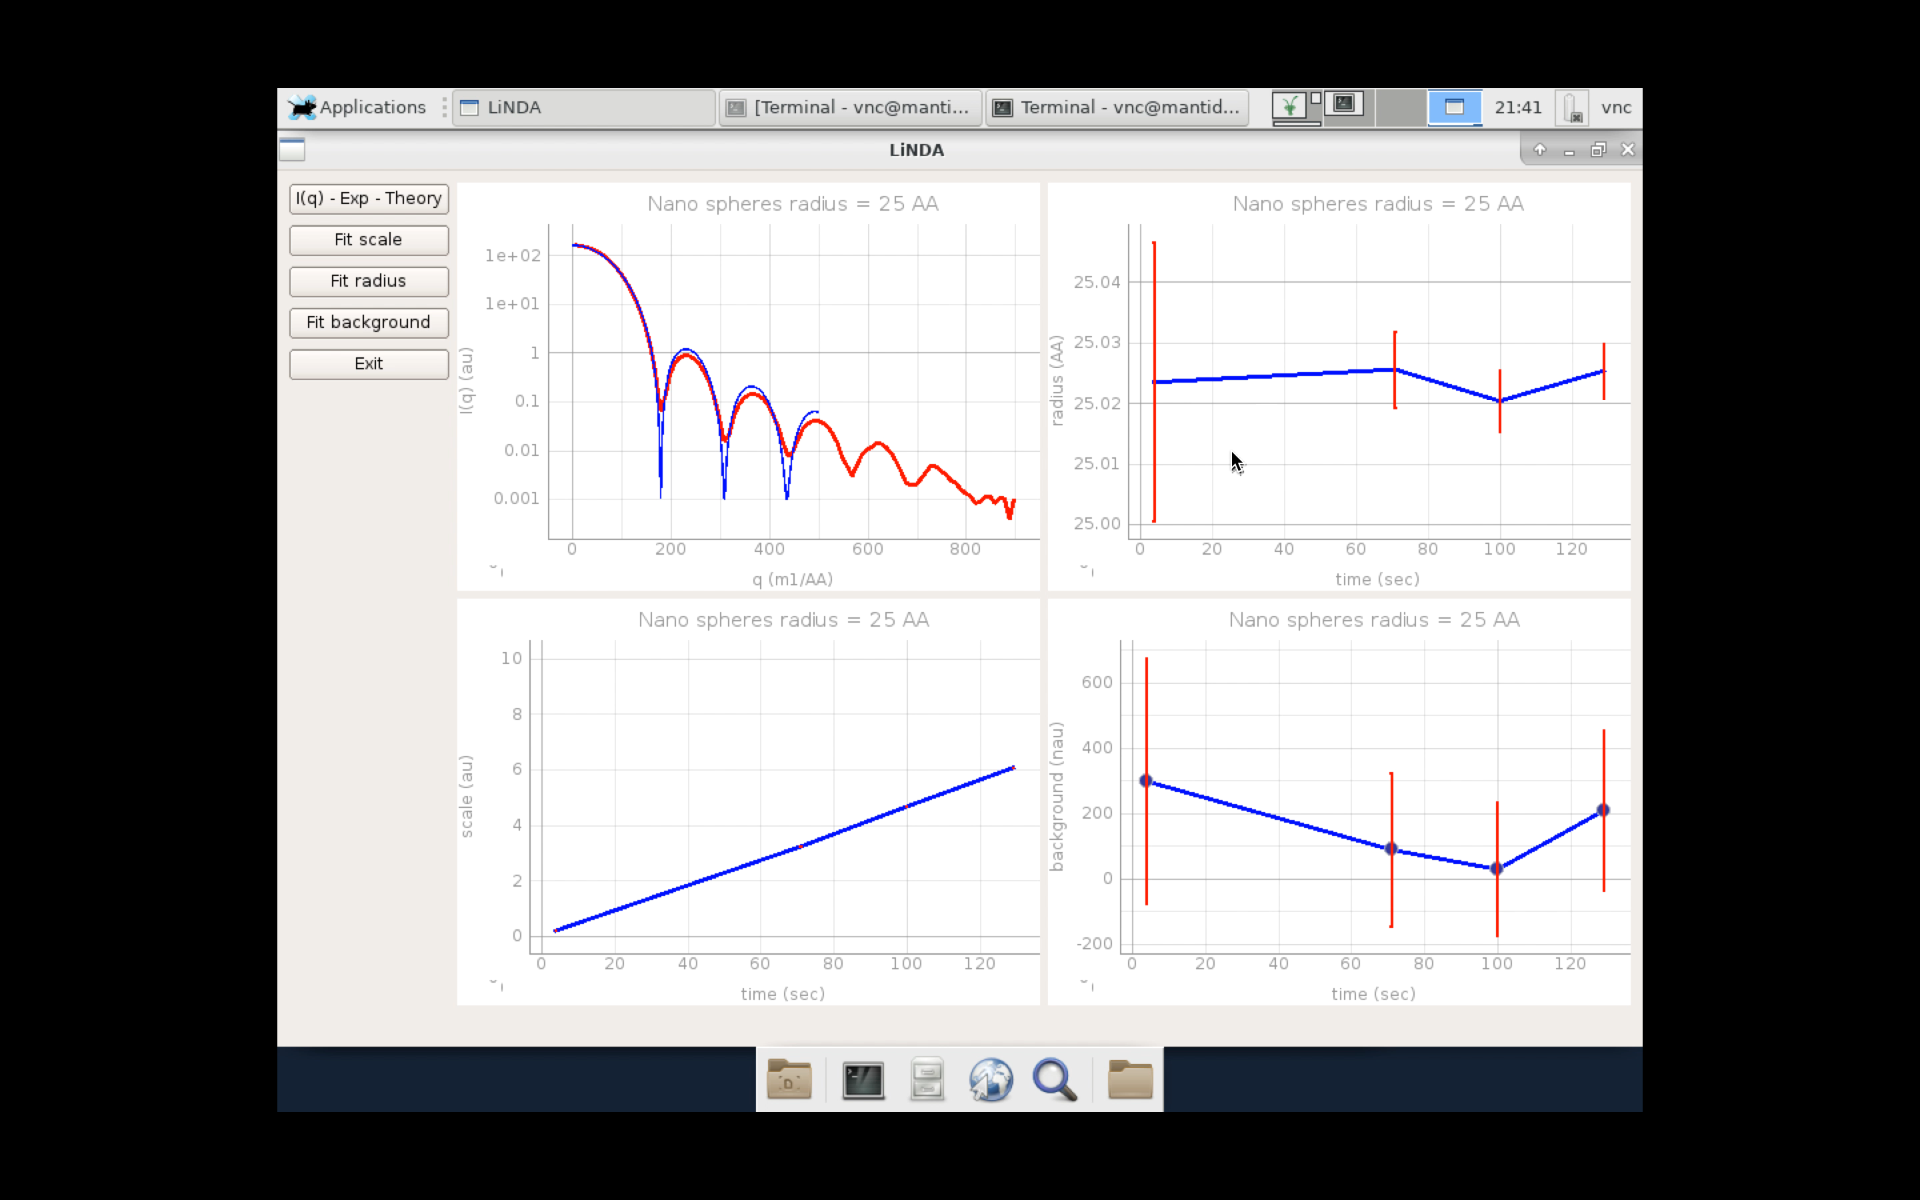
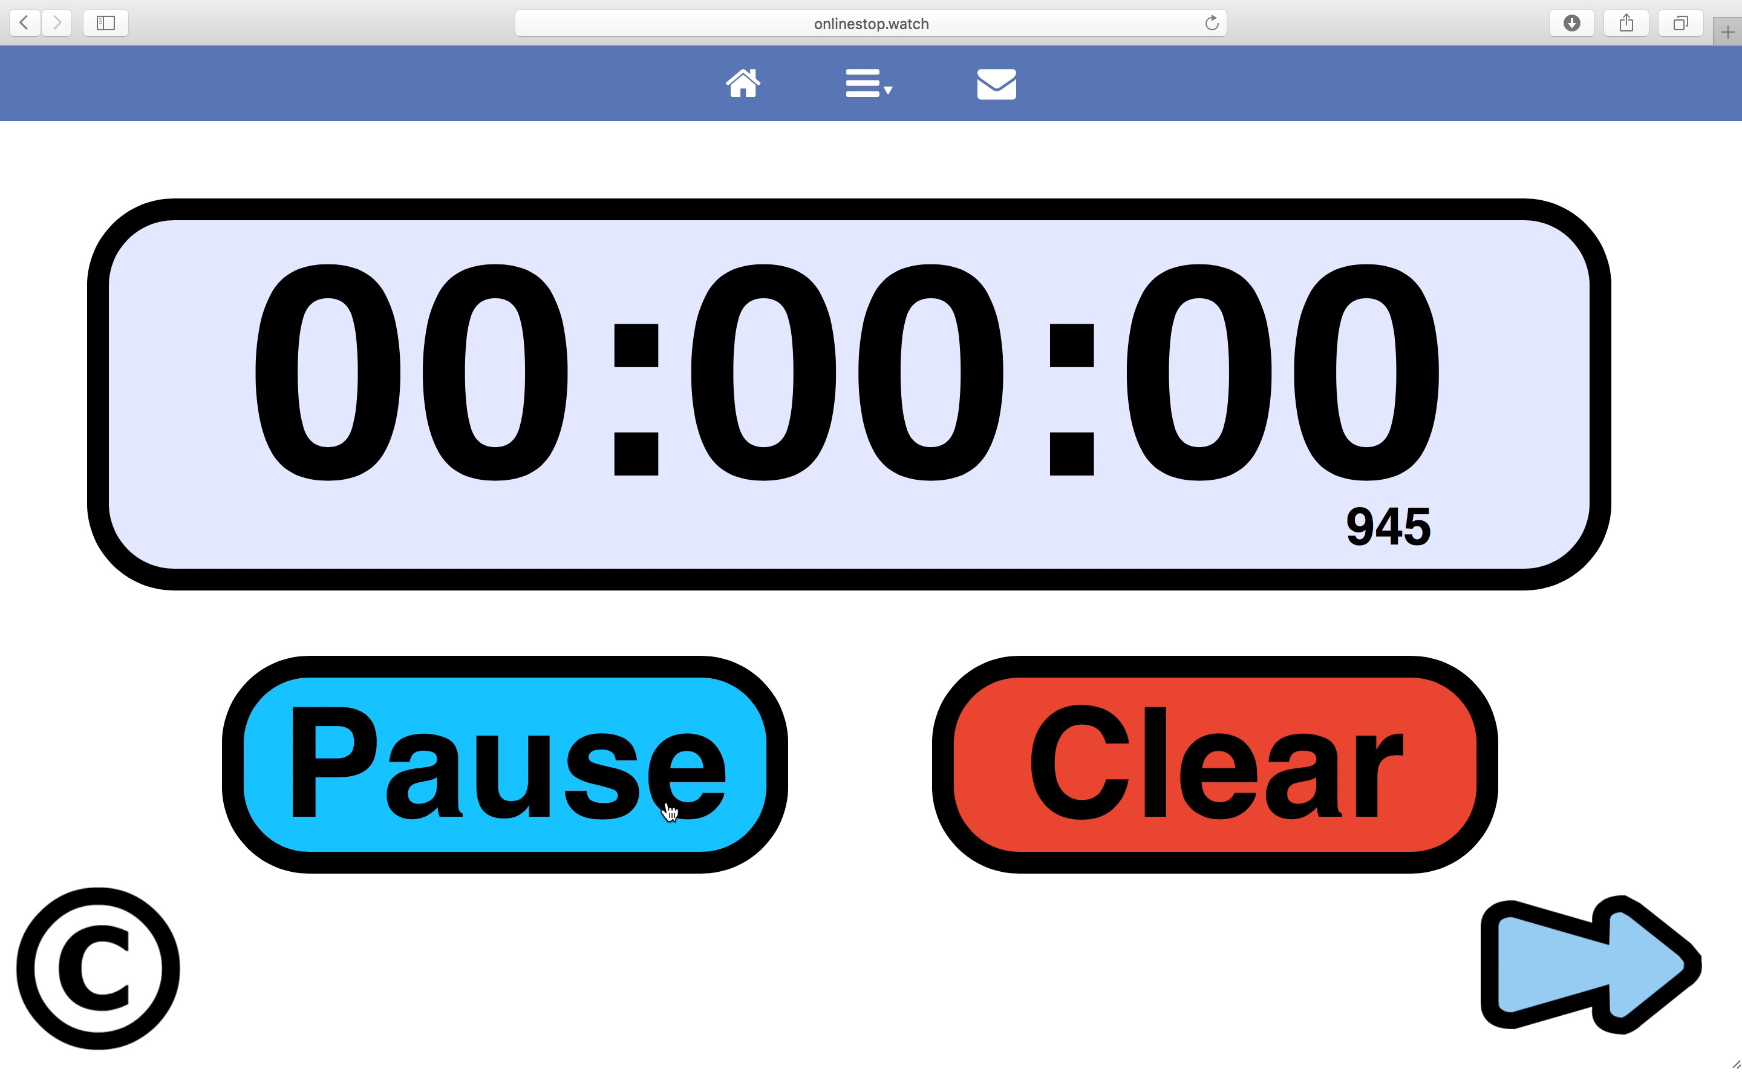
Video shows 80 seconds of processed event data
Mantid update rate ever 30 seconds
Fitting update rate ever 30 seconds

