Slide 2
DMSC STAP
Updates from DRAM
Torben Nielsen
October 2023

Slide 3
Agenda
1. DRAM
2. Staff
3. Updates since last STAP
4. Comments to STAP report
5. Summary

Slide 4
DRAM
Data Reduction, Analysis and Modelling
Data reduction
scipp will be used for all instruments
Possibly in combination with other software for NMX & Imaging
Are looking for partners
Data analysis
easyScience for powder, sxtal & reflectometry
  possibly also QENS and TOF imaging
  But always in combination with other libraries (backengines)
SasView for SANS
PACE for spectroscopy
MuhRec for Tomography.
Data modelling
McStas for instrument simulations
  Now also with Python API McStasScript
  and optimized for GPU
  NCrystal

Slide 5
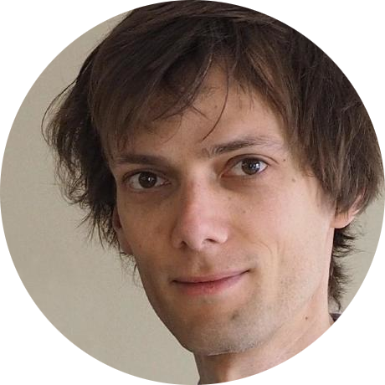
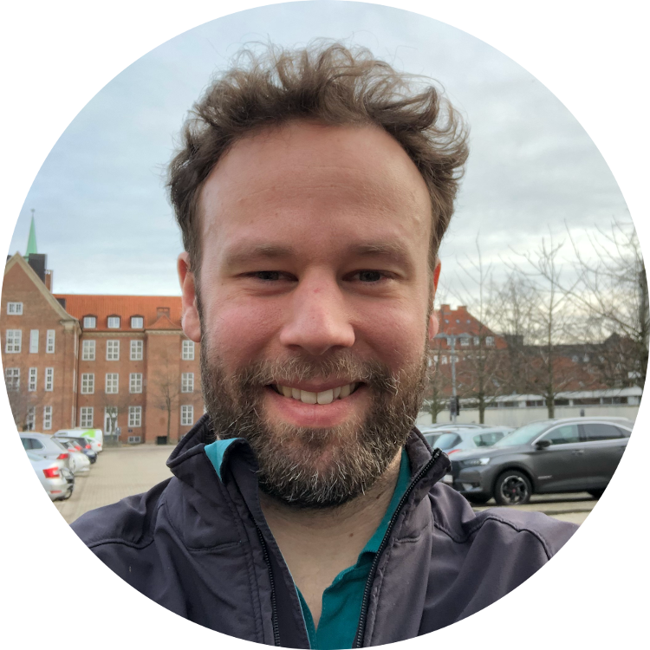
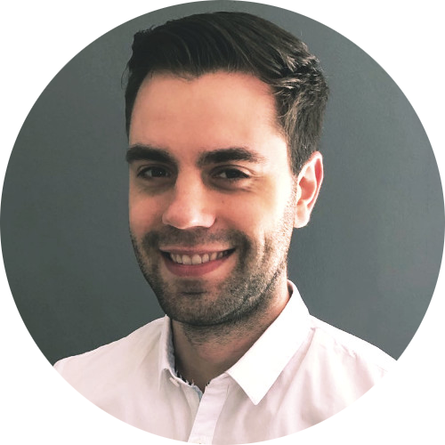
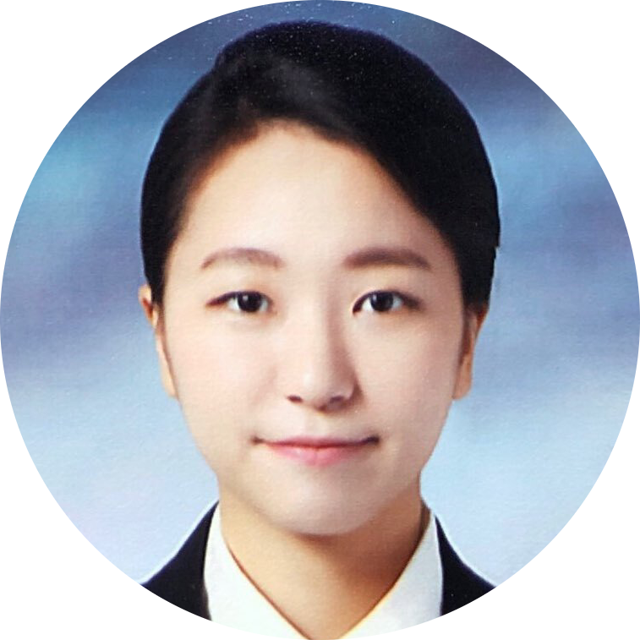
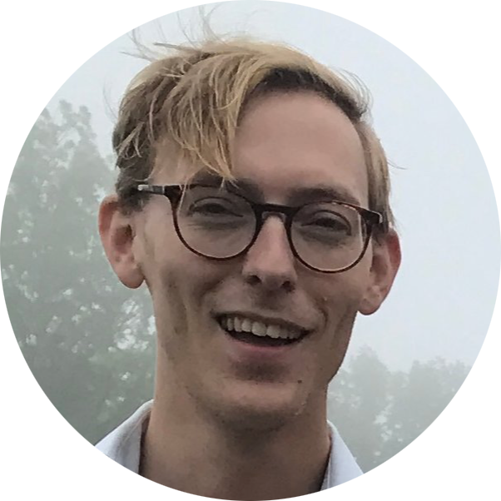

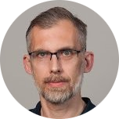
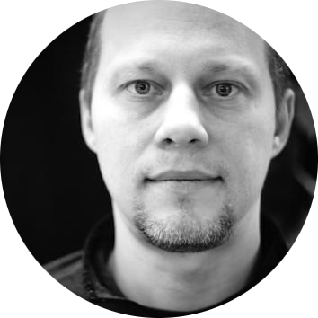
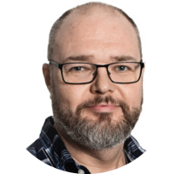
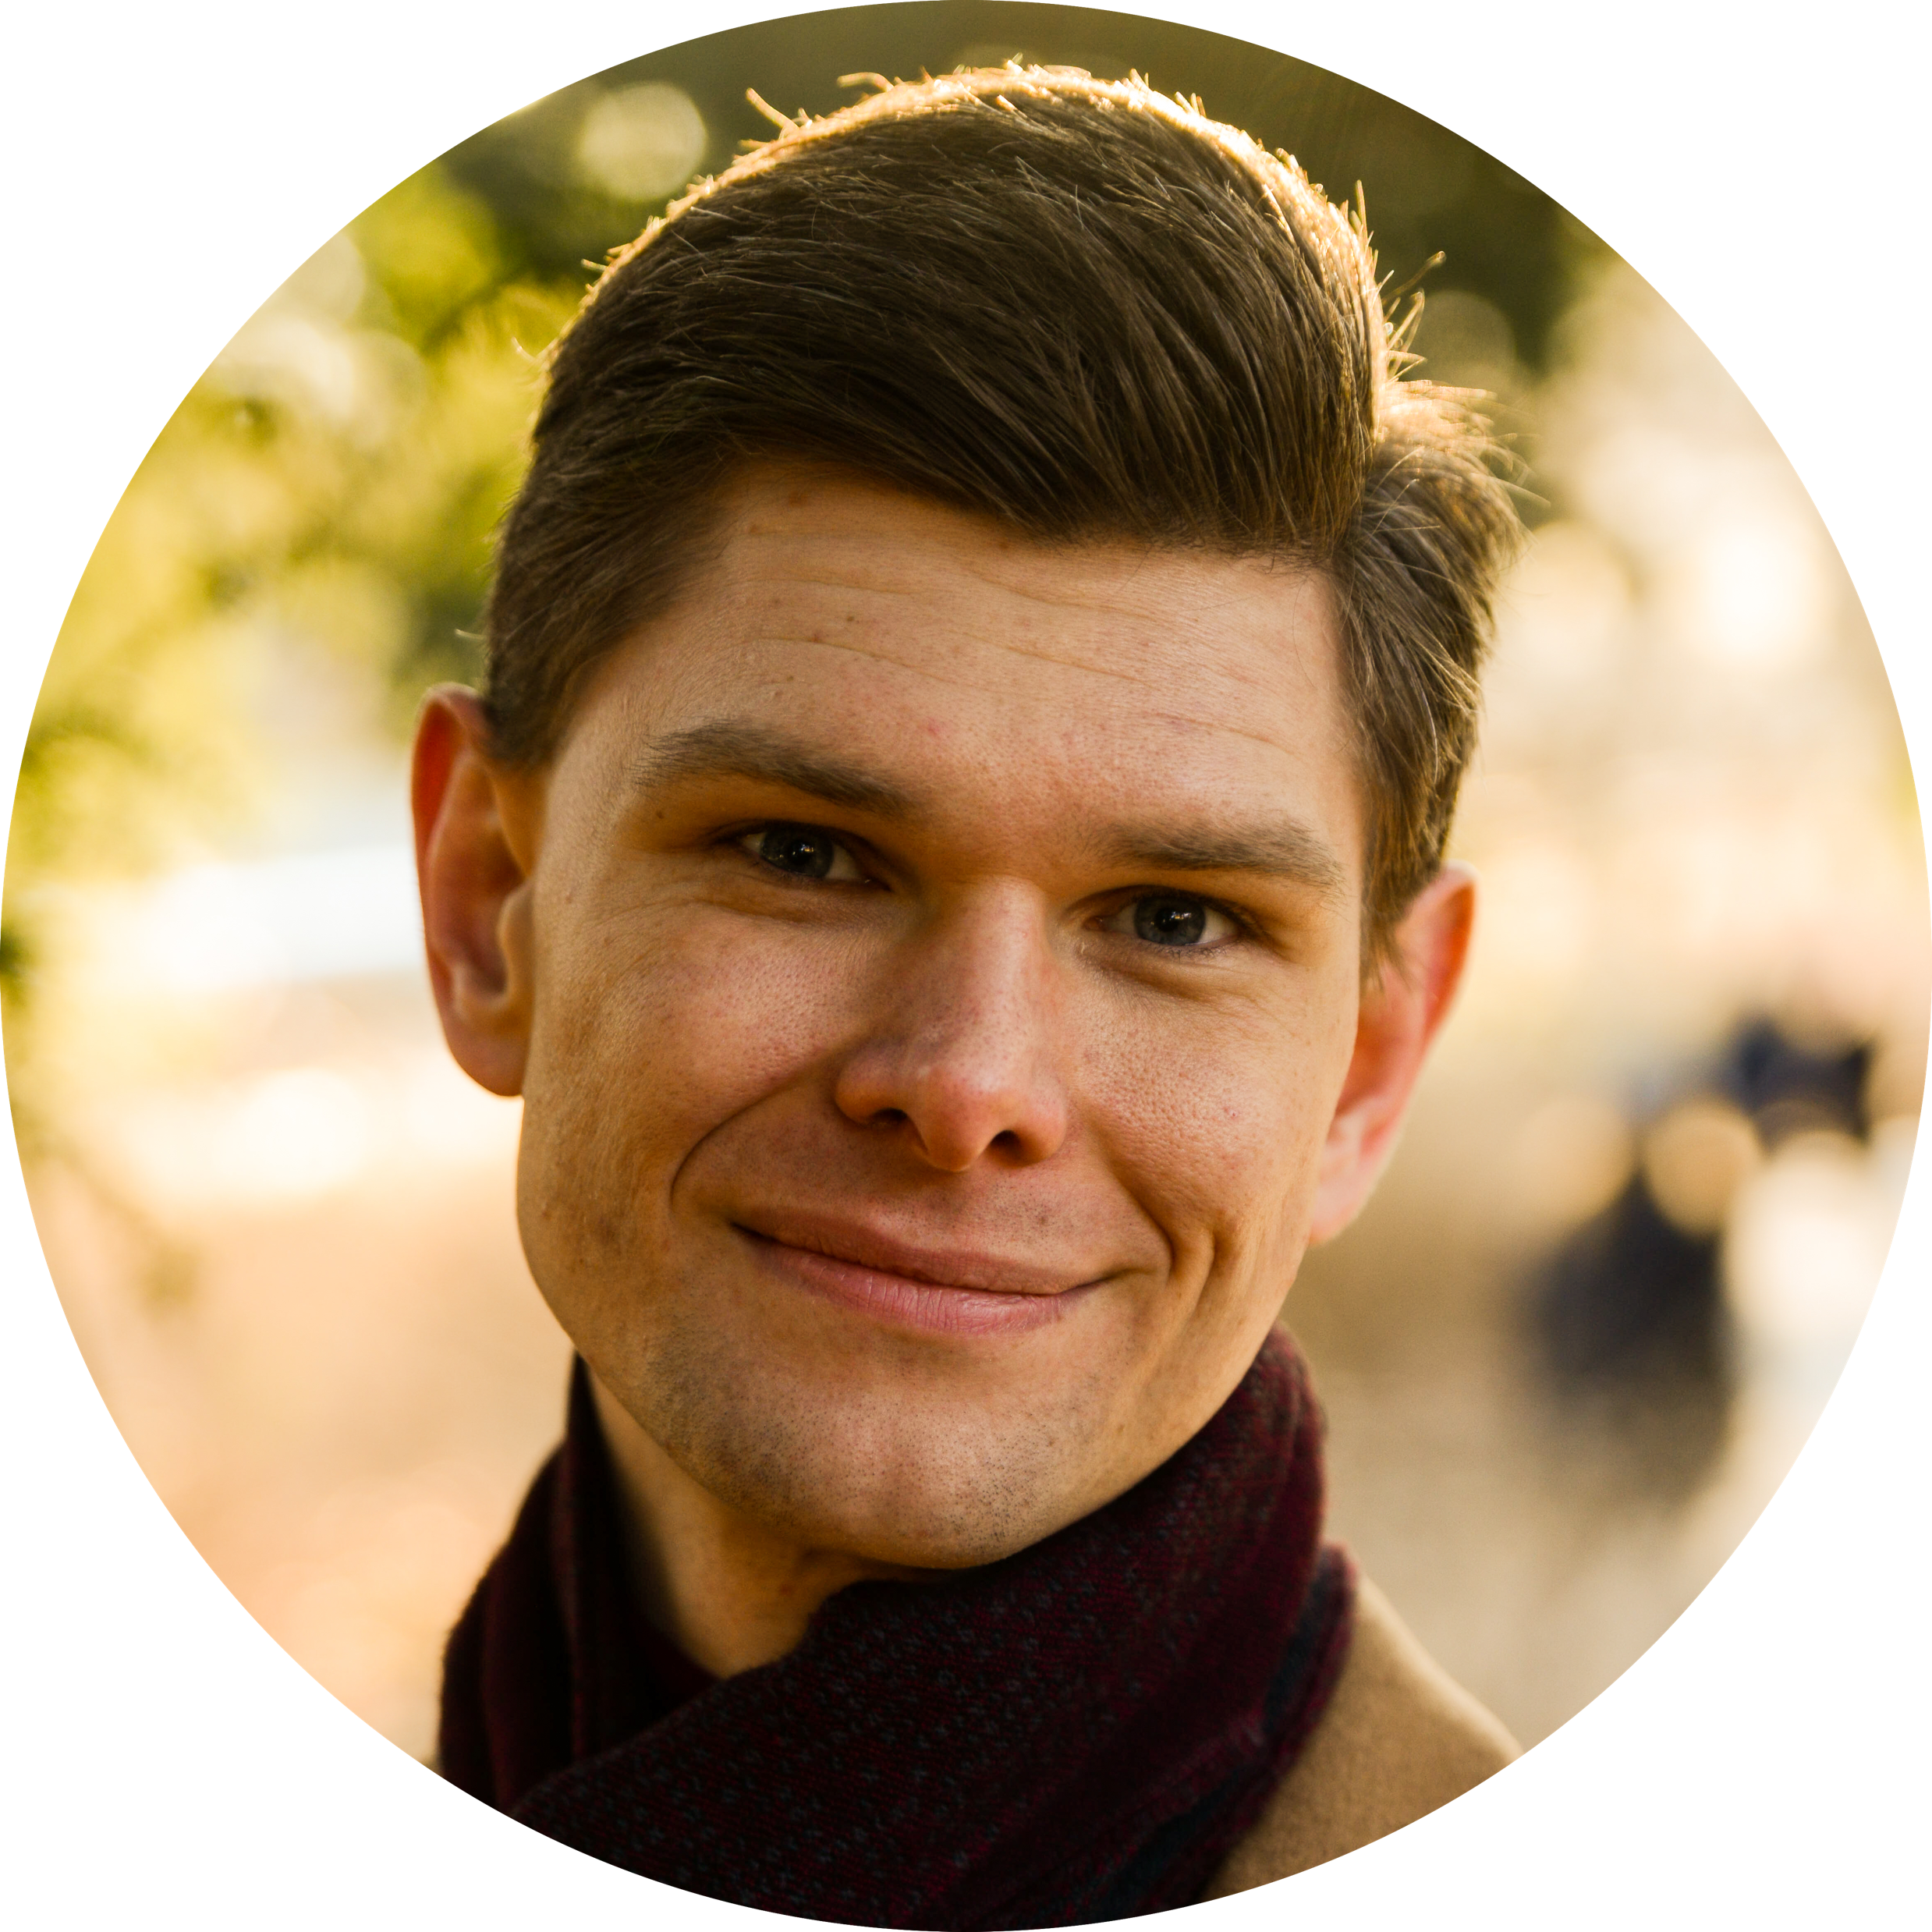
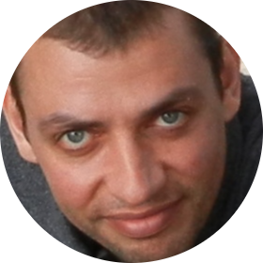
DRAM
Data Reduction, Analysis and Modelling - Staff
Scipp
Simon Heybrock
Neil Vaytet
Jan-Lukas Wynen
Sunyoung Yoo
Johannes Kasimir
MS
3 teams (14+ persons)
Data Reduction (scipp)
Data Analysis (SasView, SpinW, EasyScience, external collaborations )
Modelling (McStas++, pan-learning.org, NMX IDS, Detector Group)
SWAT
Piotr Rozyczko
Andrew Sazonov
Developer 3
Developer 4
Developer 4.5
McStas
Peter Willendrup
Mads Bertelsen
Thomas Kittlemann*
Scope
The DRAM group is responsible for providing the data reduction, analysis and modelling soft-ware for all instruments at ESS.

Slide 6
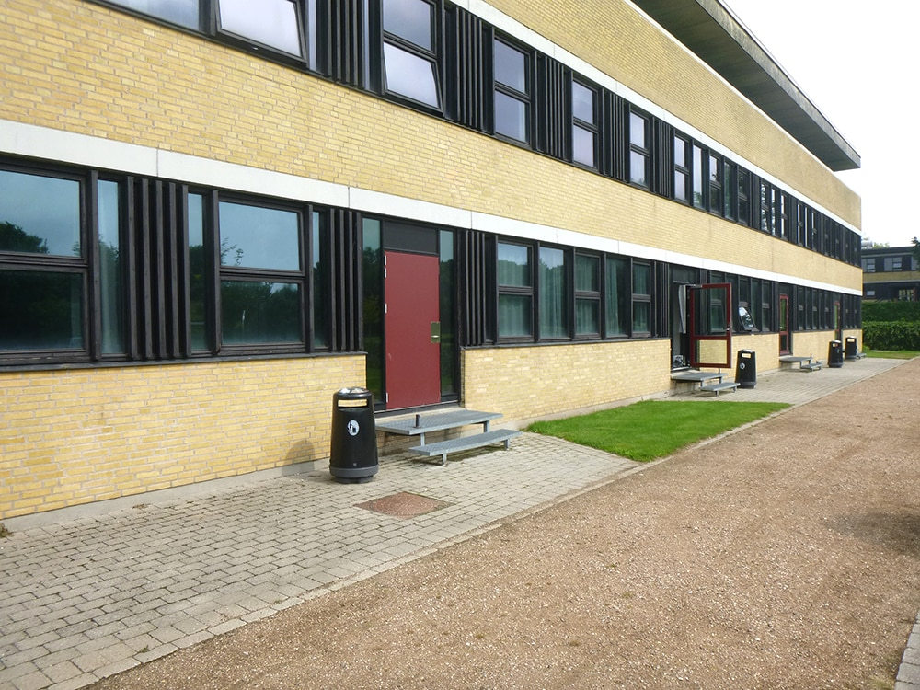
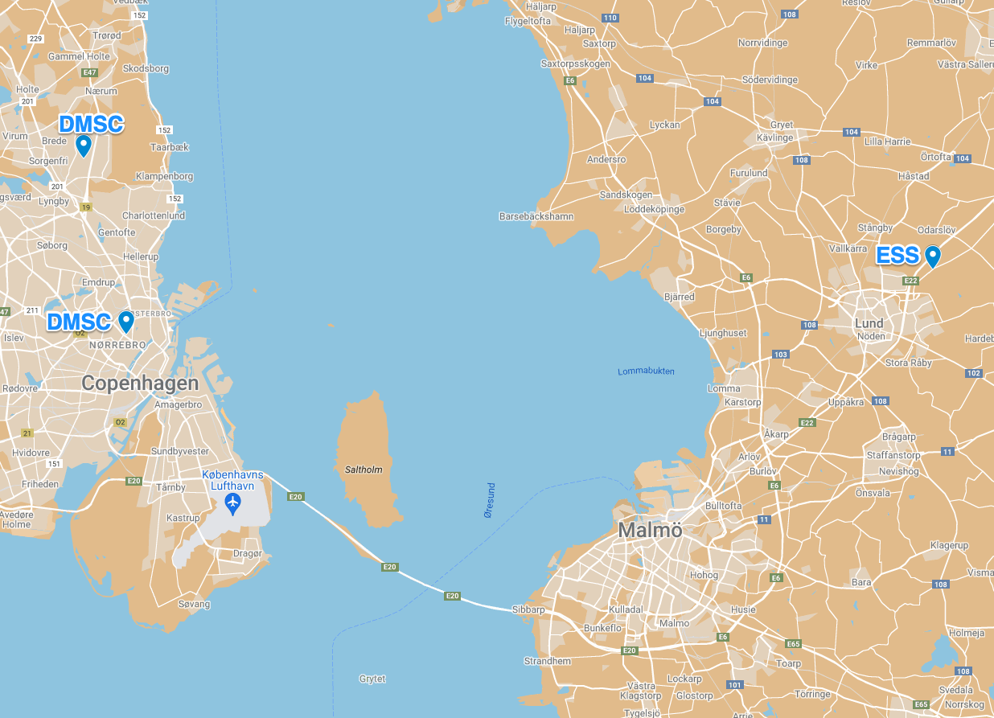
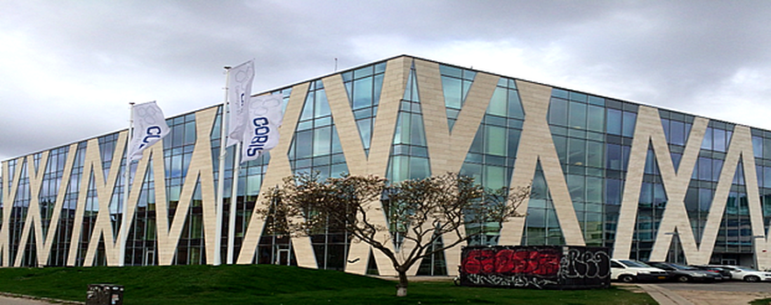
DMSC – Copenhagen/DTU – ESS – LUND
Notes:
Indtil 1889 havde læreanstalten lokaler i Studiestræde 35, herefter i J.D. Herholdts kompleks i Sølvgade ved Botanisk Have (København) som i 1930 blev udvidet med et anlæg i Øster Voldgade ved arkitekt C.O. Gjerløv-Knudsen. Pladsen blev for trang, så i perioden 1962-1974 flyttede uddannelsesinstitutionen til Lundtoftesletten ved Lyngby.

Slide 7
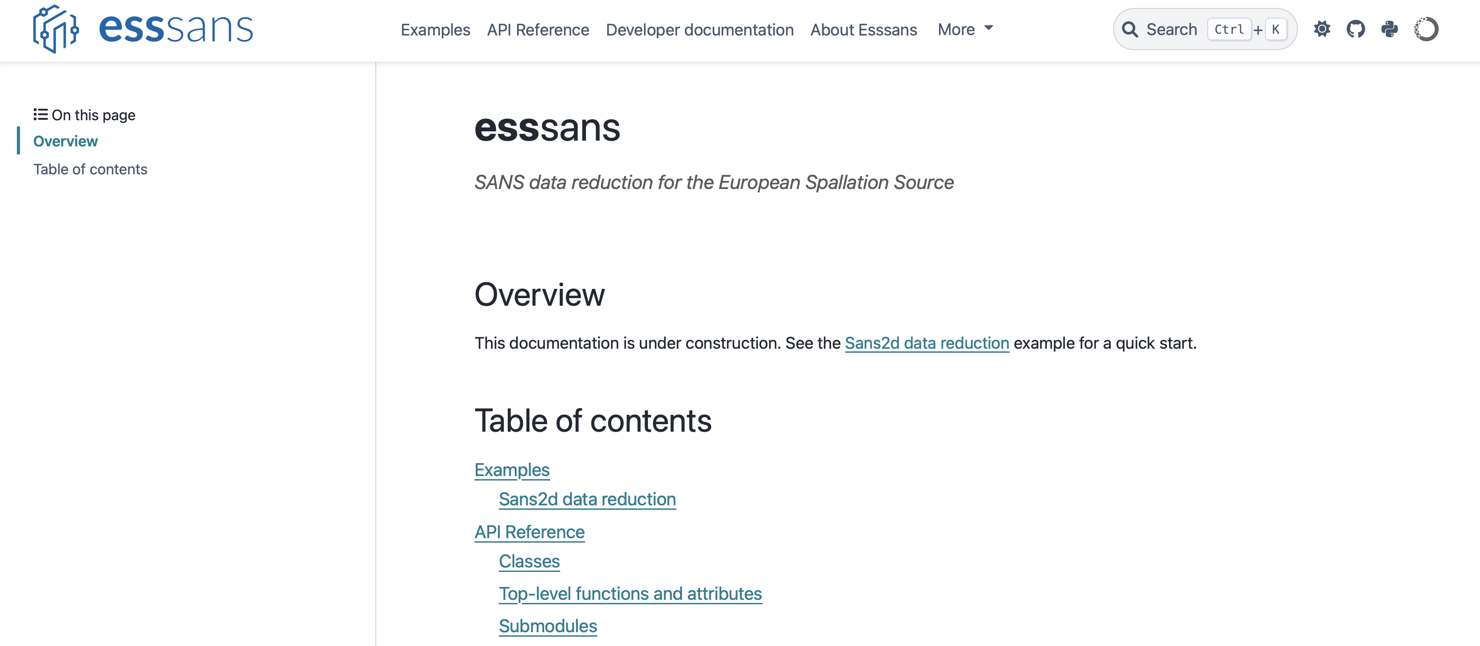
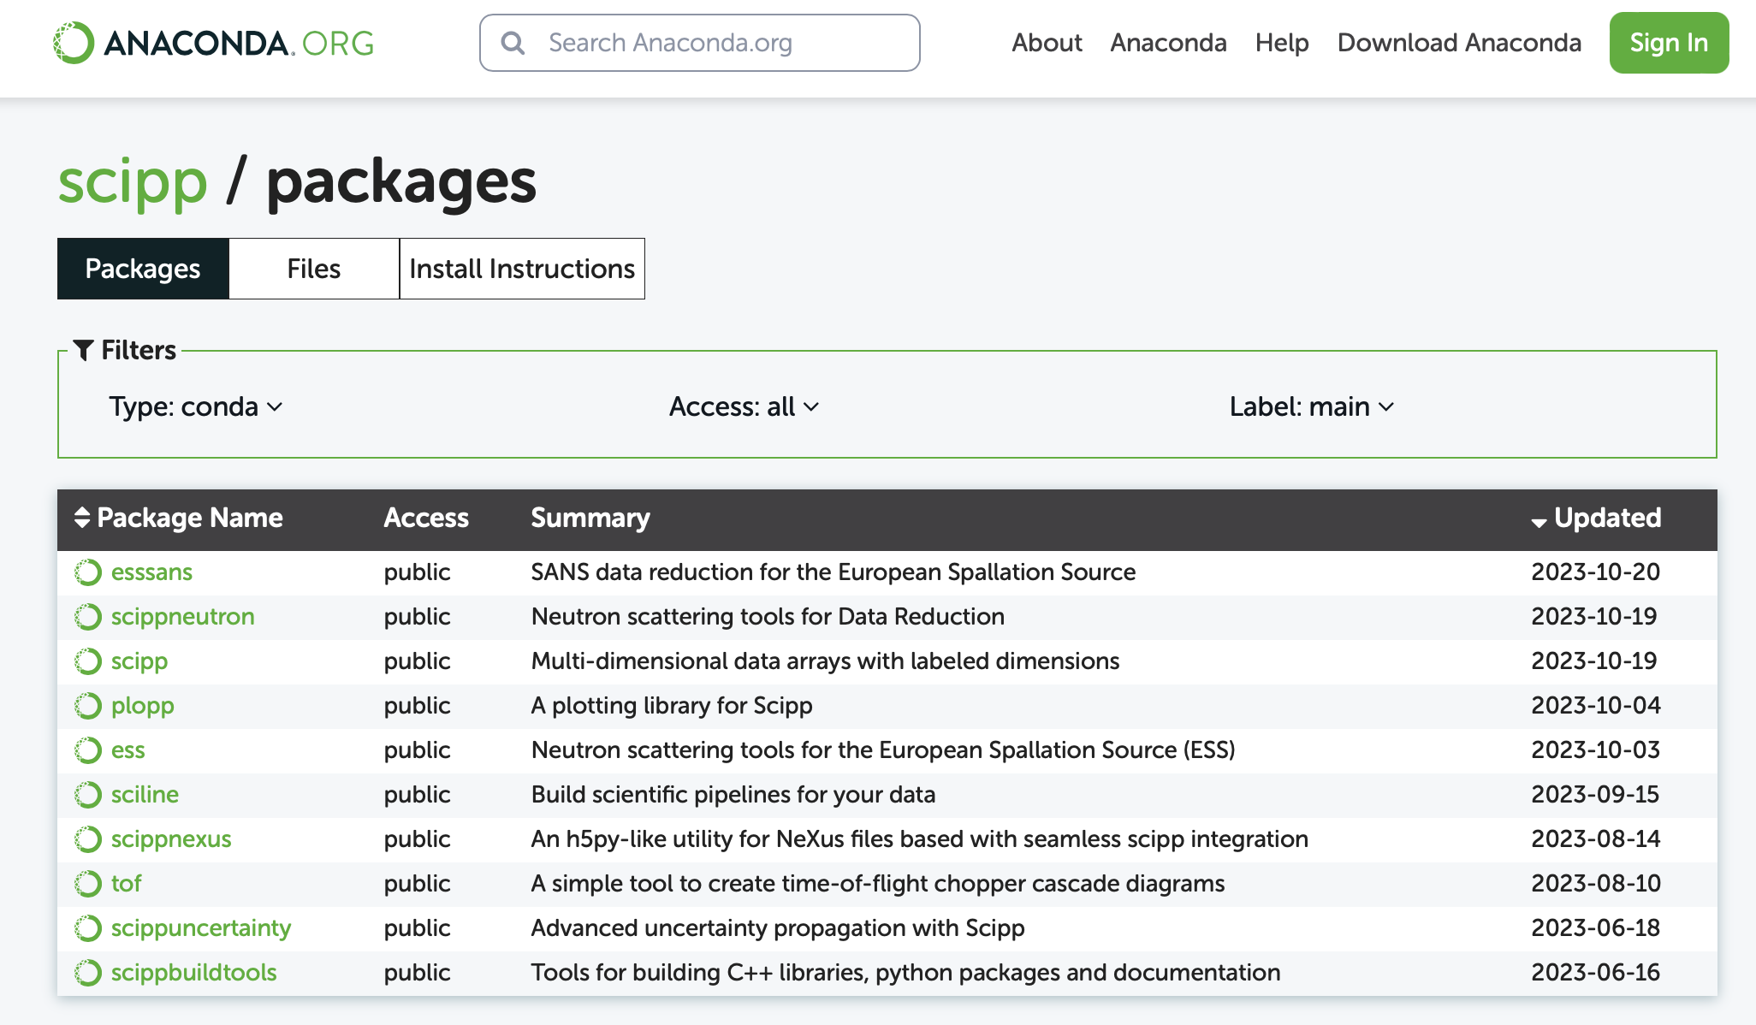
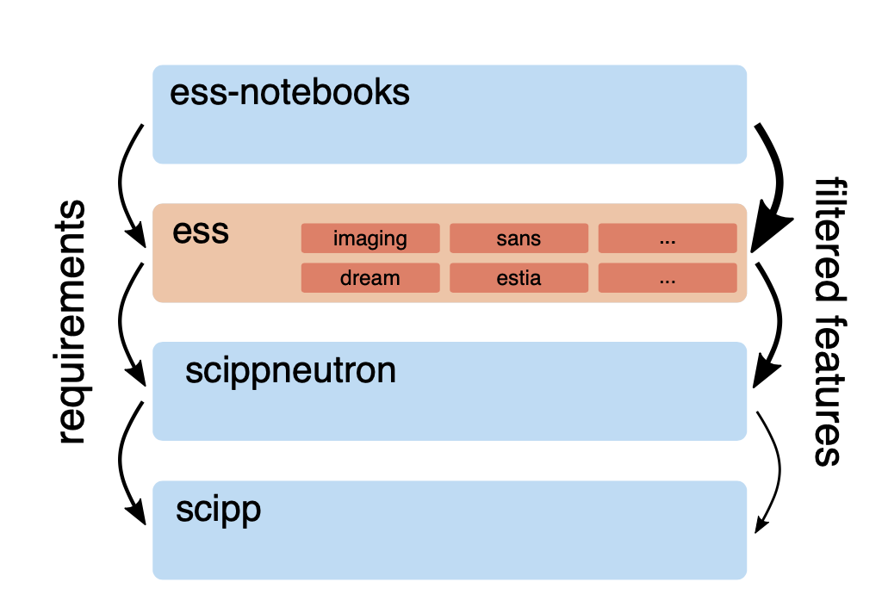
Scipp – Updates
Requirements from IDS
ess
ess_sans
ess_reflectormetry
DMSC Summer School
Sciline
Beamline
Scitation
Tof
New staff
Copier

Slide 8
Scipp – Updates 1
Requirements from the IDS
We have previously reported efforts on gathering concrete and actionable requirements from the IDS
While the effort has led to outcomes for some techniques, others have not been able to provide any feedback.
We will now try to kick off workflow development in remaining techniques by a more agile approach: Our new idea is that the team will take the lead in implementing a rudimentary workflow for each technique (unless it exists already).
This will serve as a starting point to gather feedback from the IDS, and to identify and prioritize missing features. Even for this first step, we will, however, require IDS involvement, in particular we need to obtain sample data.

Slide 9
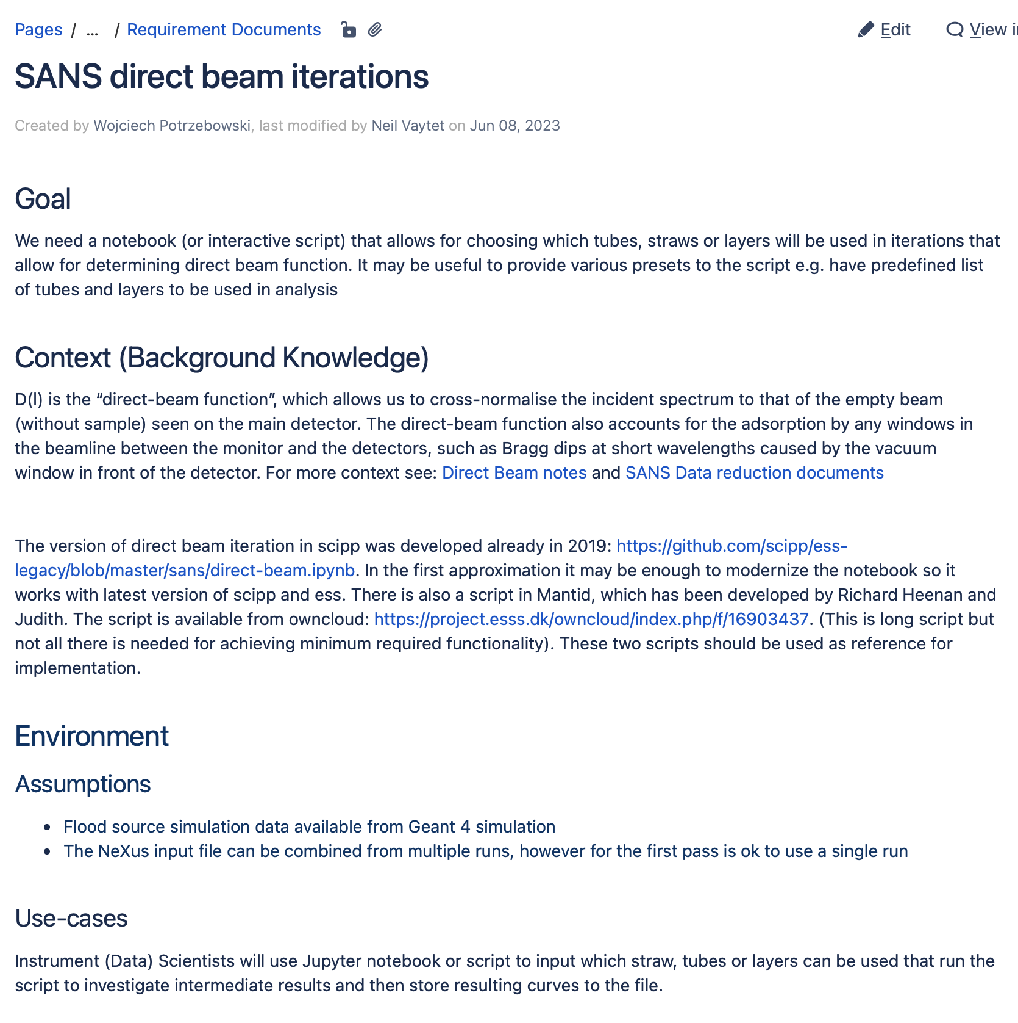

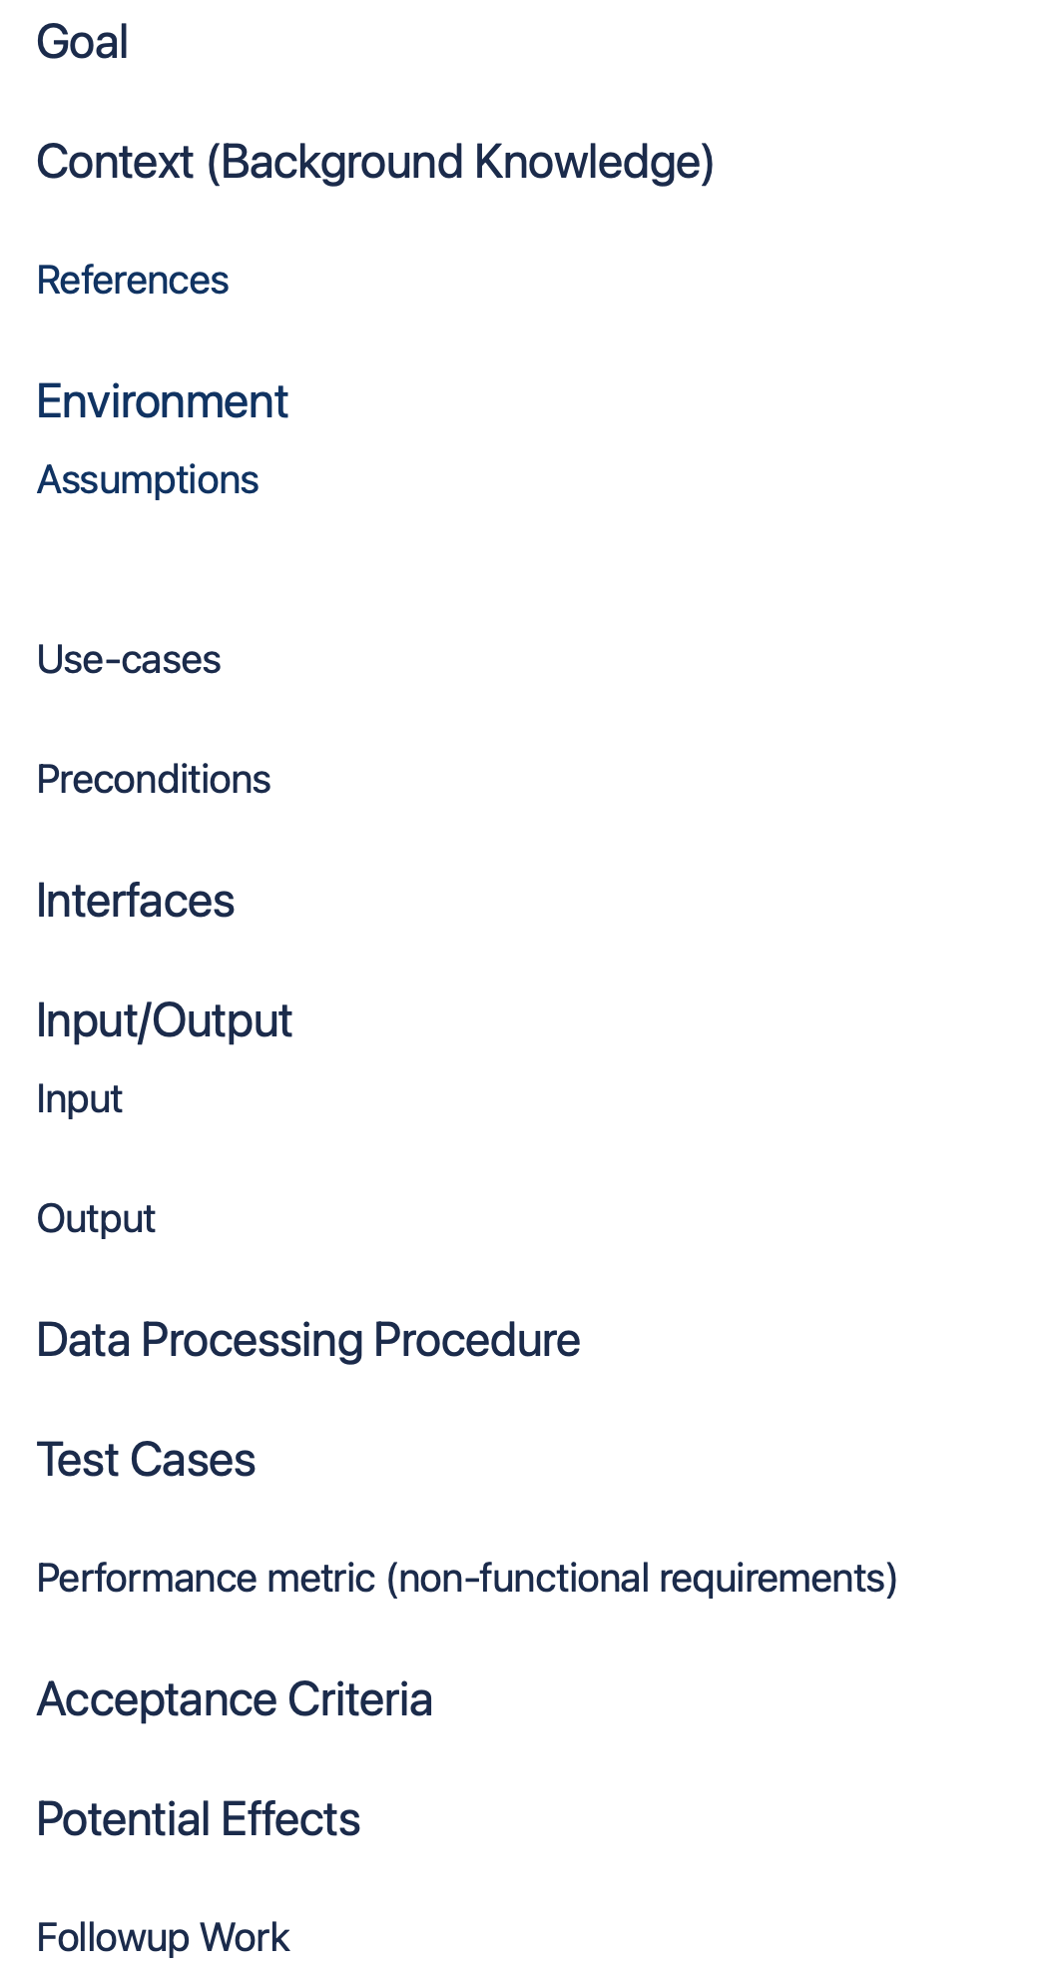
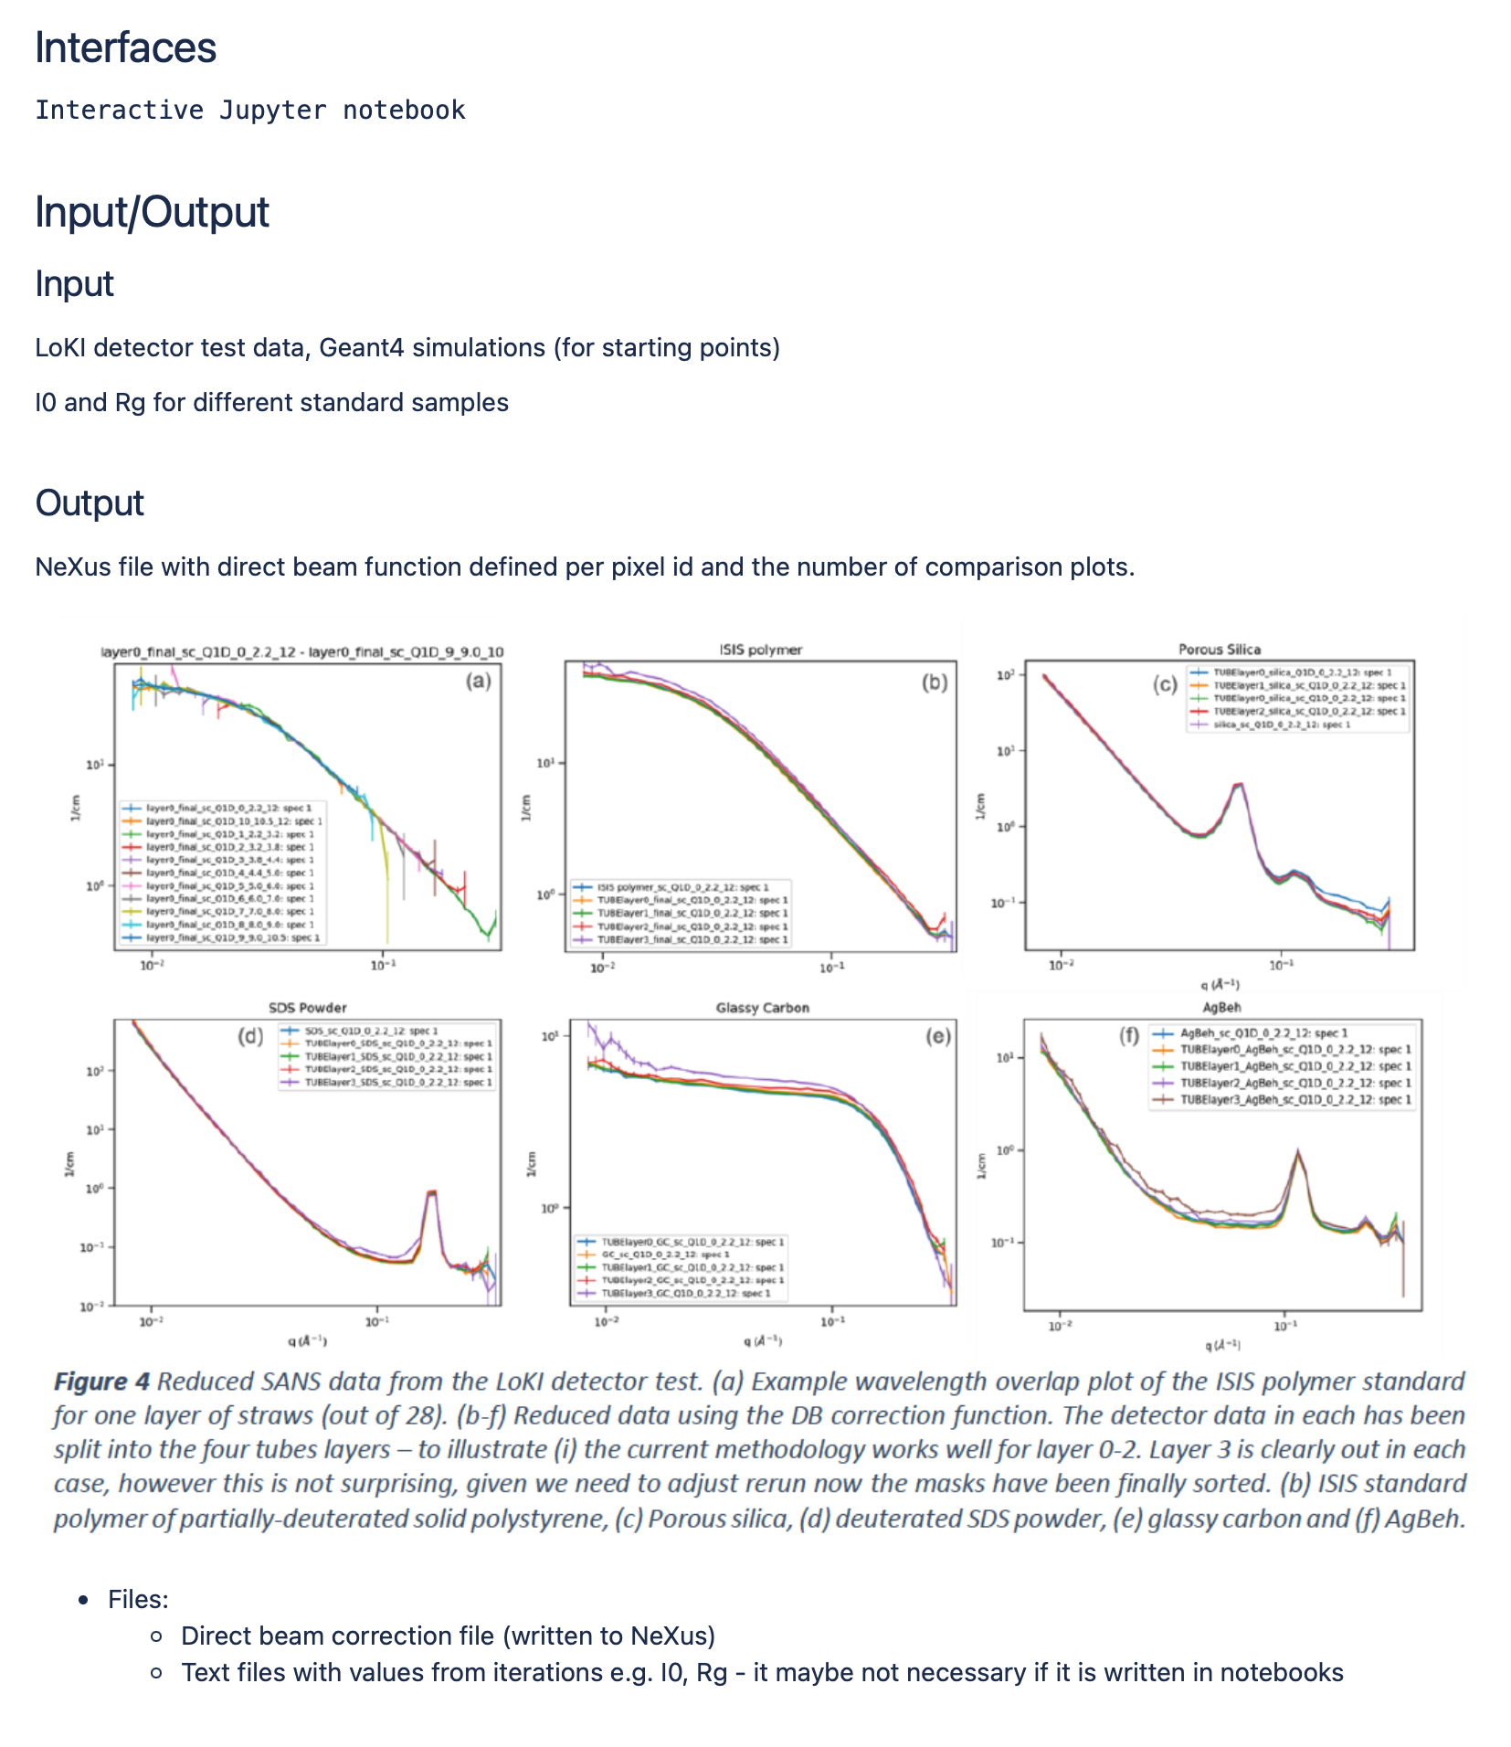
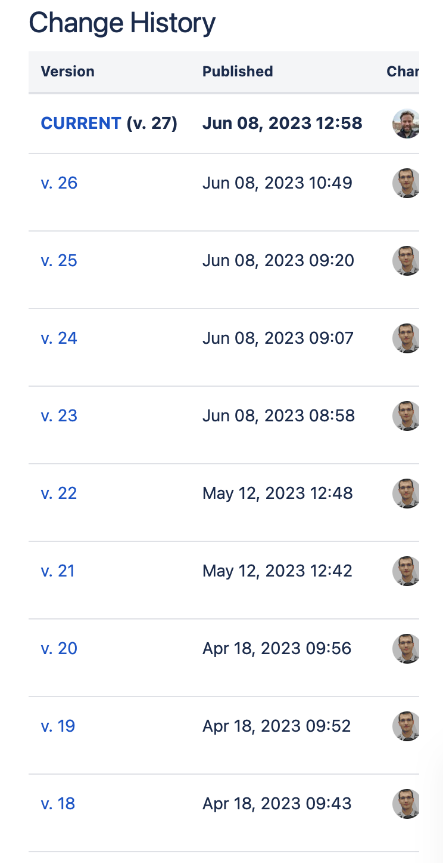
Scipp – Updates 2
IDS Requirements - Template on Confluence

Slide 10
Scipp – Updates 3
Breaking apart the ess package
The ess package has long served as a collection of all ESS-specific data reduction code. It contains submodules for instruments, techniques, and generic helpers. We have, however, struggled for a while with keeping it up to date with developments in Scipp and other libraries, as it proved challenging to update all techniques “in sync”, in particular in light of ongoing developments.
As an example, this approach prevents releasing new features and bugfixes for instrument A if instrument B is not yet ready for release. While this has a relatively low impact currently, we believe it would turn into a major problem when entering hot-commissioning.
A second issue is that dependencies for all techniques are tied together. For example, some techniques may depend on Mantid which is not available via pip. This slows down continuous-integration and releases as conda has to be used. Furthermore, Mantid requires a fixed Python version, and would thus prevent techniques that do not even depend on Mantid from using a more recent Python version.

Slide 11
Scipp – Updates 4
esssans
With the release of Sciline, we are now able to move existing workflows to use the new library. As SANS currently is the most developed and most actively used workflow, we have focused on this technique.
The old (pre-Sciline) workflow is available in the ess package, in the ess.sans module. We have been intending to break the ess package into smaller packages for more than a year (see below), and this has hereby been started: The rewrite of the ess.sans module can be found in the new esssans package. While the bulk of the rewrite is complete, it is not done yet, and still has to be rolled out to users.
esssans is spearheading the move to Sciline, serving multiple purposes:
Identify remaining problems and usability issues in Sciline.
Serve as a full and nontrivial example for how Sciline can be used to write other data-reduction workflows.
Enable developments that have deliberately been avoided in the old workflow due to growing complexity, e.g., combining data from multiple input files.

Slide 12
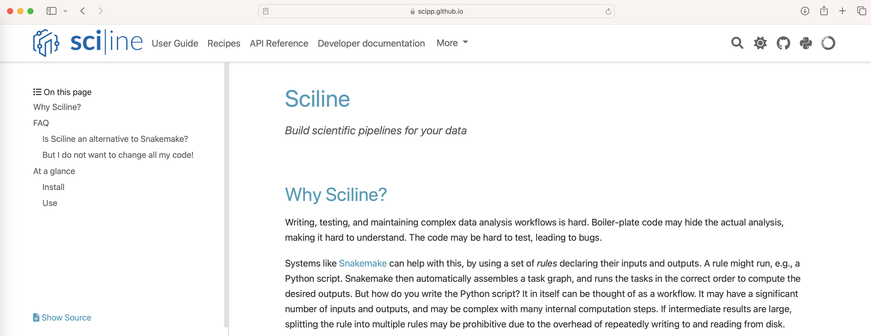
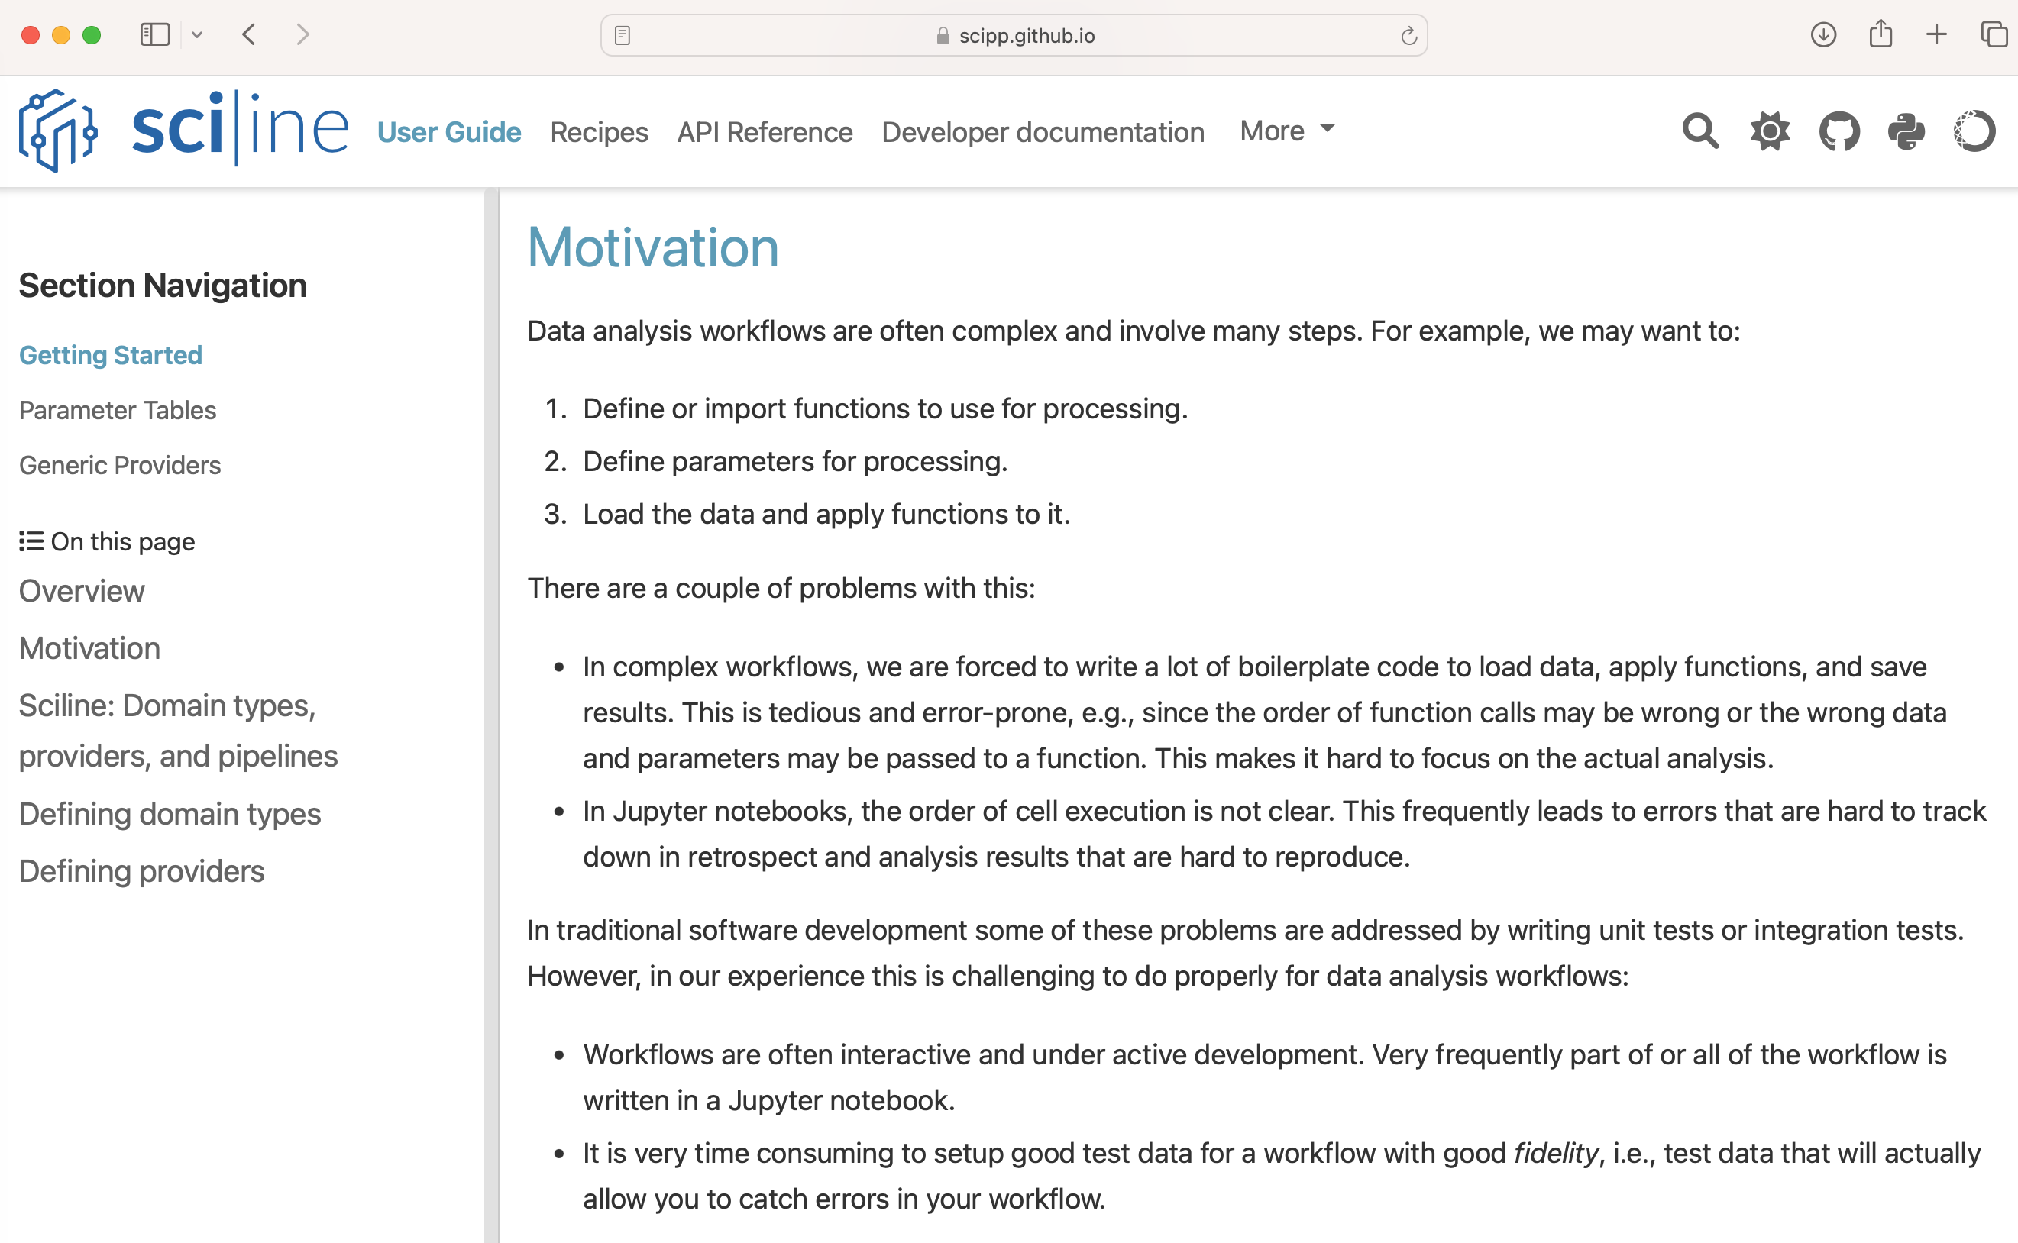
Scipp – Updates 5
Sciline
After many discussions over the past year, as well as a number of small prototypes, we have converged on a solution for writing data-reduction workflows. This has resulted in our new Python library Sciline, which will be used to build such pipelines.
Sciline builds tasks graphs which can be used to compute desired workflow results or intermediate results.
It is worth noting that Sciline is independent of Scipp, i.e., it can be used with other data such as NumPy arrays of Pandas DataFrames. This might make this solution more attractive to outside users.

Slide 13
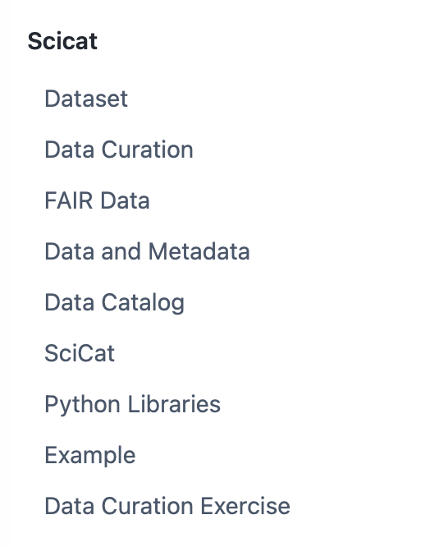
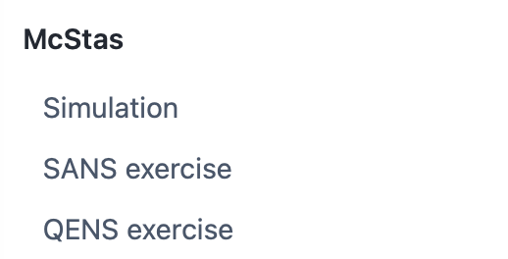
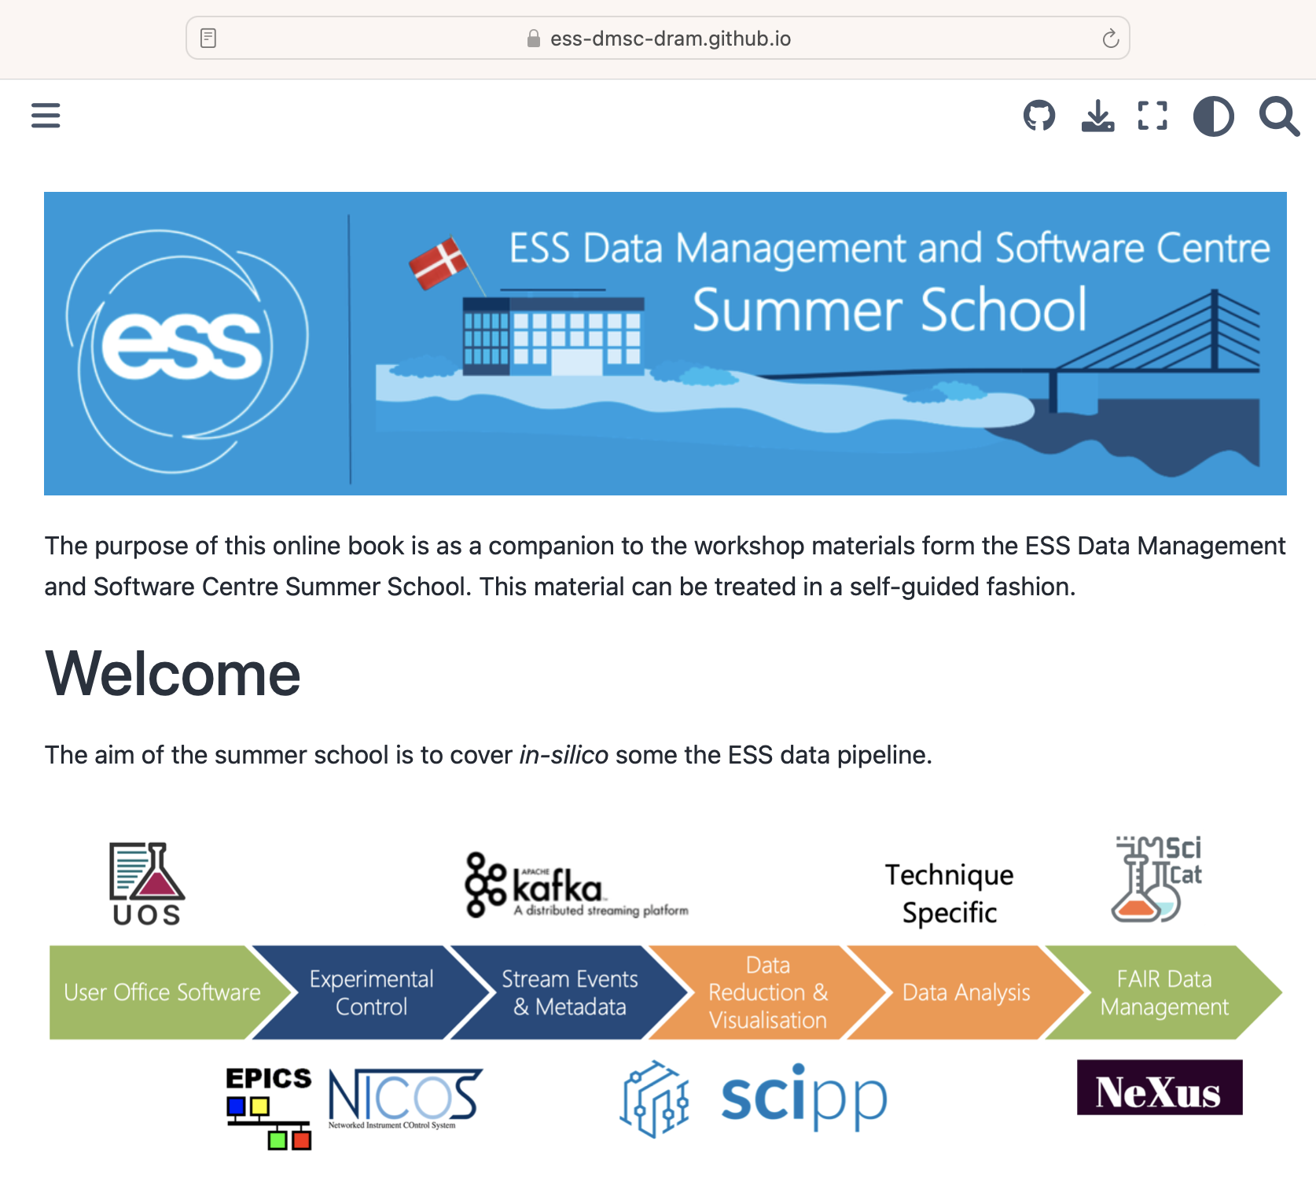
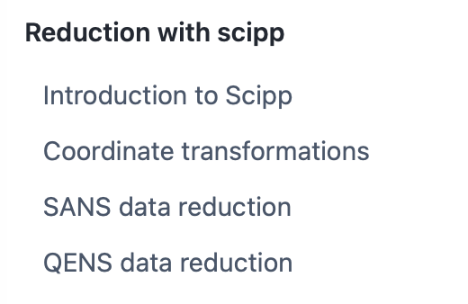
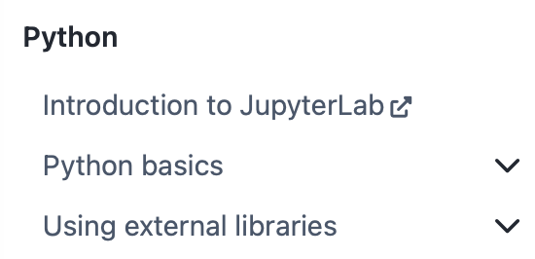
Scipp – Updates 6
DMSC Summer School 2023
The team has contributed a major session to the DMSC Summer School. As a highly valuable side effect, the work on the teaching material served as an integration test of almost the entire data pipeline. We will be looking into how we could turn this into a regular integration test, e.g., by running it as part of our continuous integration.
https://ess-dmsc-dram.github.io/dmsc-school/intro.html

Slide 14
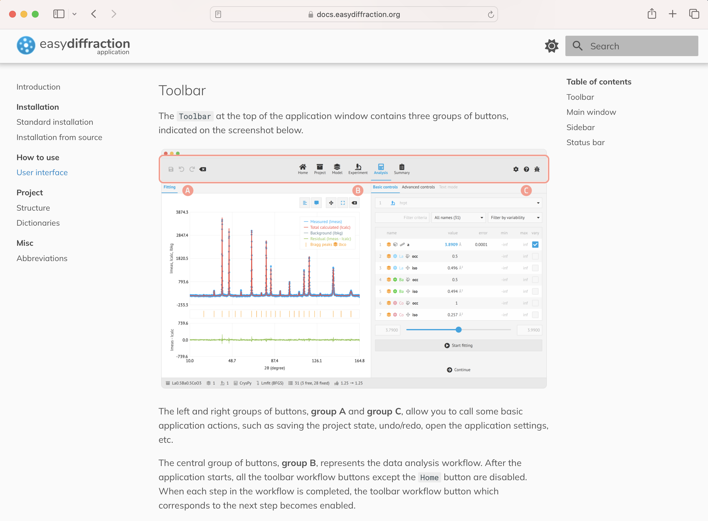
Data Analysis – Updates 1
Staff: farewell to two developers: Simon W & Andrew M. In the process of hiring two new developers.
EasyDiffraction: IUCr 2023 meeting and EDA demo at Software Fair (also at IUCr 2023)
EasyDiffractionApp (EDA)
  out to users
  get freedback
  Fix gui
    fixed slow start-up
    fixed slow gui
    fixed slow fitting
    fixed a few user reported issues
    New updated user documentation

Slide 15
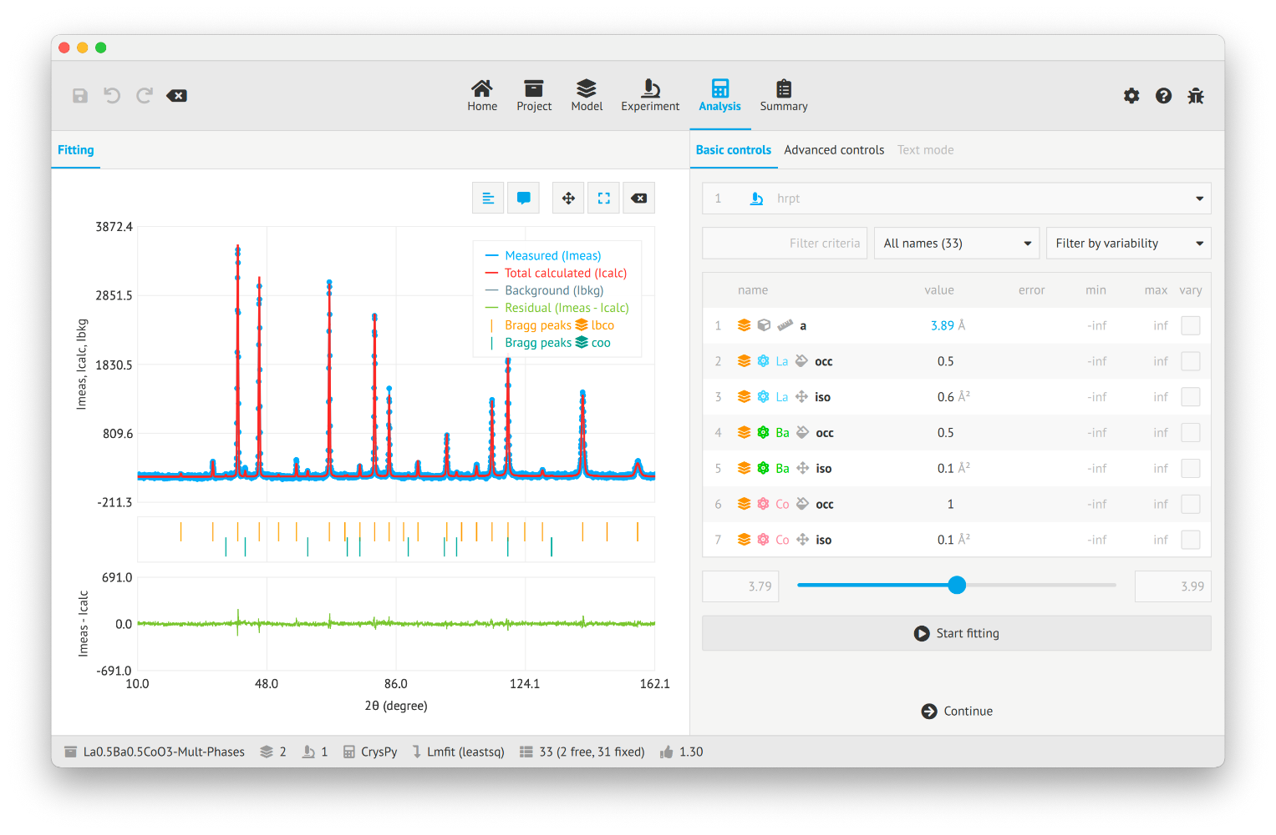
Data Analysis – Updates 2
EasyDiffractionApp
Main effort on redesigning the EasyScience based applications to provide performance comparable to most widely used software in the field
Minimization (fitting) performance has been made more robust and significantly improved (3-30 times)
Improved GUI design and significantly improved visualization performance of charts and structures
New crystal structure visualiser which will be extended to support magnetic structures
Currently on 8th alpha release (Oct 2023)

Slide 16
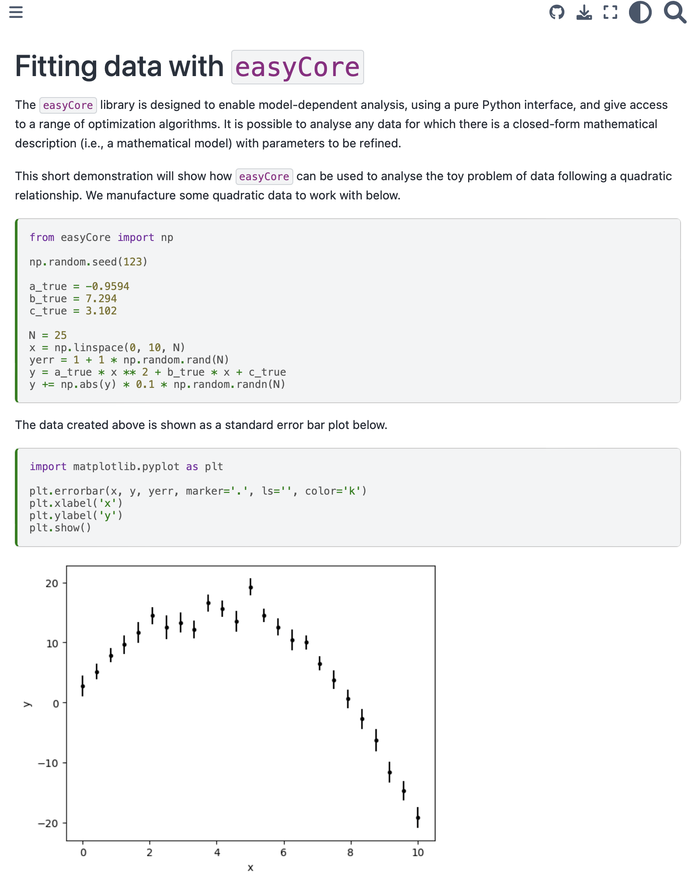
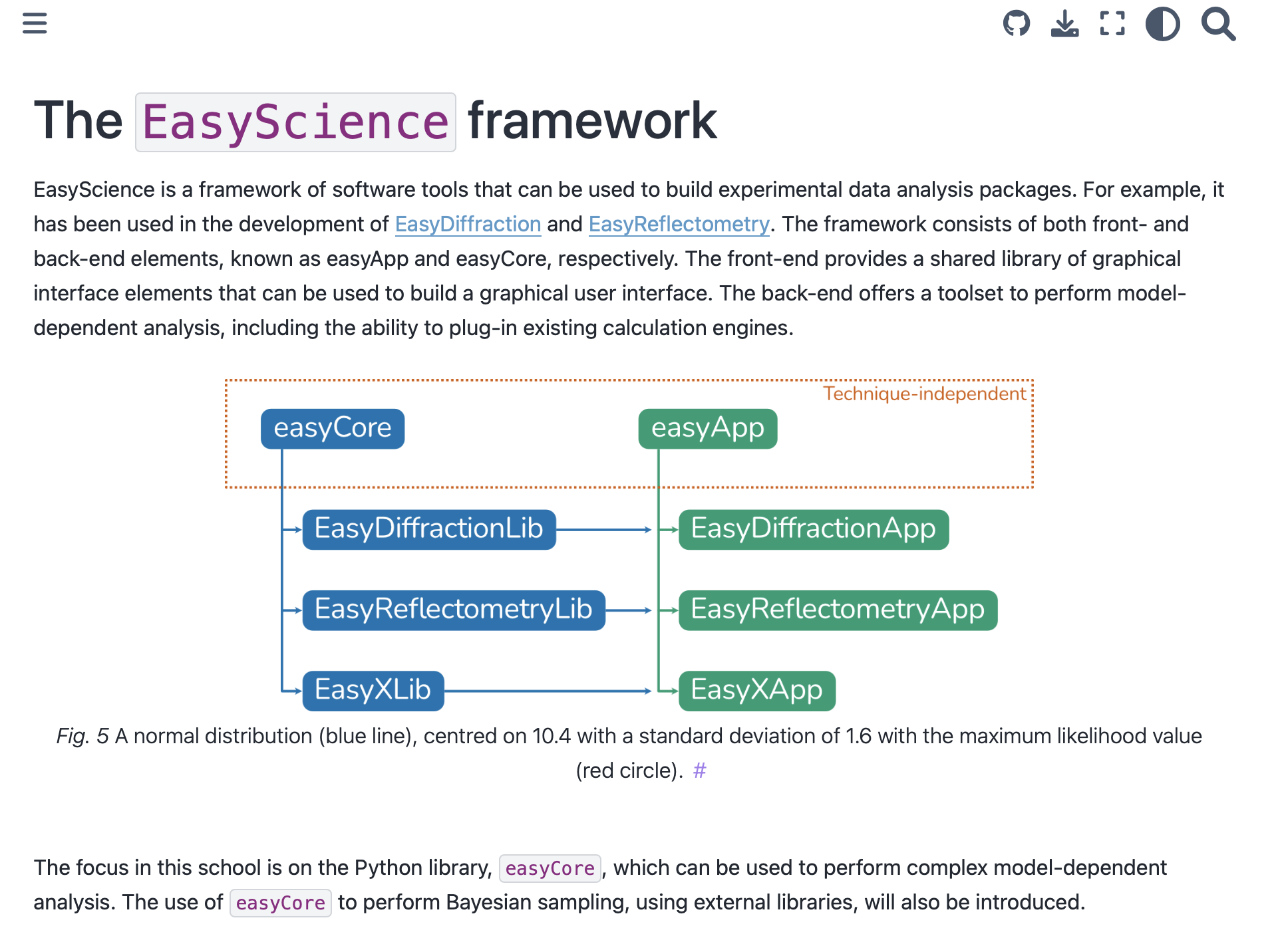
Data Analysis – Updates 3
DMSC Summer School 2023
The team has contributed a major session to the DMSC Summer School. Showing how easyCore can be used for fitting.
https://ess-dmsc-dram.github.io/dmsc-school/intro.html

Slide 17
Instrument modelling – Update 1
McStas etc. updates
McStas 3.3, March 31st, 2023 (Presented at ECNS in Garching)
  Built-in NeXus support on all platforms
  mcgui run dialogue now allows to directly specify --format=NeXus and --format=NeXus –IDF
McStas 3.4, September 19th, 2023
  End of McStas 2.x releases
  End of support for Perl tools
  Build process for both macOS and Windows overhauled, embedded conda environment.
  MPI support is now included with the installation on Windows
Collaboration with SOLEIL for McXtrace school May 2023, Talk and demo at HighNESS scattering kernel school May 2023, DMSC Summer School September 2023
  https://e-learning.pan-training.eu/course/view.php?id=135 school entry point (Federated login)
  https://panlearningjhub.esss.dk/dmscsummerschool2023 “Fat” docker with McStas-McStasScript-NeXus-SCIPP developed and deployed

Slide 18
Instrument modelling – Update 2
McStas etc. updates
McStasScript continues, the package can now load McStas generated NeXus data.
McStas now ships with McStasScript and a JupyterLab
The McStas package now also includes a translation tool that can write a McStasScript python file from a classic instrument file
The current development efforts on McStasScript concerns creating a widget interface to explore event data generated by McStas.
This widget uses scipp and plopp to group the data as individual rays using the neutron id and to build interactive widgets that display the data.
It will for example be possible to highlight a peak on the detector and see the history of the neutron rays that make up the peak.

Slide 19
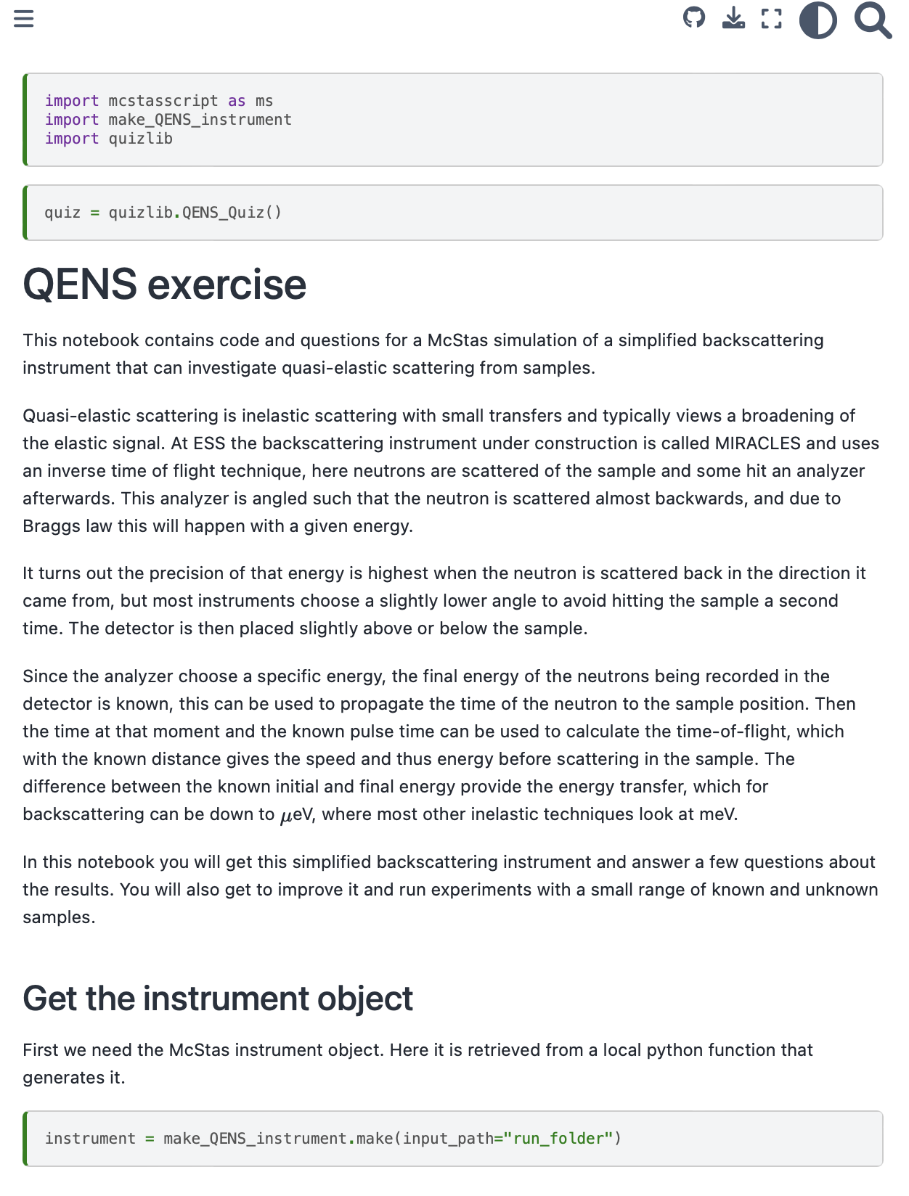
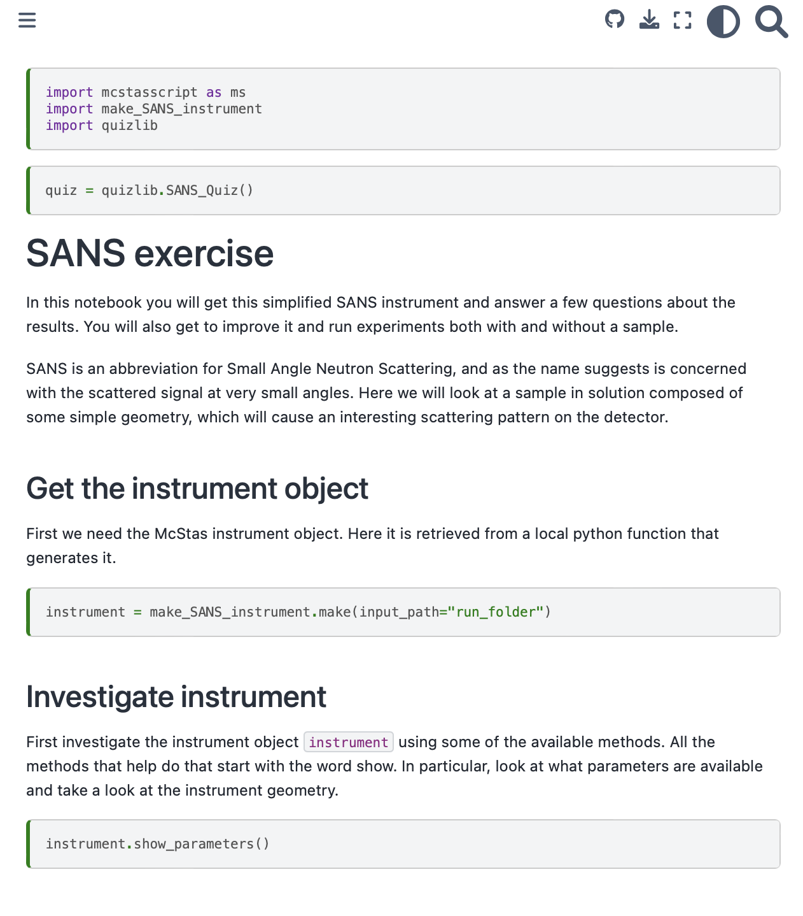
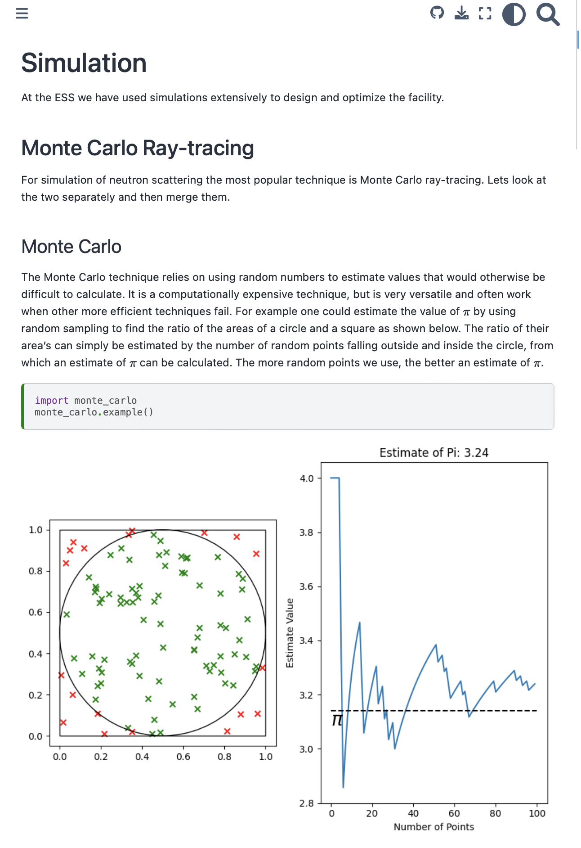
Instrument modelling – Update 3
DMSC Summer School 2023
The team has contributed a major session to the DMSC Summer School. Showing how McStasScript can be used for instrument simulations.
https://ess-dmsc-dram.github.io/dmsc-school/intro.html
https://e-learning.pan-training.eu/course/view.php?id=135
Docker with McStas-McStasScript-NeXus-SCIPP developed and deployed

Slide 20
Instrument modelling – Update 4
The conclusion of the 3 year EU project HighNESS
Simulated their performance (three conceptual instruments) on the different proposed moderators put forth in HighNESS
The concepts were two SANS instruments, one conventional and one with focusing optics, and a simple imaging instrument.
In the HighNESS project it was found that using a solid deuterium moderator rather than liquid deuterium could provide unprecedented intensity at wavelengths above 40 Å.
The results were described in a thorough deliverable report and in the main HighNESS deliverable, the conceptual design report (CDR) https://arxiv.org/pdf/2309.17333.pdf

Slide 21
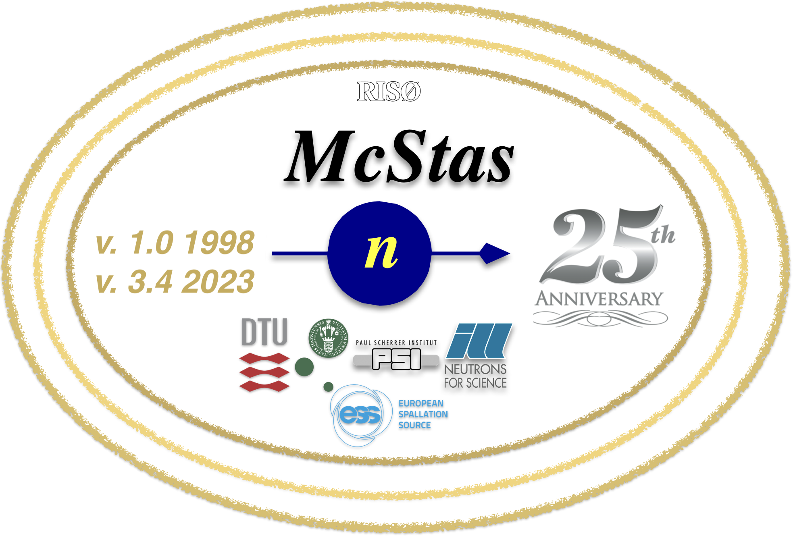


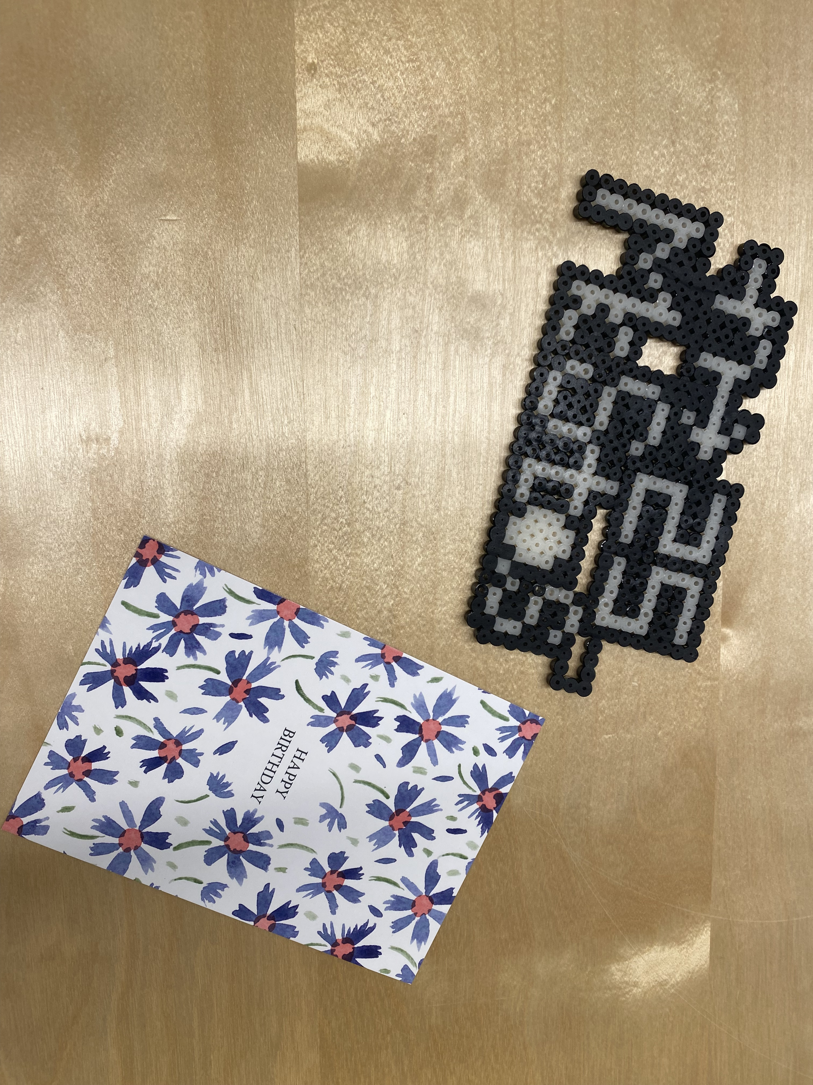
McStas timeline at a glance
When did what functionality arrive
v1.9-1.11 2005-2007
PowderN & Isotropic_Sqw,
mcstas.org domain Polarisation, macOS,
Debian pkg, MPI support
v2.0-v2.1 2012-2014 /Initial Mantid support, comp std., first
Python tools
v2.5-2.7 2018-2020
NCrystal
GPU efforts
Lots of new instruments
v3.2, 2022
Official GPU support
arrives
v2.7.2 is last 2.x release
v1.1-1.6x, 1999-2002
mcrun, mcplot, mcgui,
Single_crystal, Source_gen,
v1.0, October 15, 1998
v1.7-1.8, 2003-2004
Windows supp.
GPL license,
new tools
v1.12.x “era” 2008-2011
McXtrace project start,
ESS-oriented simulation
work, workshop efforts
take off
v1.12c is last 1.x release
v2.3-2.4.x 2015-2017
ESS_butterfly,
MCPL
Union subsystem, Python tools fully default
v3.0-3.1, 2020-2021
Official GPU support
arrives
v3.3-3.4, 2023
Embedded NeXus,
mcstas-pygen, McStasscript embedded
Steady in-flow of “smaller” developments, bugfixes, user contributions…

Slide 22
Addressing STAP comments & suggestions
From STAP report – and reply from DRAM
1) Workflows
  Regarding workflows, many of the IDS are having challenges in working with scientists on the instrument teams to get the calibration and reduction/analysis steps defined.
  A good starting point would be to look at the existing workflows in Mantid as an outline to at least help start a discussion.
  A good suggestion we will keep in mind. Aligns with our new approach for handling IDS’s requirements.
2) Repository
  Having a separate repository for workflows make sense.
  ESS-Spectroscopy, ESS-Diffraction, ESS-Imaging/Engineering, ESS-SANS, ESS- Reflectometry, ESS-General?
  We have arrived at the same conclusion. This has already been implemented a few months ago.
3) GitHub repository tools
  Having the GitHub repository provides the ESS with a unique opportunity that other facilities did not have in the build up to operations.
  The time and process of developing specific workflow tasks can be monitored and then the process refined in response to expedite future developments.
  A good suggestion we will keep in mind. It was mentioned durring the April STAP meeting; and point was noted.
4) Mcstas – Geant4 coupling
  The current workflow of merging McStas and Geant for Dream is not sustainable beyond instrument design
  This was never the design goal. The goal is to mimic all of Geant4 features in a one-stop McStas-shop for the untrained McStas user.

Slide 23
Addressing STAP comments & suggestions
From STAP report – and reply from DRAM
5) Ownership
  Something that needs to be decided is who owns the simulations
  Will they be maintained long term by the instrument teams, the IDSs, centrally by the DRAM group, or by some other means
  Already on our radar. We have more or less consensus in the team. Need to check with stakeholders.

Slide 24
Finish presentation
Questions ?

Slide 26
Scipp – Updates 7
Beamlime
We have developed a working prototype of the backend of live-reduction dashboards. Before moving on to a full dashboard implementation, we have begun thorough benchmarking of the architecture. This will ensure that the design can scale to the expected pixel counts and event rates for ESS instruments. This has, e.g., highlighted a performance bottleneck due to Scipp grouping operations, which is used for grouping events by their IDs into pixels.
We have been able to mostly resolve the problem by implementing an improved algorithm in Scipp, leading to, e.g., a 3x speedup for instruments with more than 1 million pixels. The improvement will also benefit other operations, in particular loading NeXus files, and binning operations into many bins.
Benchmarking will continue until we have reasonable confidence that we can cover the parameter space defined by the ESS instrument suite and their operating modes, before moving on to a full implementation.

Slide 27
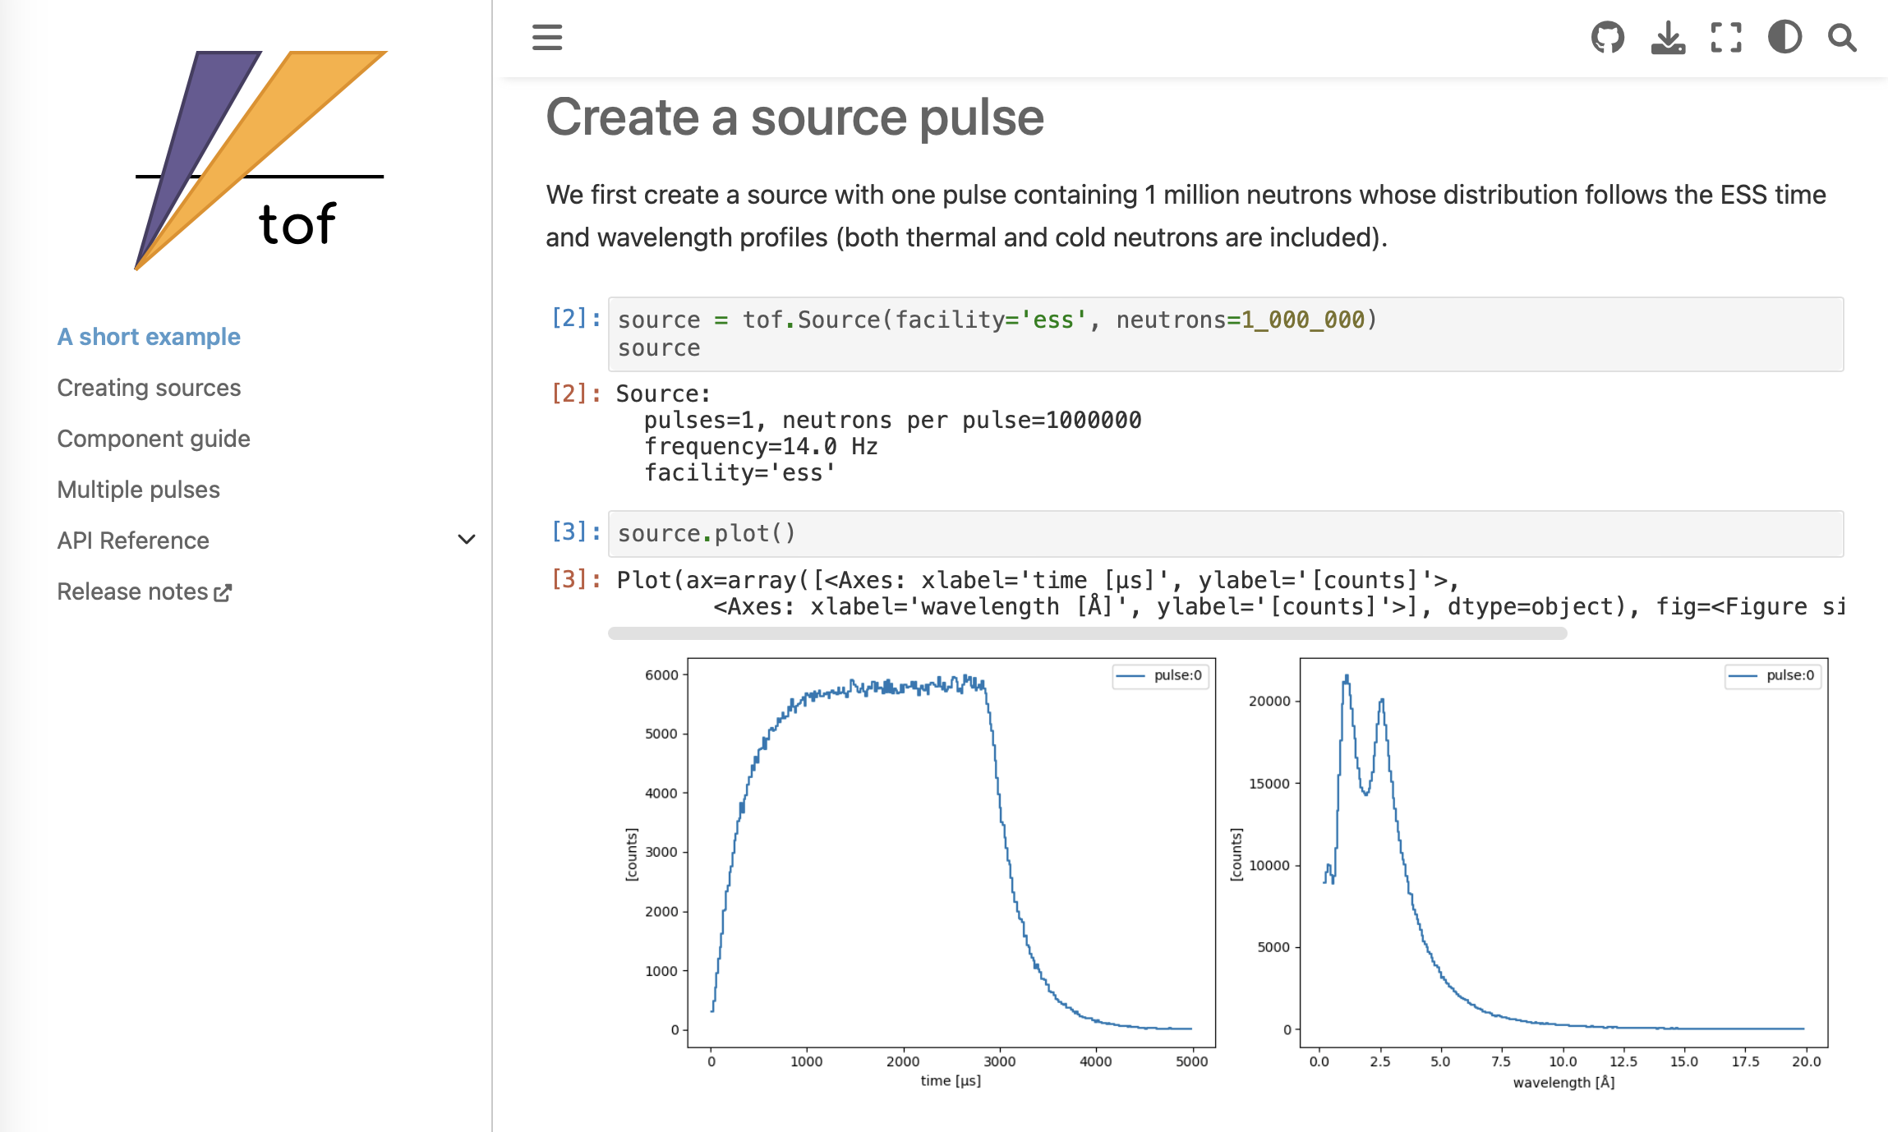
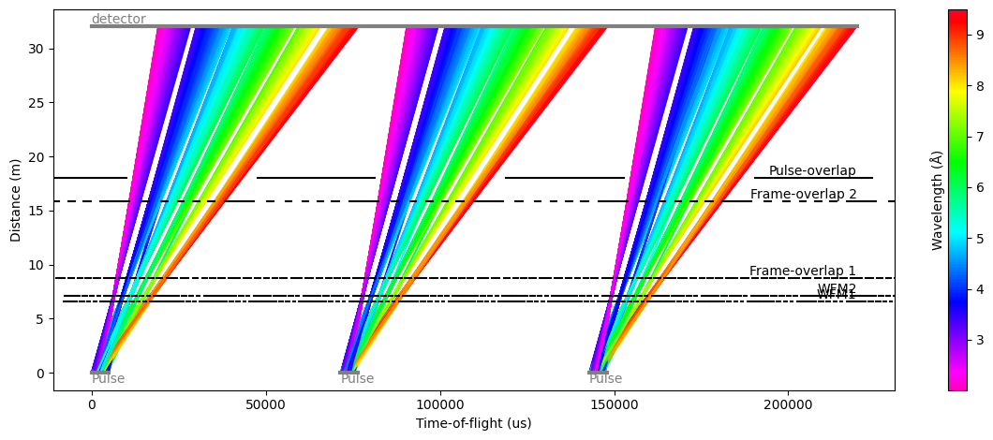
Scipp – Updates 8
TOF
After being asked by scientists from the NSS division to update a small script that was used to compute time-distance diagrams for the V20 WFM chopper cascade, we developed a new package to create such diagrams for any chopper setup. We named this package tof, and the documentation is available at https://tof.readthedocs.io.
It uses random sampling on the characteristics of the ESS pulse to generate neutrons that are then individually propagated through the chopper system up to the detector. The user can then inspect the neutrons that would be received by the detector, as well as visualizing which neutrons get blocked by the choppers.

