Slide 2
DMSC STAP April 2022
DRAM Update
Torben Nielsen

Slide 3
Agenda
1 DRAM group
2 PaNOSC & HighnESS
3 Data Analysis
4 Modelling
5 Data Reduction
6 General Update

Slide 4
DRAM
The DRAM group (old organization 2021)
Data Reduction, Analysis and Modelling group
Is responsible for providing data reduction, analysis and modelling software for all instruments at ESS.
4 sub sections (+15 persons)
Data Reduction (Mantid, scipp++)
Data Analysis (SasView, SpinW, EasyScience, external collaborations )
Modelling (McStas++, integration, pan-learning.org)
IDS (Instrument teams)

Slide 5
Data Reduction
scipp – the team
Simon Heybrock
Niel Vaytet
Jan-Lukas Wynen
Scope: providing data reduction software for ESS
Nearest DMSC collaborators: IDS, ECDC, SWAP, Modelling, DST

Slide 6
Data Analysis
SWAT – the team (SoftWare Analysis Toolkit)
Piotr Rozyczko
Simon Ward
Andrew Sazonov
Scope: providing data analysis software for ESS
Nearest DMSC collaborators: IDS, DR, SWAP, Modelling, DST

Slide 7
Modelling, integration, and e-learning
DONKI – the team
Peter Willendrup
Torben Nielsen
Mads Bertelsen (PaNOSC & HighnESS)
Stella d’Ambrumenil (PaNOSC)
Scope: providing modelling and simulations and e-learning for ESS
Nearest DMSC collaborators: IDS, ECDC, SWAP, DR, DA, DST

Slide 8
Agenda
1 DRAM group
2 PaNOSC & HighnESS
3 Data Analysis
4 Modelling
5 Data Reduction
6 General Update

Slide 9
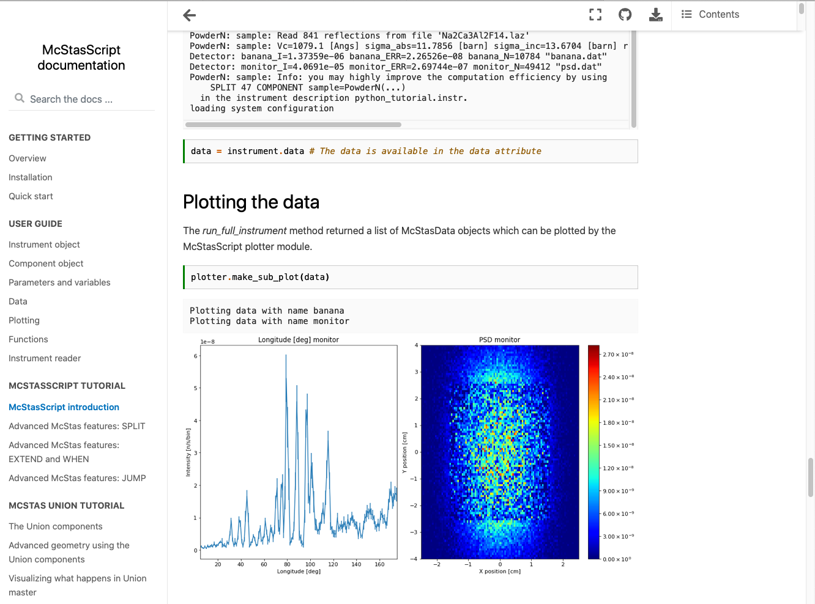
PaNOSC WP5
mcstasscript - documentation now on github pages
WP5:
Harmonized simulation platform for simulations of both neutron and X-ray instrumentation
Objectives:
Python API for McStas
Data base for instrument simulations
Outcome:
Easier on-boarding
Tutorials based on previous IKON Python courses
Allow for writing advanced McStas instr

Slide 10
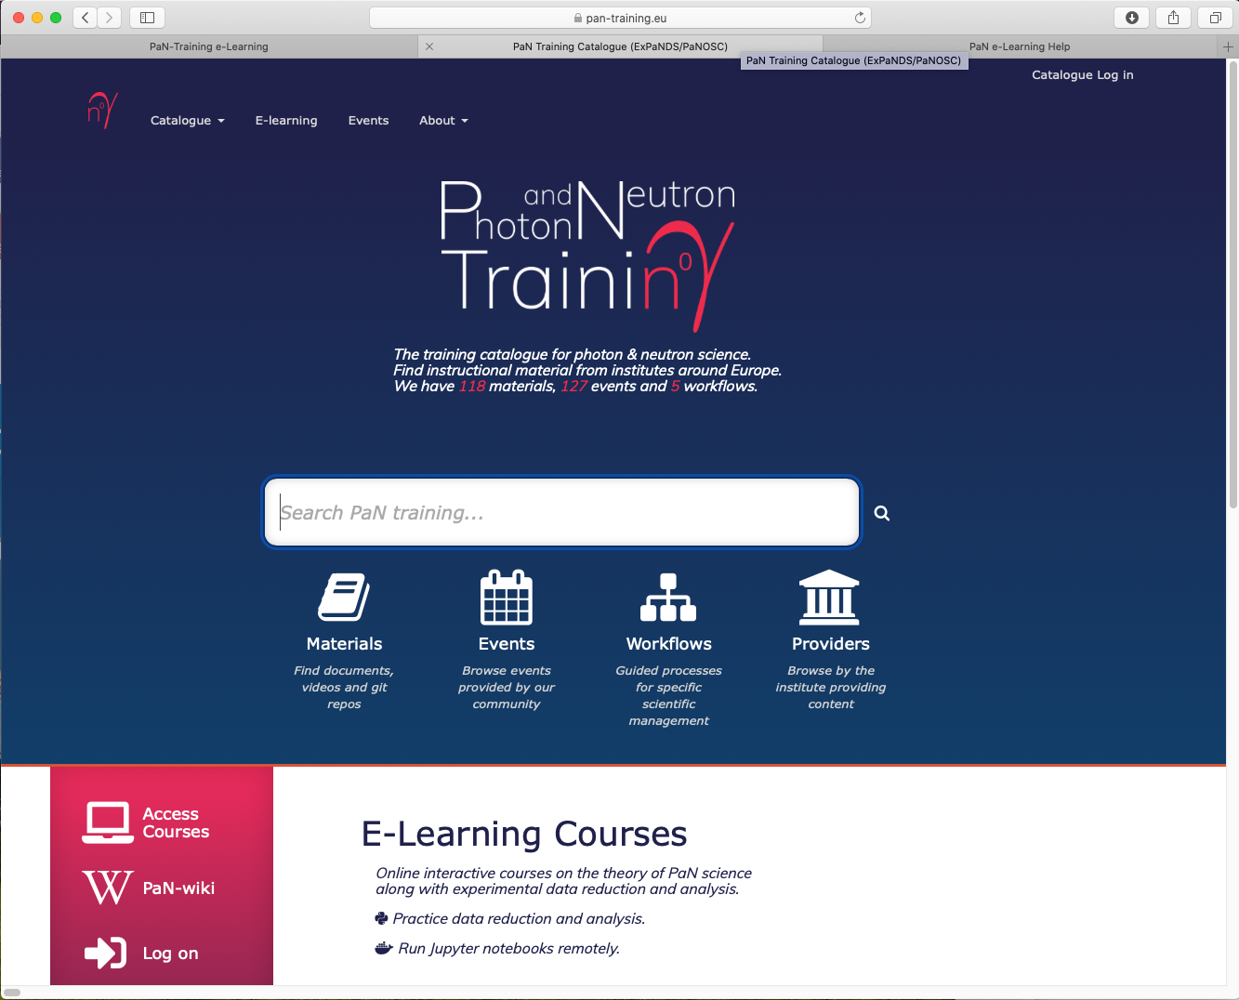
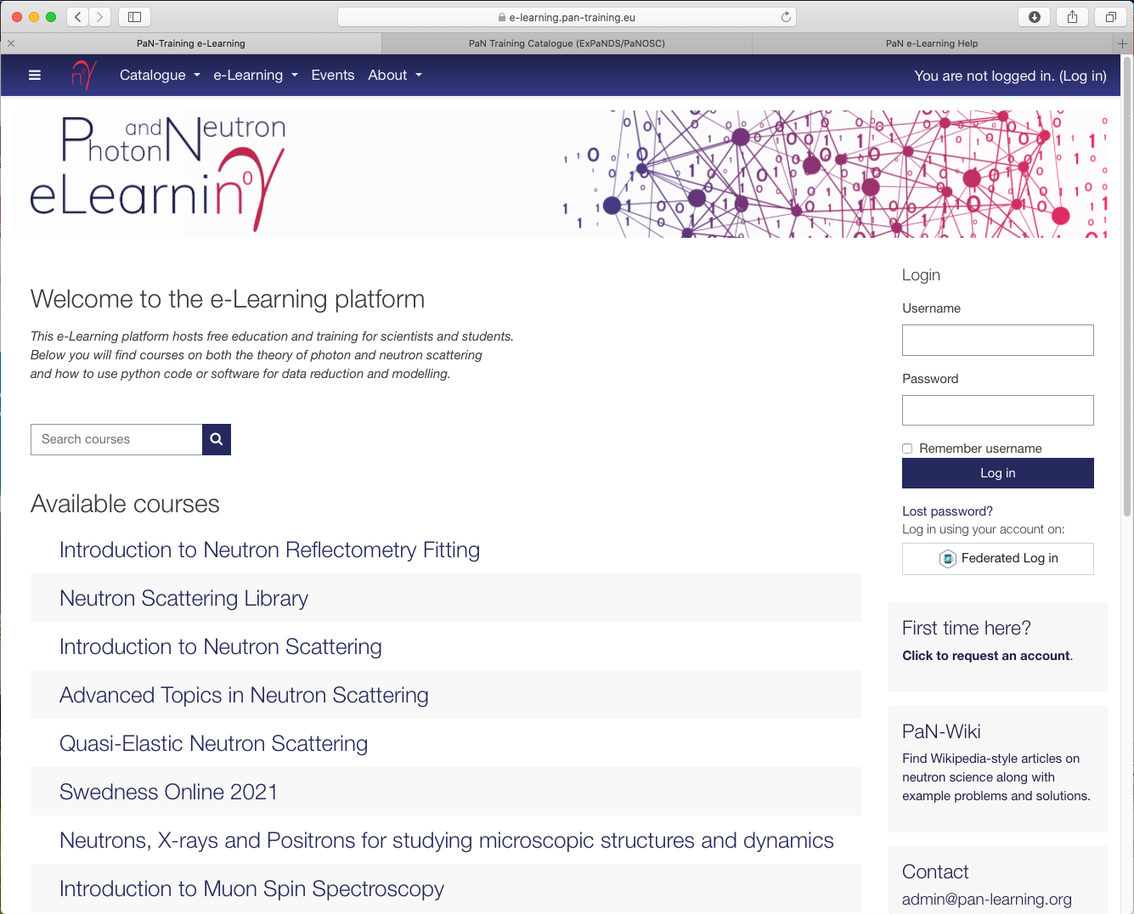
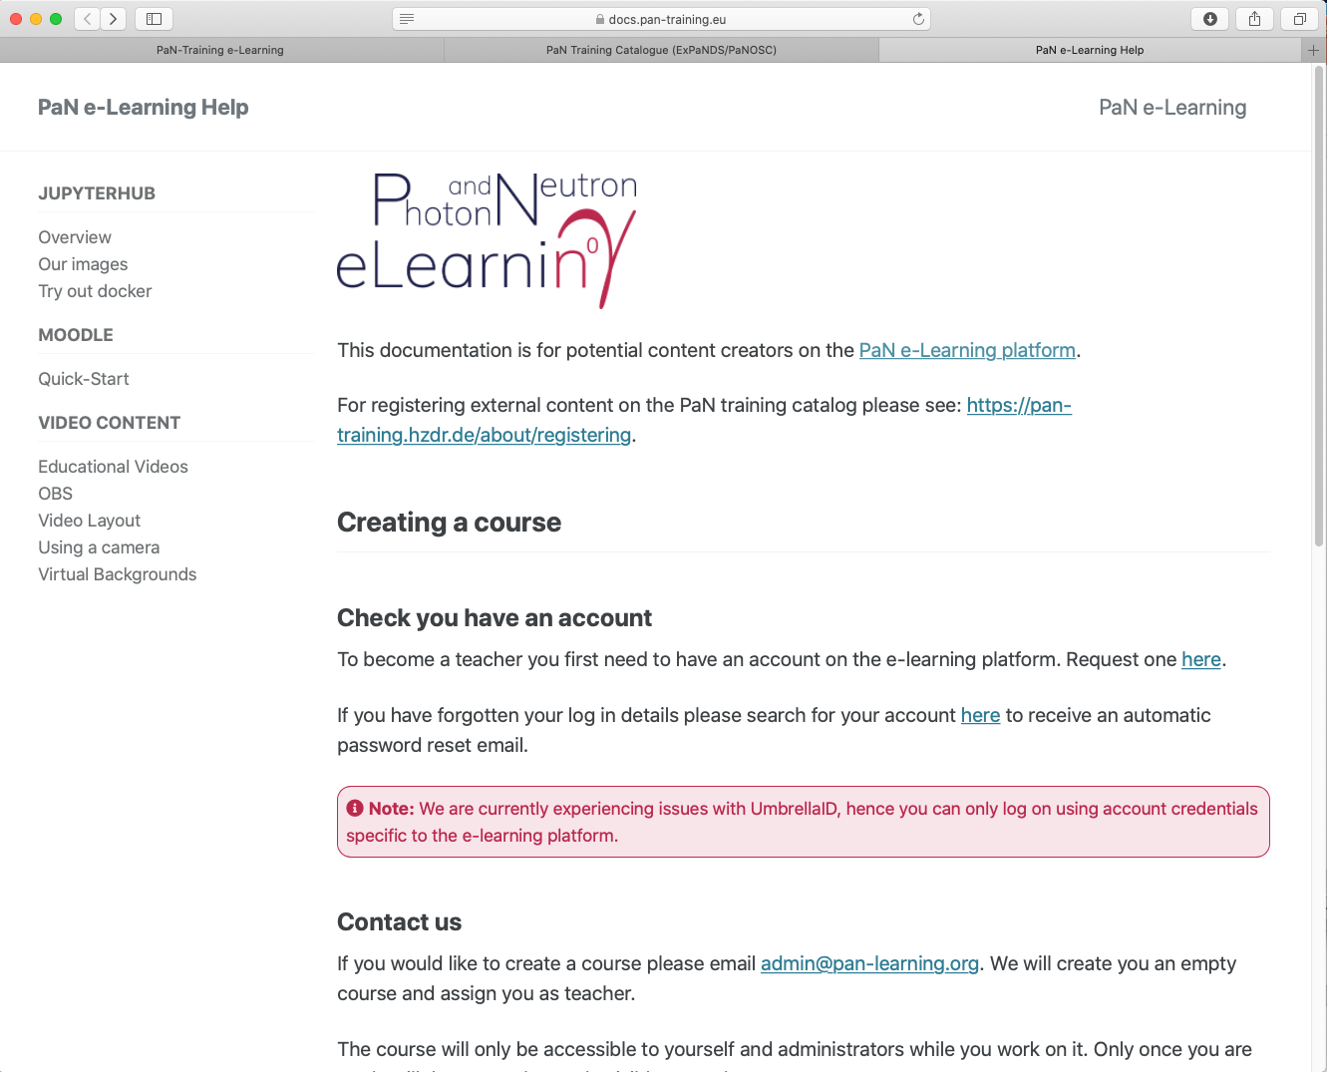
PaNOSC WP8
WP8: e-learning portal
pan-learning.org
Front-stage: New design of pages and merge into https://pan-training.eu
Updated documentation for adding content: Tip & Trick for teachers on Jupyter, Moodle Quiz, Videos
Back-stage: consolidating the docker setup use in training sessions

Slide 11
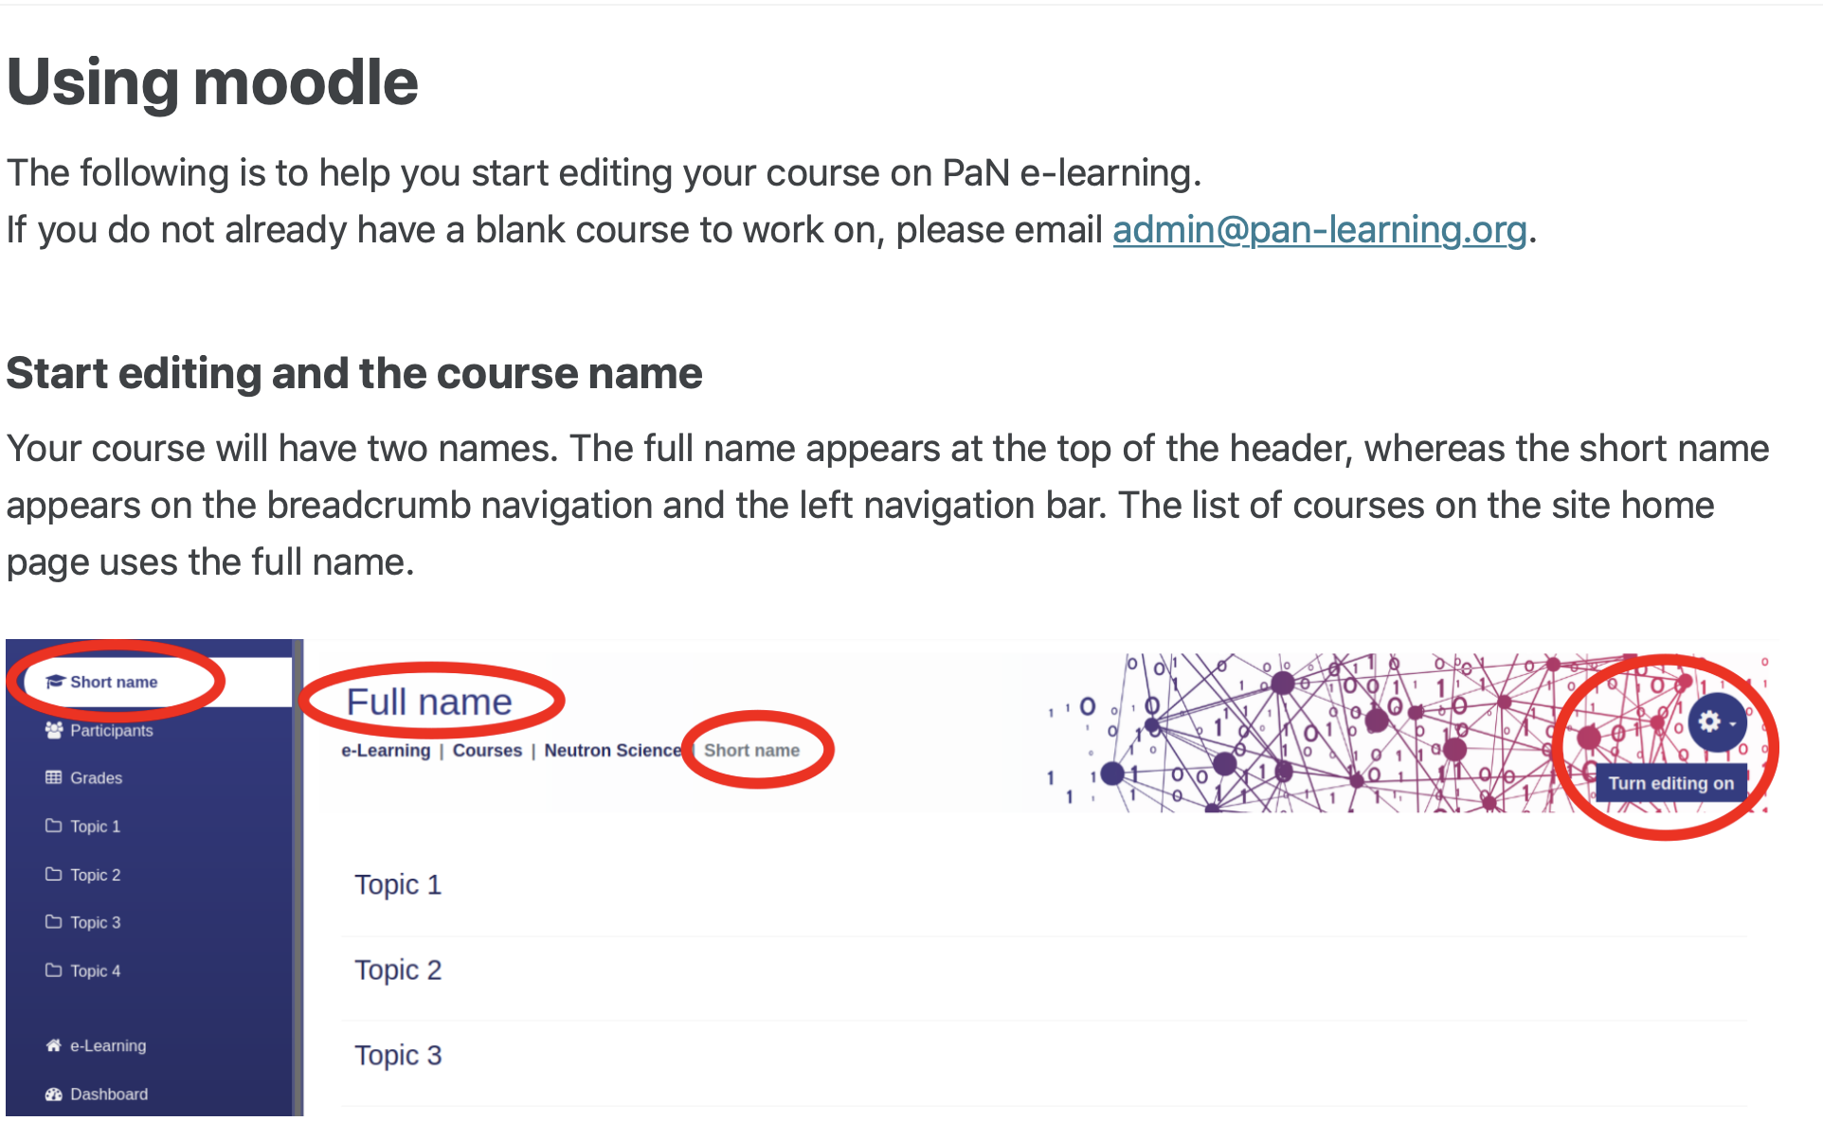
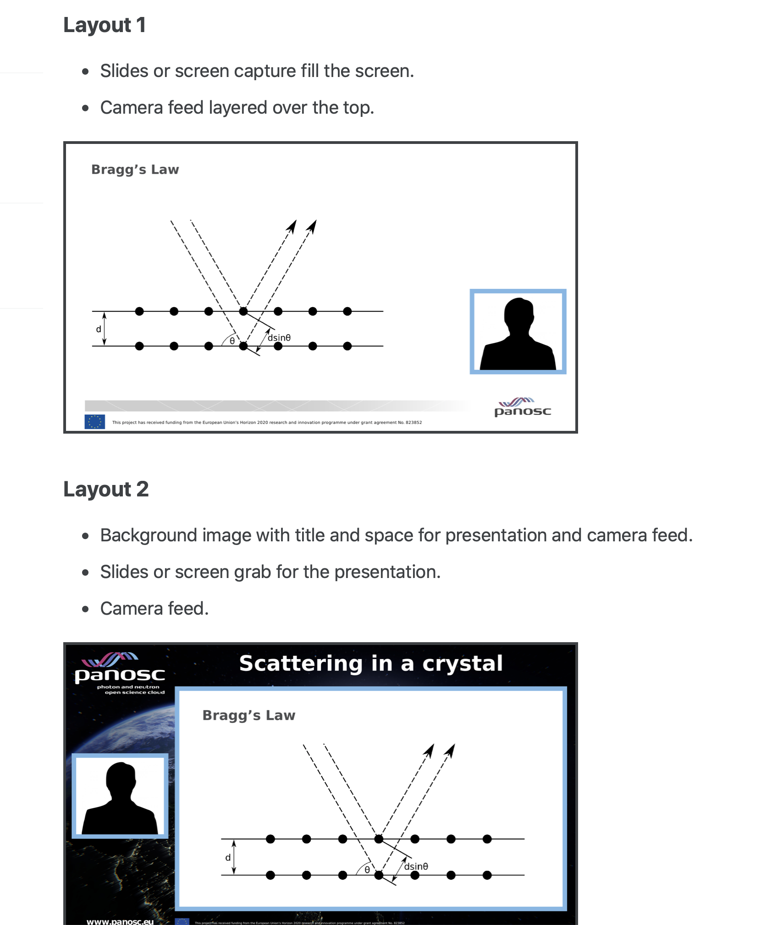
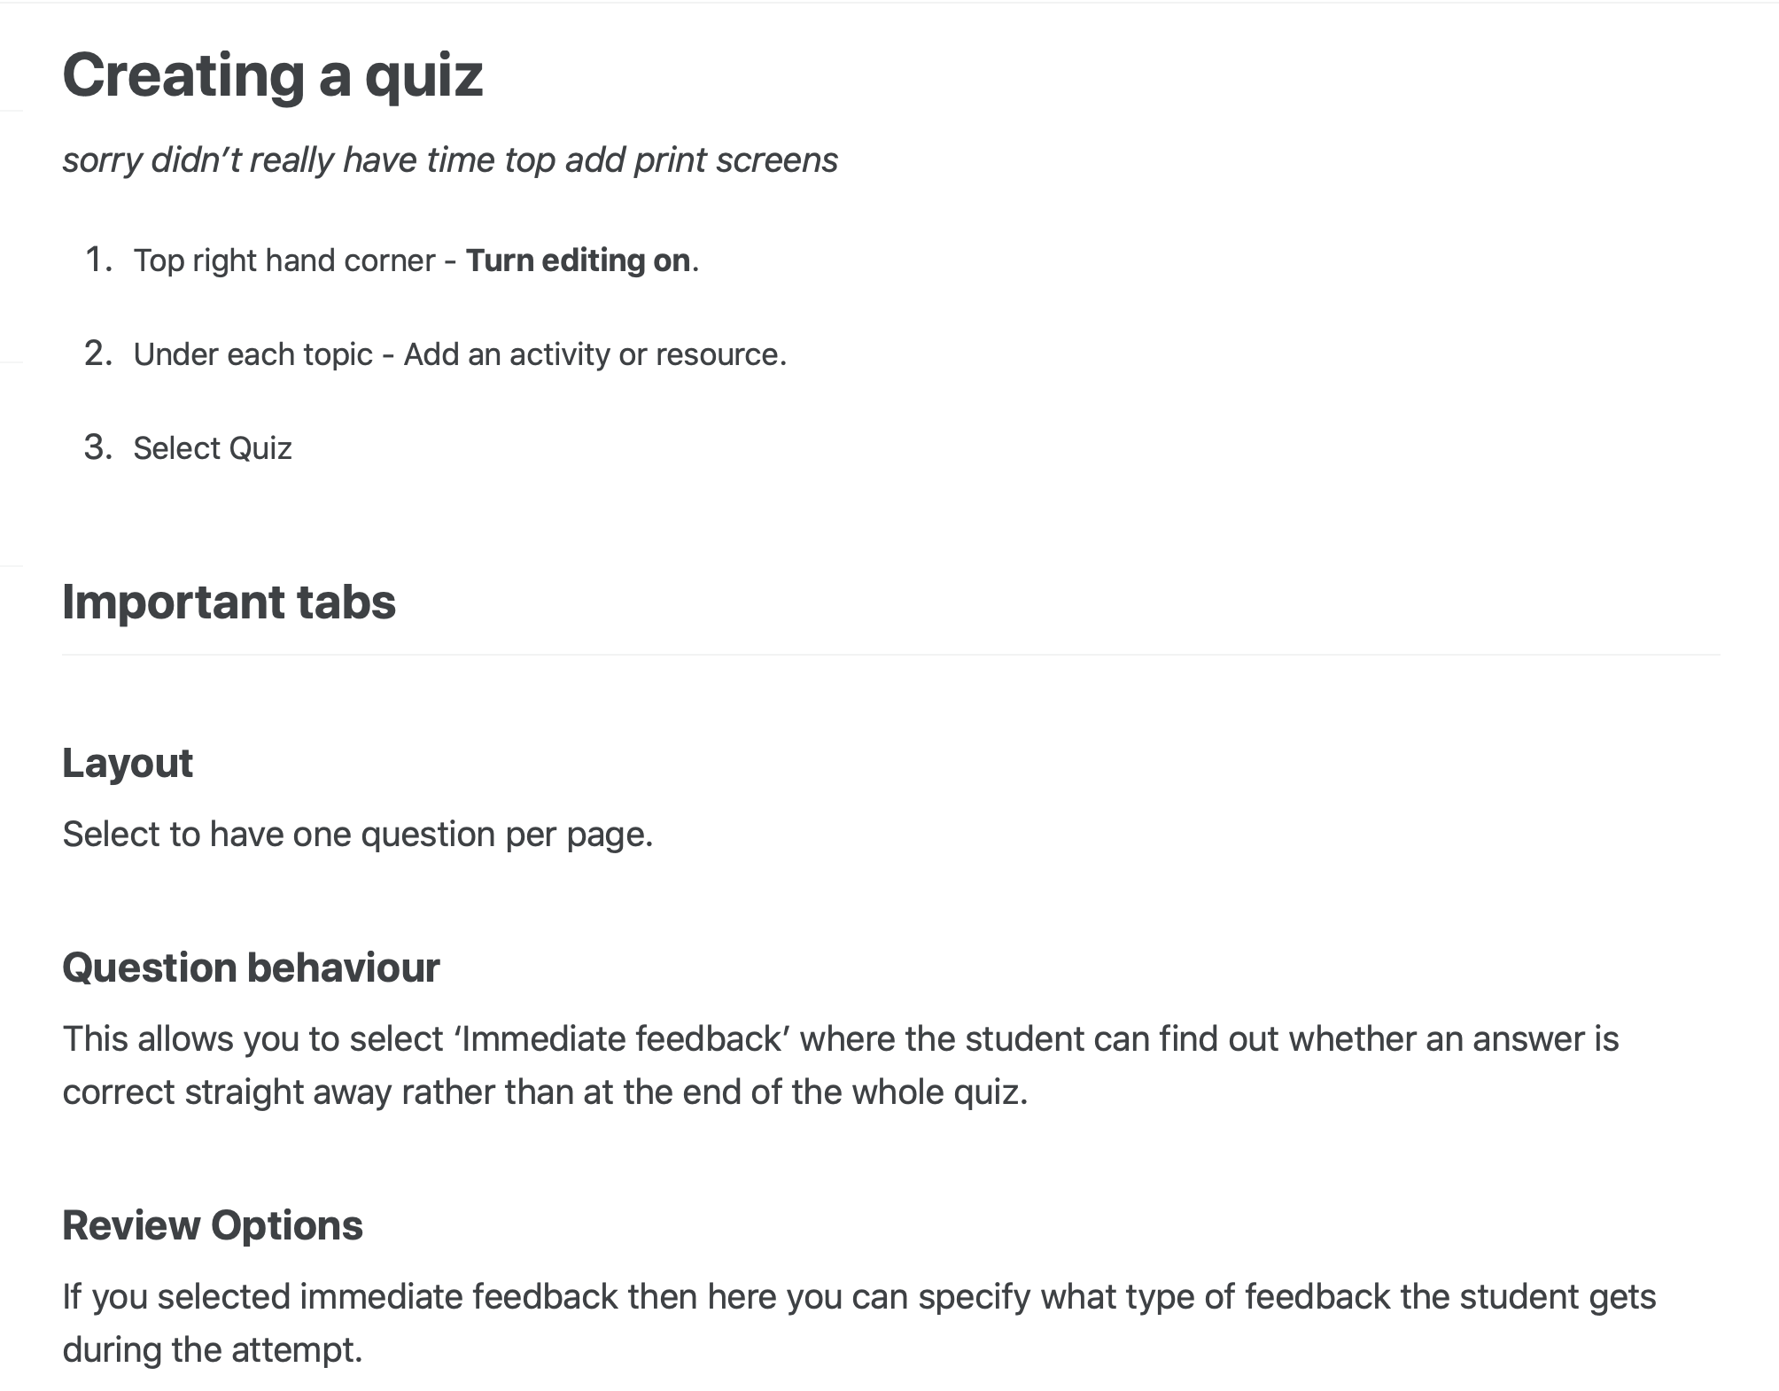
PaNOSC WP8: Hands-on tips & tricks
Tips & Tricks for Video Recording
Tips & Tricks for Moodle

Slide 12
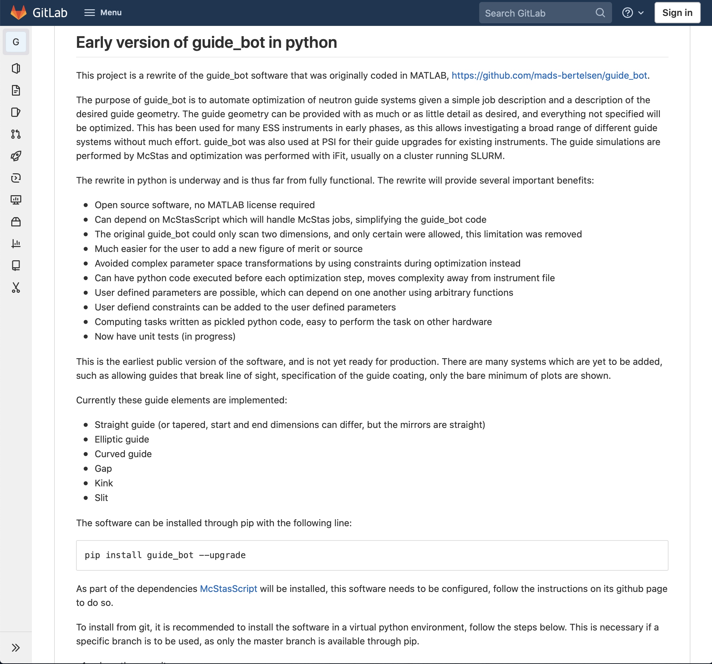
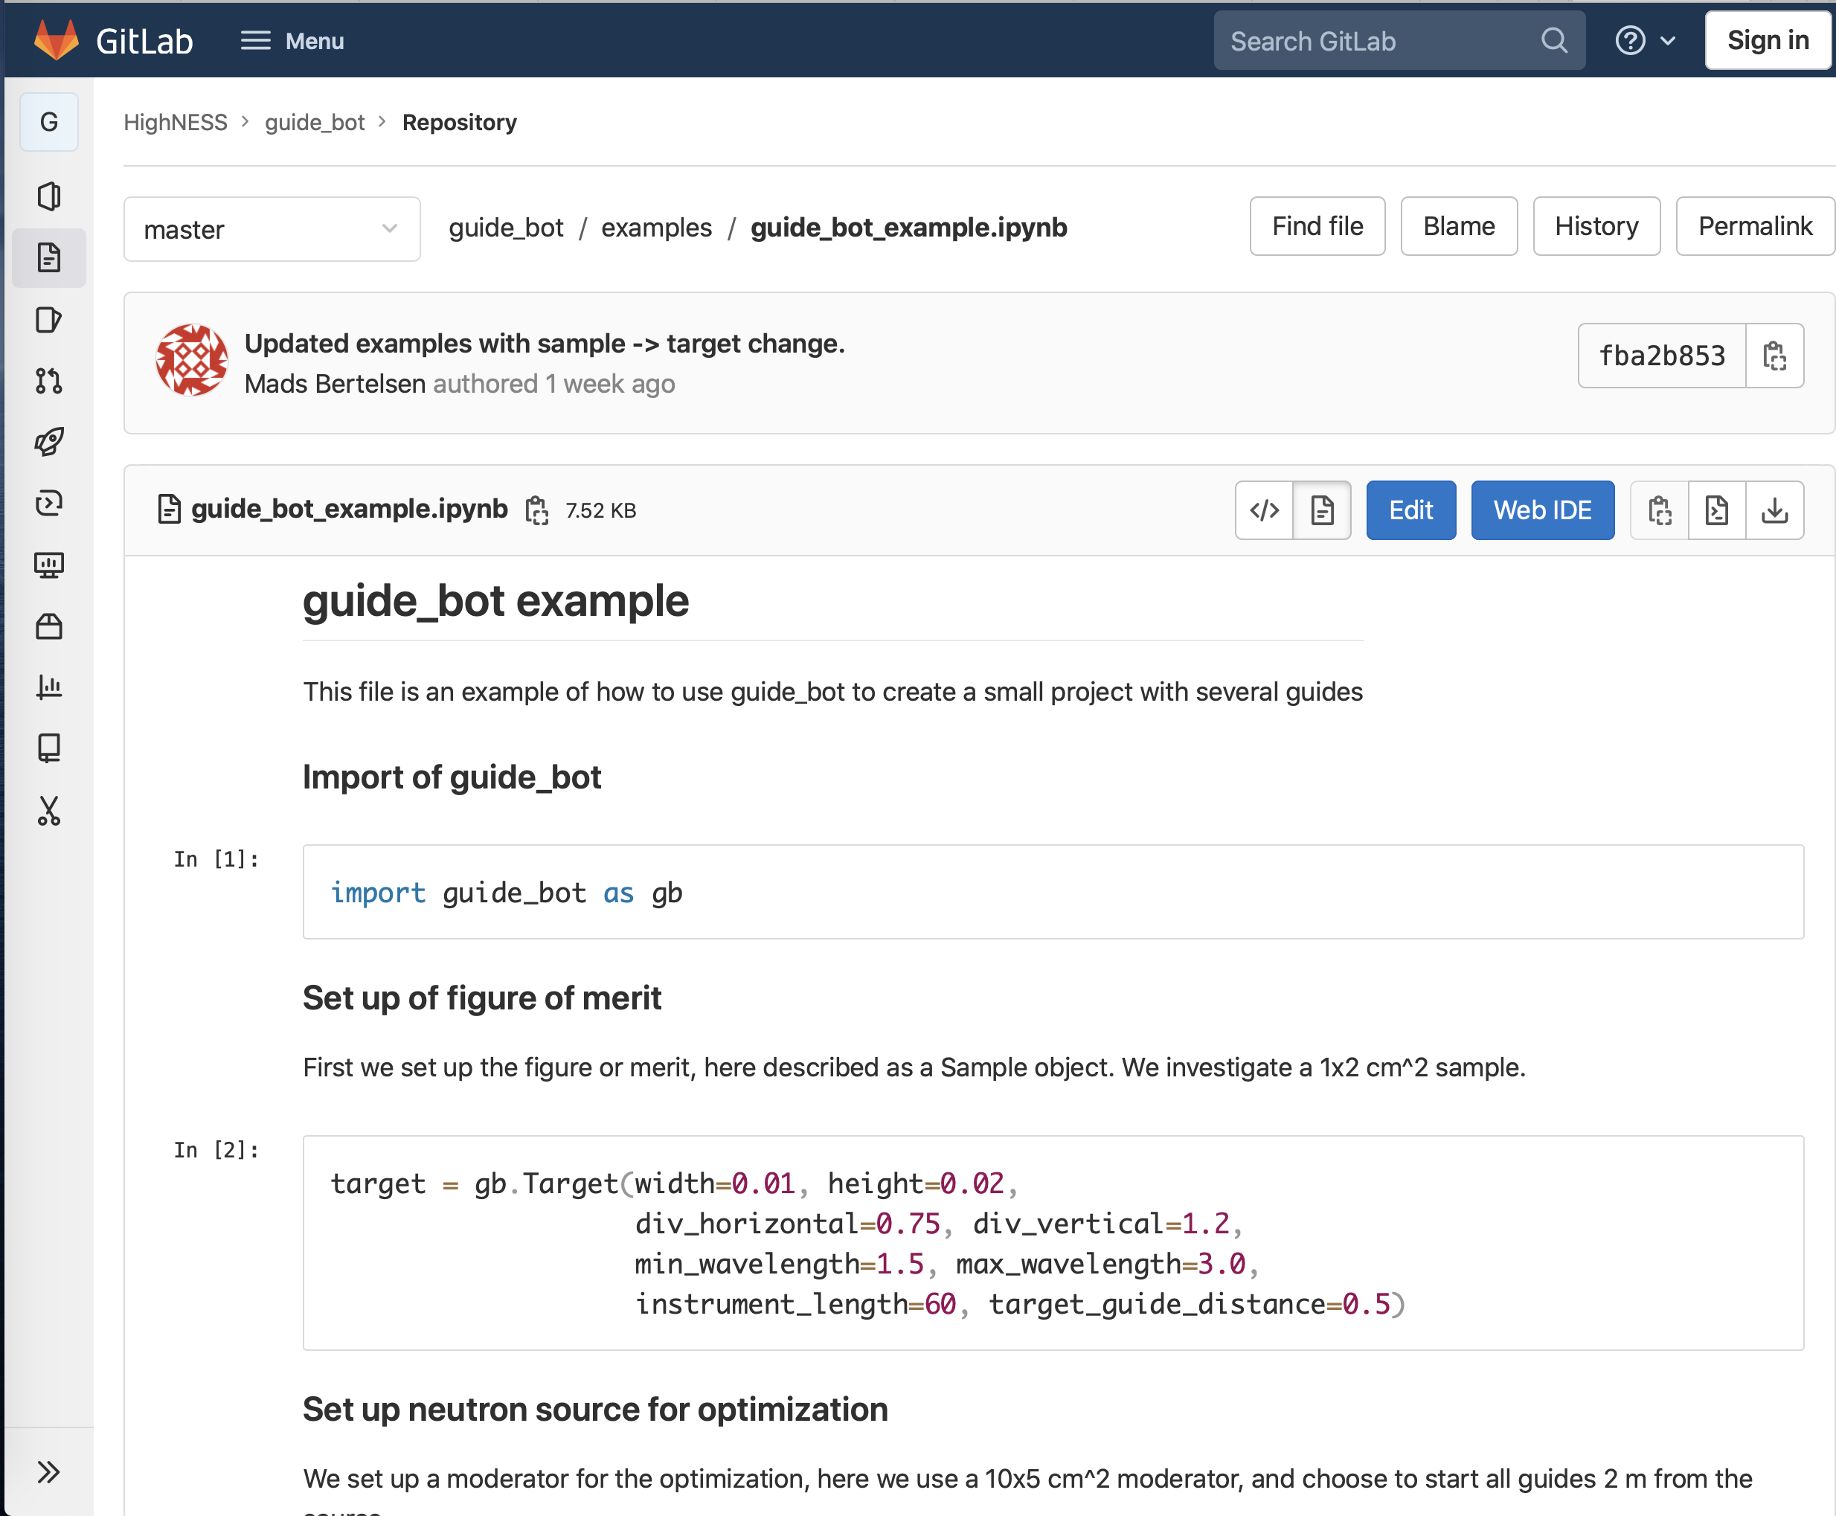
HighnESS WP7
The purpose of guide_bot is to automate optimization of neutron guide systems given a simple job description and a description of the desired guide geometry.
Python base version of guide_bot. Now production ready.
The guide simulations are performed by McStas and on a cluster running SLURM
guide_bot

Slide 13
Agenda
1 DRAM group
2 PaNOSC & HighnESS
3 Data Analysis
4 Modelling
5 Data Reduction
6 General Update

Slide 14
Data Analysis updates
Releases and new projects
Good progress on the data analysis software has been made with new releases. Some highlights for the analysis software include:
EasyDiffraction (Version 0.8.3)
EasyReflectometry (Version 0.0.3 beta)
New: EasyQens in the early planning phase. Together with the CSPEC team compiled list of requirement and features need for first demo (Q3/Q4).
SasView (5.0.5rc)

Slide 15
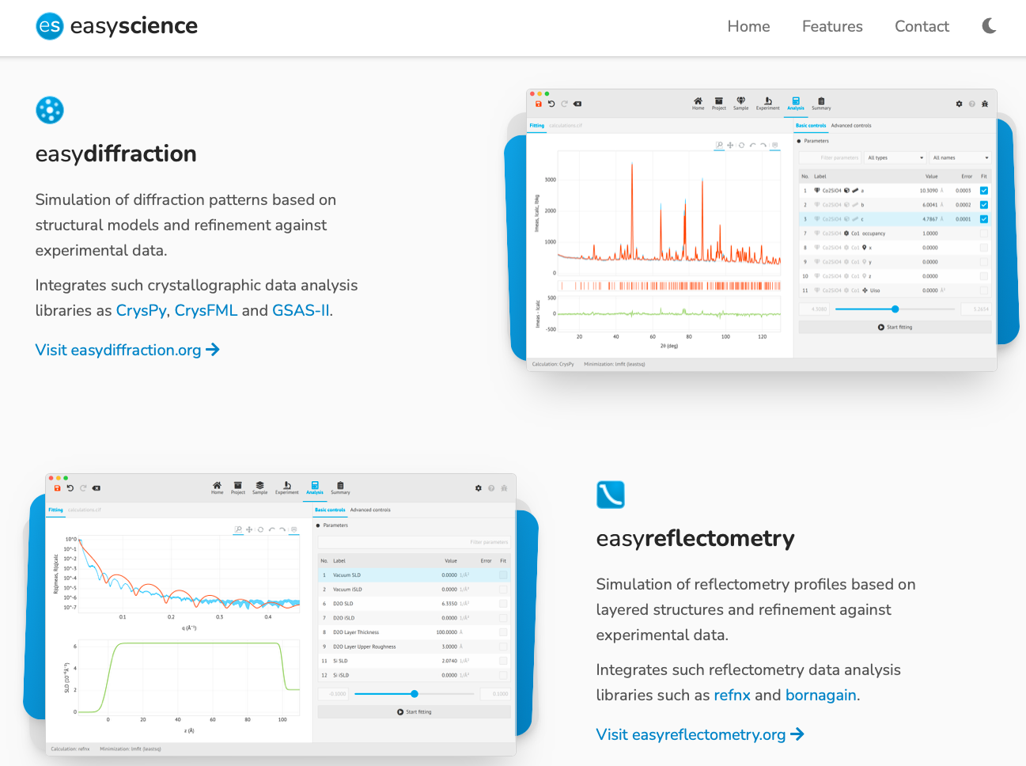
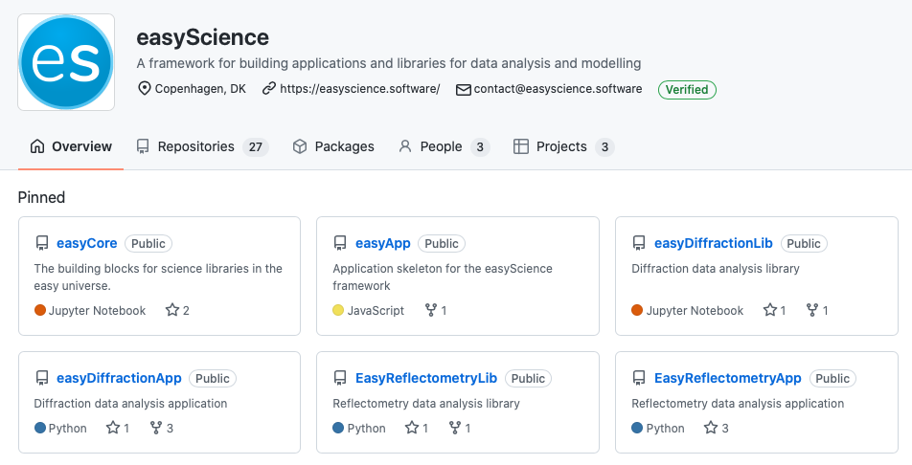
EasyScience
EasyDiffraction & EasyReflectometry
EasyDiffraction (App and notebooks)
EasyReflectormetry (App and notebooks)
See https://github.com/easyScience
See https://easyscience.software

Slide 16
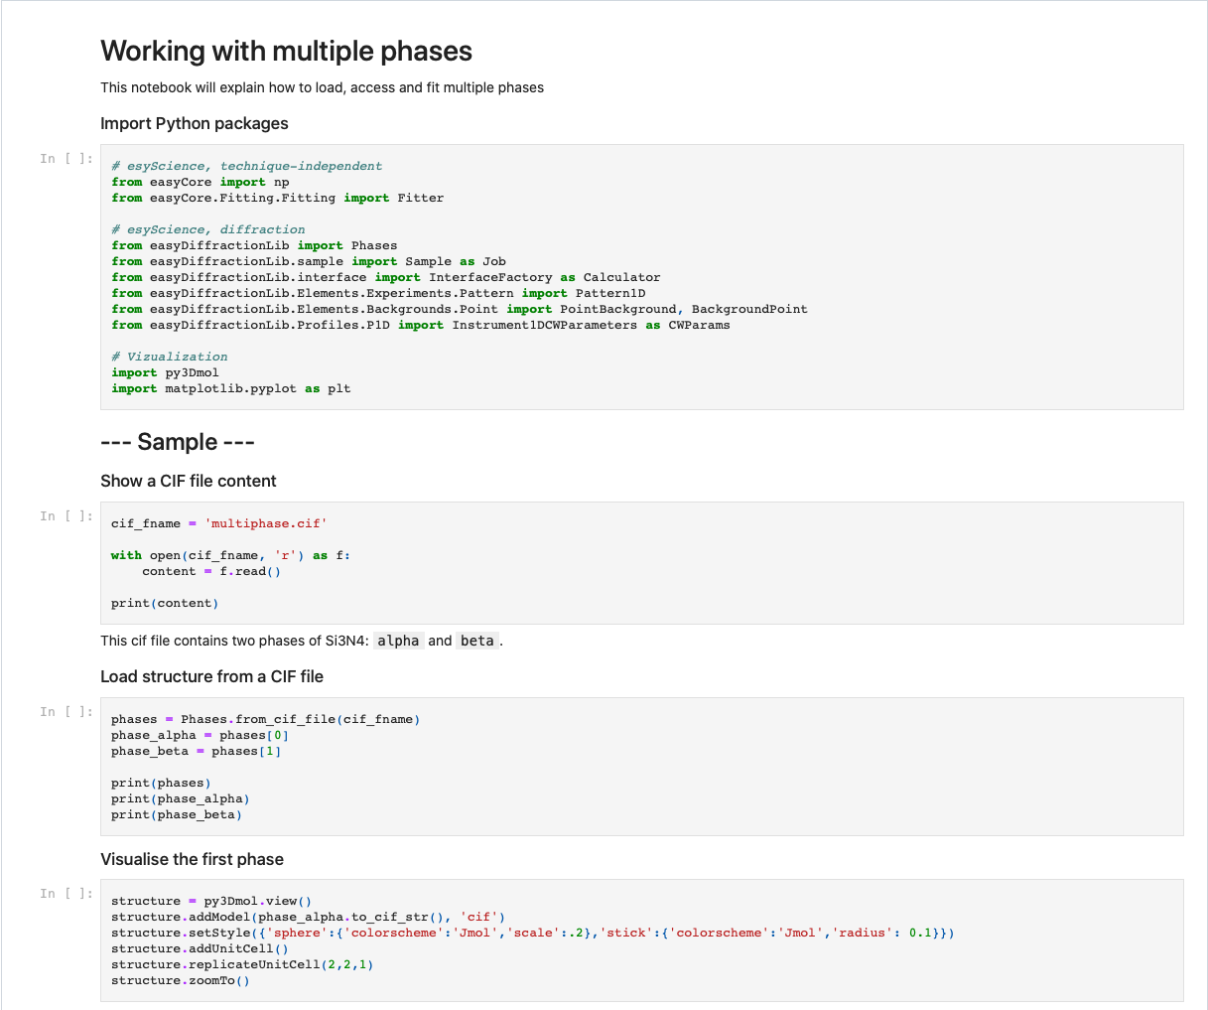
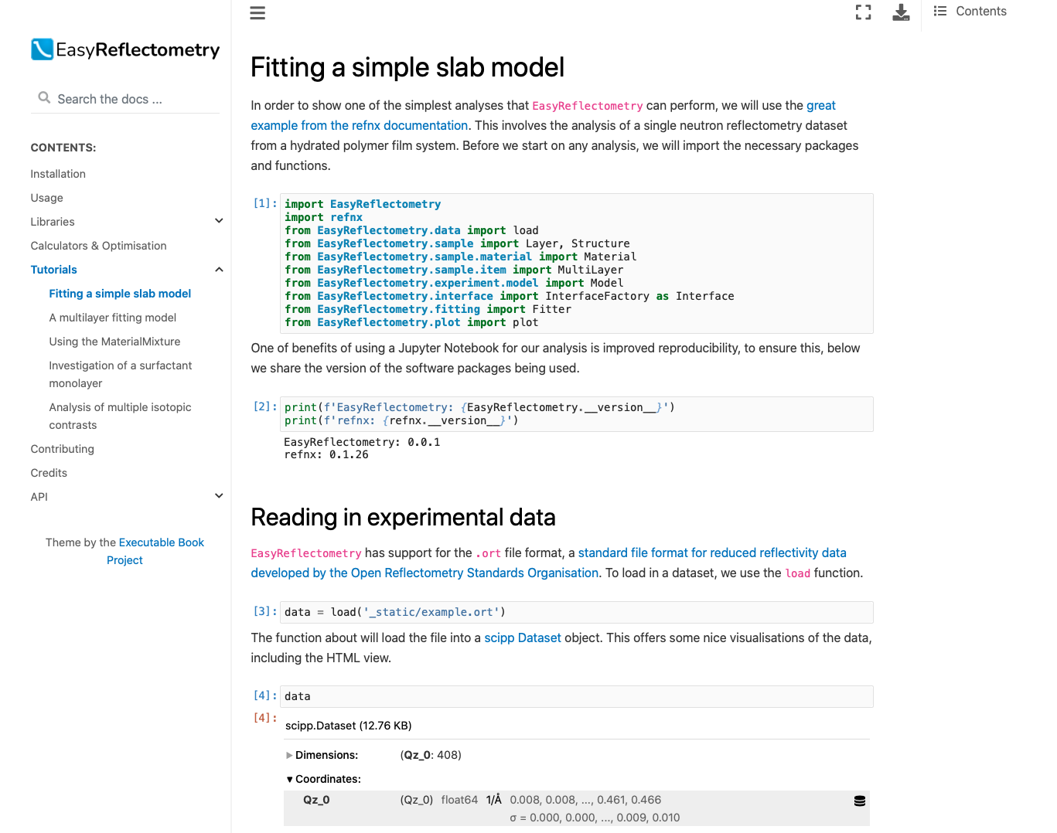
EasyScience
First steps towards running Jupyter Notebooks
EasyDiffraction
EasyReflectometry

Slide 17
Data Analysis Group
Piotr Rozyczko: | Expert in scientific software development (Biovia, Synopsys), atomistic simulations, and SasView | Expert in scientific software development (Biovia, Synopsys), atomistic simulations, and SasView
Simon Ward: | Spectroscopy expert, SpinW maintainer | Spectroscopy expert, SpinW maintainer
Andrew Sazonov: | Diffraction expert | Diffraction expert
NN: | Imaging expert (1 year before BOT) | Imaging expert (1 year before BOT)
Support from Instrument Data Scientists. Specifically:
Wojciech Potrzebowski | SANS (SasView) | SANS (SasView)
Andrew McCluskey | Reflectometry | Reflectometry
In kind (coming to a close)
PSI | Imaging
FZJ | Reflectometry + QENS
Erik Fransson from Chalmers University of Technology wokring on a joint Chalmers-MAX IV-ESS post doc project
The project is about statistical learning applied to diffraction data and will make use of easyScience / easyDiffraction. The post doc will have multiple longer stays at MAX IV
As part of a project funded by the Swedish Research Council (VR) related to data processing solutions for NMX
we also have a part time seconded developer from Lund University and a full-time post doc starting to work on questions related to both data reduction and analysis for NMX.

Slide 18
Agenda
1 DRAM group
2 PaNOSC & HighnESS
3 Data Analysis
4 Modelling
5 Data Reduction
6 General Update

Slide 19
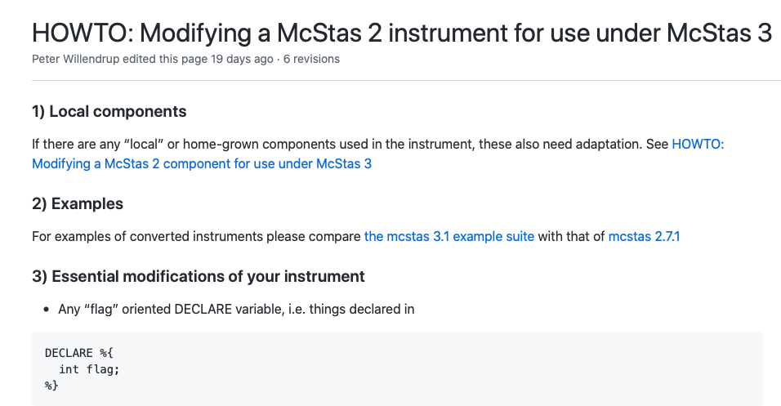
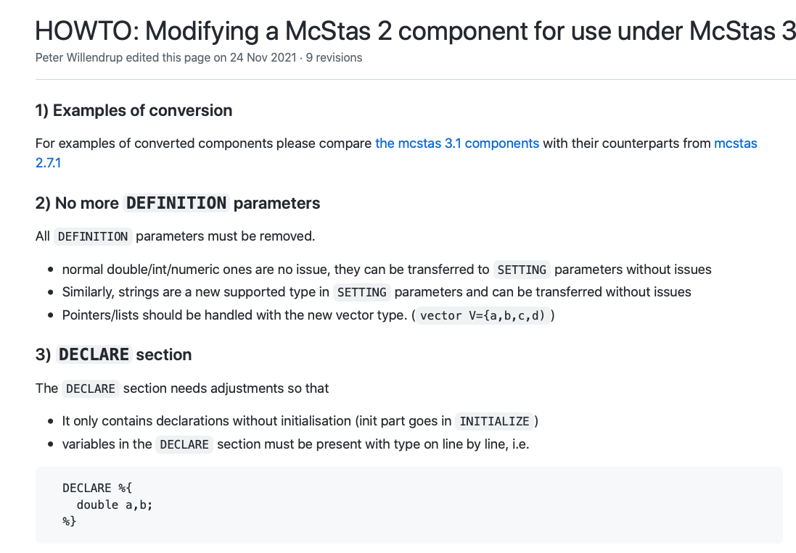
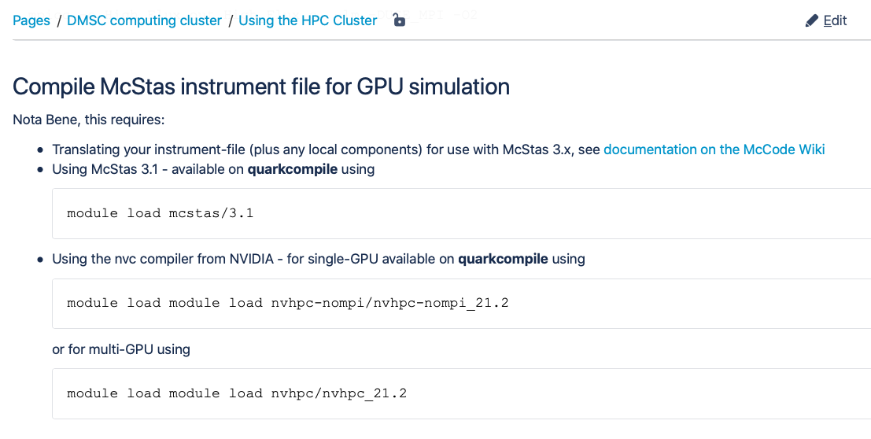
Modelling updates
McStas, McStasScript
McStas (3.1, 2.7.1)
McStasScript (0.0.40)
Support for GPU
Update documentation on migration from 2.7 to 3.x
Update documentation for using GPU (on DMSC HPC)
See McStas docs on github

Slide 20
McStas workshop for IDS
Internal DMSC workshop on how-to run McStas simulations with special focus of on-boarding the IDS team
Also SWAP + new DRAM staff (NMX)
Mixture of presentations and exercises
Easy setup for participants with docker running a desktop environment + JupyterLab

Slide 21
Agenda
1 DRAM group
2 PaNOSC & HighnESS
3 Data Analysis
4 Modelling
5 Data Reduction
6 General Update

Slide 22
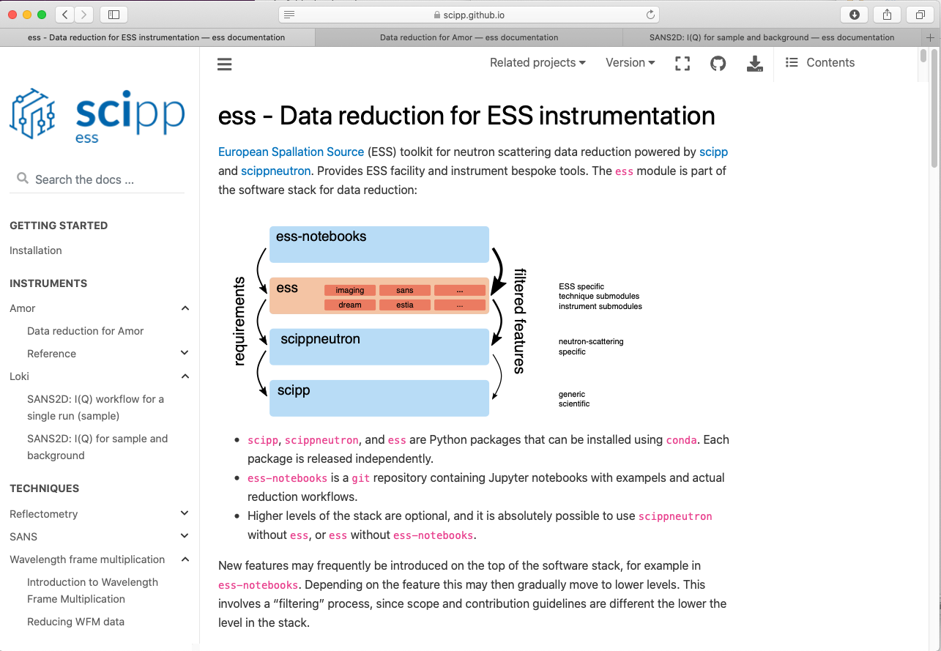
scipp
scipp, scippneutron, ess, and ess-notebooks
scipp continues to be developed with input and requirements from instrument data scientists.
Good progress
Lots of features added & issues fixed
Close collaboration between scipp and IDS team for defining data reduction workflows in scipp
Joint meetings, pair-programming, and lively discussion on a dedicated Slack channel.
From: https://scipp.github.io/ess/

Slide 23
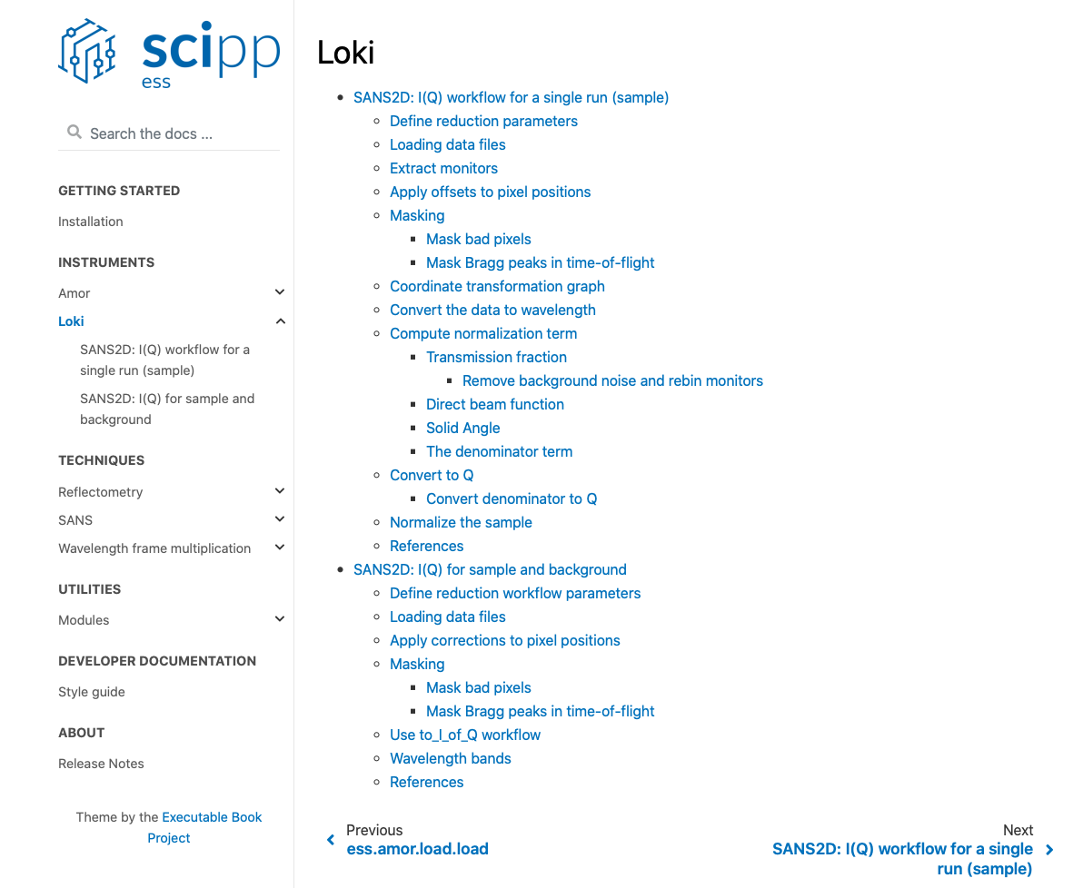
scipp / IDS
Data reduction workflow - - see ess package
Some of the highlights include the ess package being extended for SANS and reflectometry support such that reduction workflows are now available directly for the users on the online documentation pages.
SANS workflows and notebooks
Reflectometry workflows and notebooks
Diffraction workflows and notebooks (soon, PR pending)
Imaging workflows and notebooks (scheduled for development)
Assisted LOKI test at ISIS

Slide 24
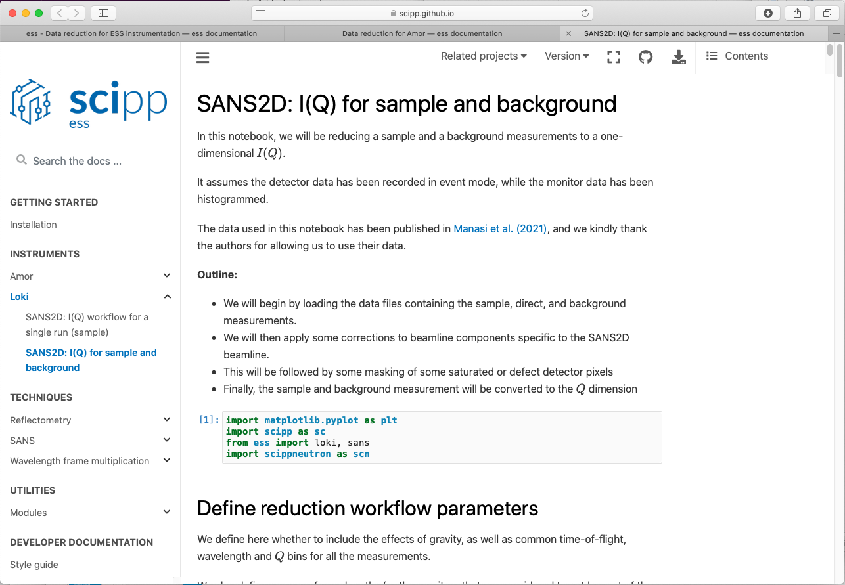
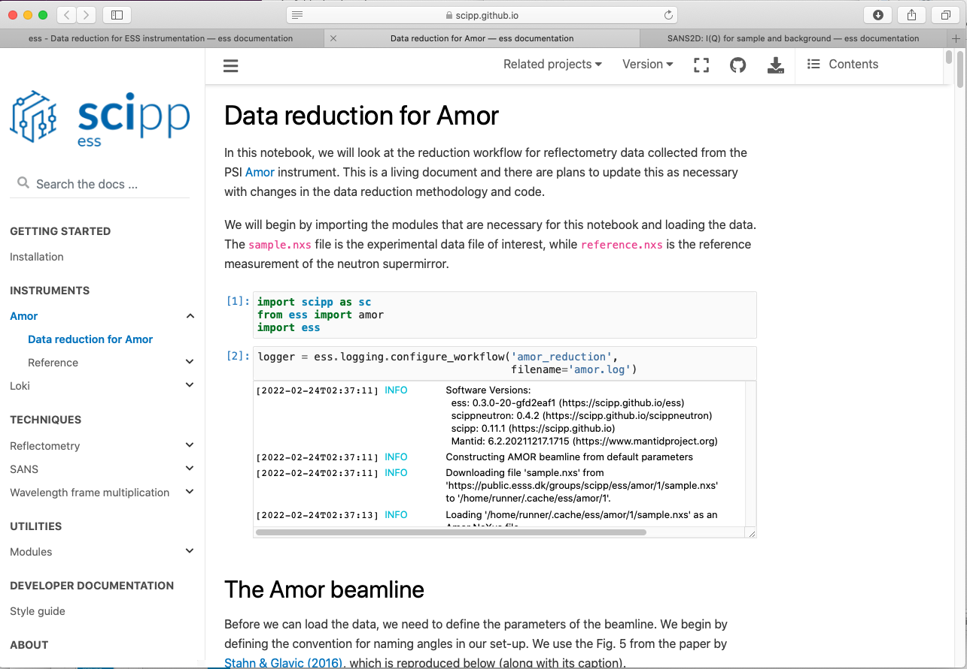
scipp / IDS
Data reduction workflow - - see ess package
Some of the highlights include the ess package being extended for SANS and reflectometry support such that reduction workflows are now available directly for the users on the online documentation pages.
SANS workflows and notebooks
Reflectometry workflows and notebooks
Diffraction workflows and notebooks (soon, PR pending)
Imaging workflows and notebooks (scheduled for development)
Assisted LOKI test at ISIS

Slide 25
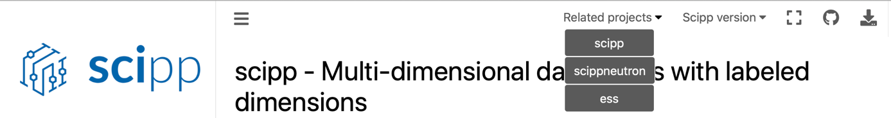
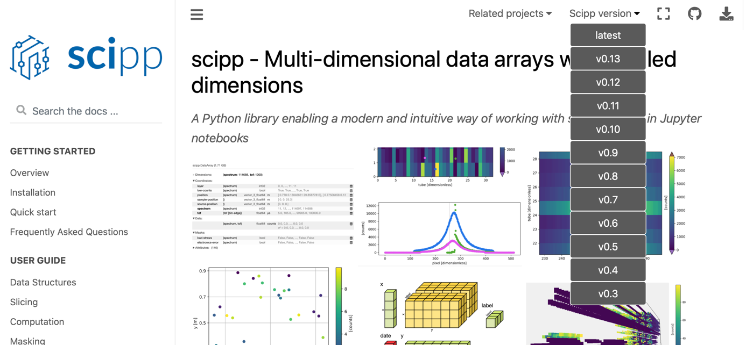
scipp
Documentation on https://scipp.github.io
scipp, scippneutron, and ess have updated the online documentation
making all the projects interconnected, such that it is easy to jump from one project to the next
as well as find the documentation for a specific release version

Slide 26
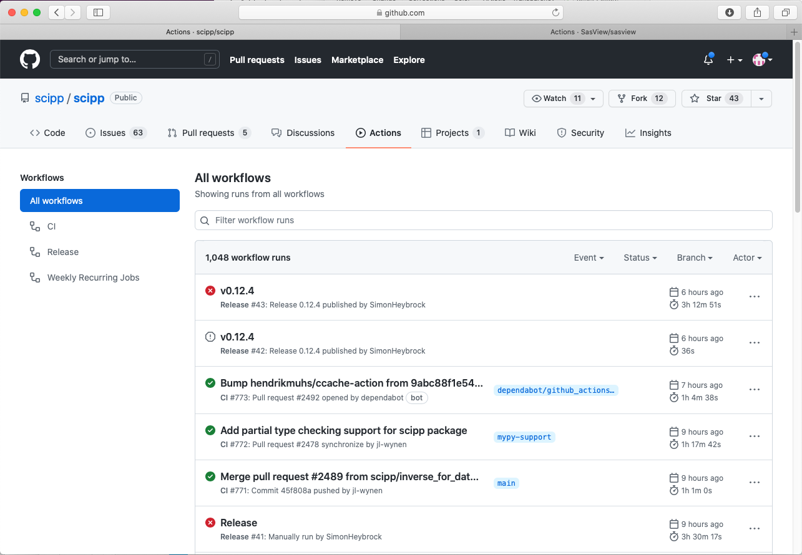
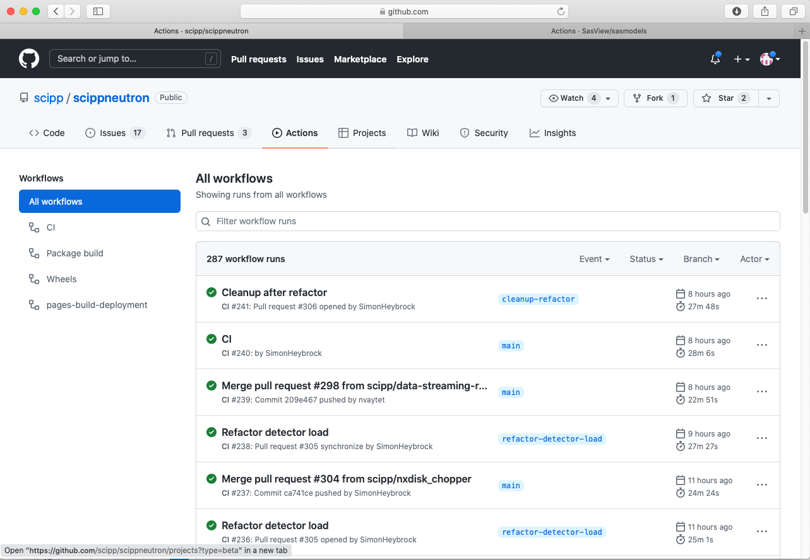
Build systems
Moving towards Github actions
Another important aspect of delivering a software project is the build system.
The build system has been migrated from Azure to GitHub Actions.
Other projects in the DRAM group also using GitHub Actions are: SasView, EasyScience, and McStasScript.
Synergies between these projects for running CI (continuous integration) and online documentation can and have been obtained.
See e.g. https://github.com/scipp/scipp/actions

Slide 27
Agenda
1 DRAM group
2 PaNOSC & HighnESS
3 Data Analysis
4 Modelling
5 Data Reduction
6 General Update

Slide 28
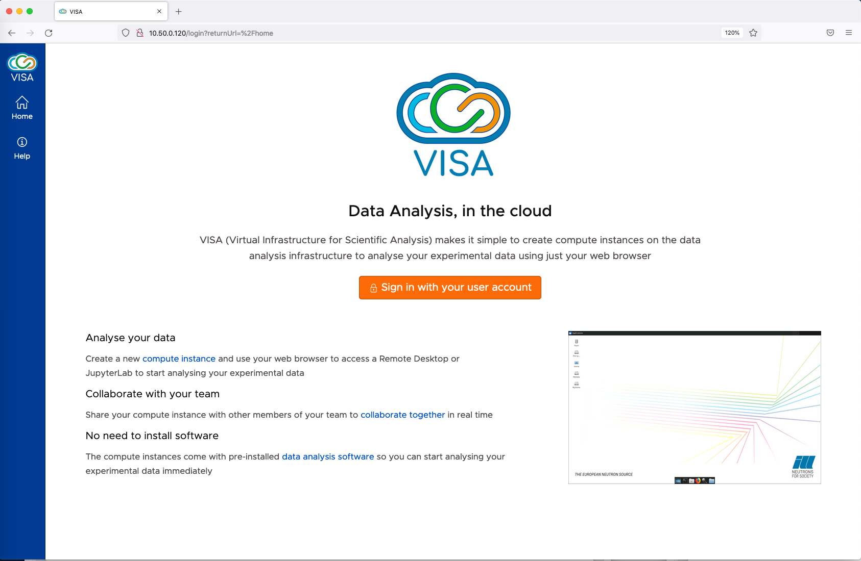
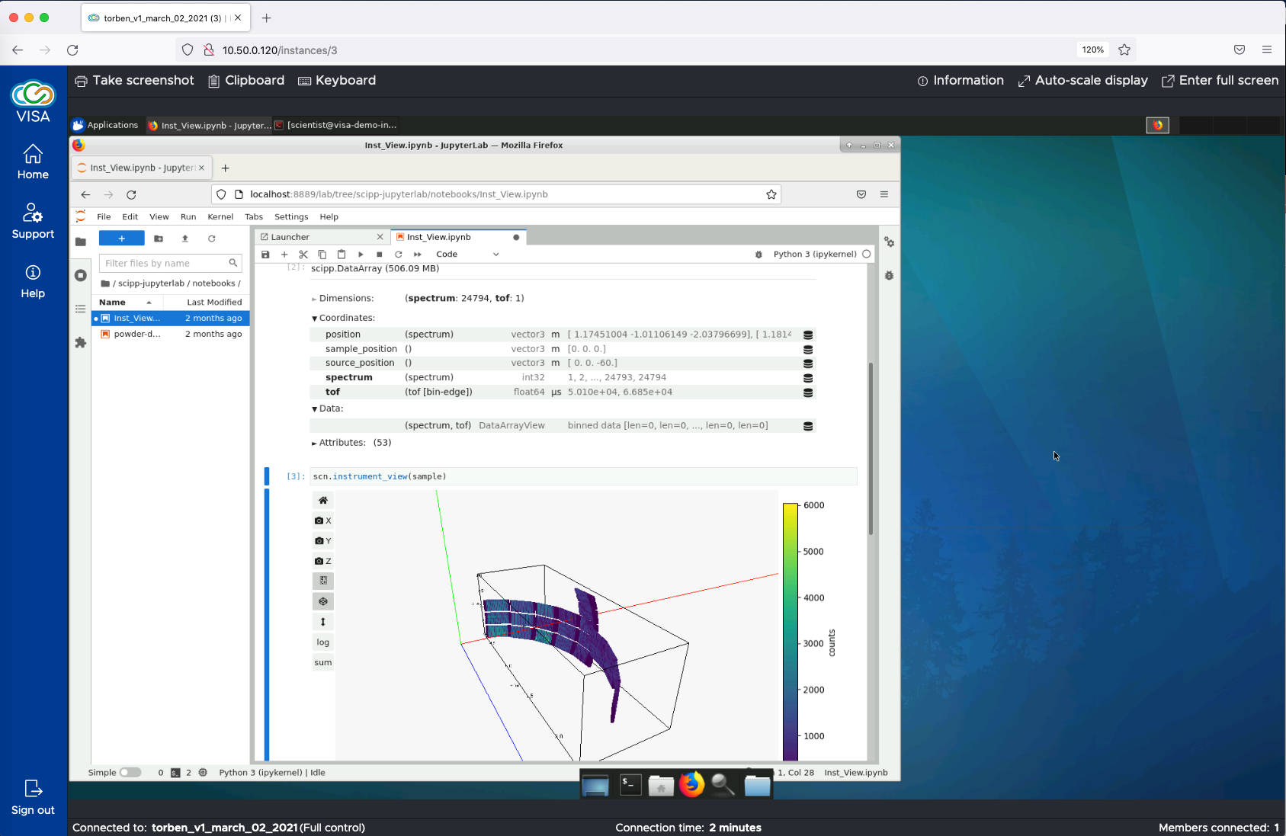
VISA
Test Demo version – ILL - PaNOSC
VISA Remote Desktop solution tested and send requirements to DST
Testing by DRAM users
Also test during the LOKI test at ISIS (early March)
Still a few hick-ups along the way. Only natural for this stage of the test VISA demo
We have a Slack space for VISA
We have a confluence page for VISA requirement
Looking forward to a production ready VISA

Slide 29

User Experience Workshop
Competence development / Improvements of UX (e.g. GUIs) across DMSC
4
4.
Workshops:
3.
User Experience
User Interface Design
Service Design
Command Line Interfaces
2.
1.
Part 1: Like old UX course
Part 2: General Design guide lines
Part 3: A holistic view – “a user journey”
Part 4: CLI and Jupyter
Start October 2021
End January 2022

Slide 30
UX Part 3: SWAP DRAM collaboration
Service Blue Print. From SciCat to Jupyter and back

Slide 31
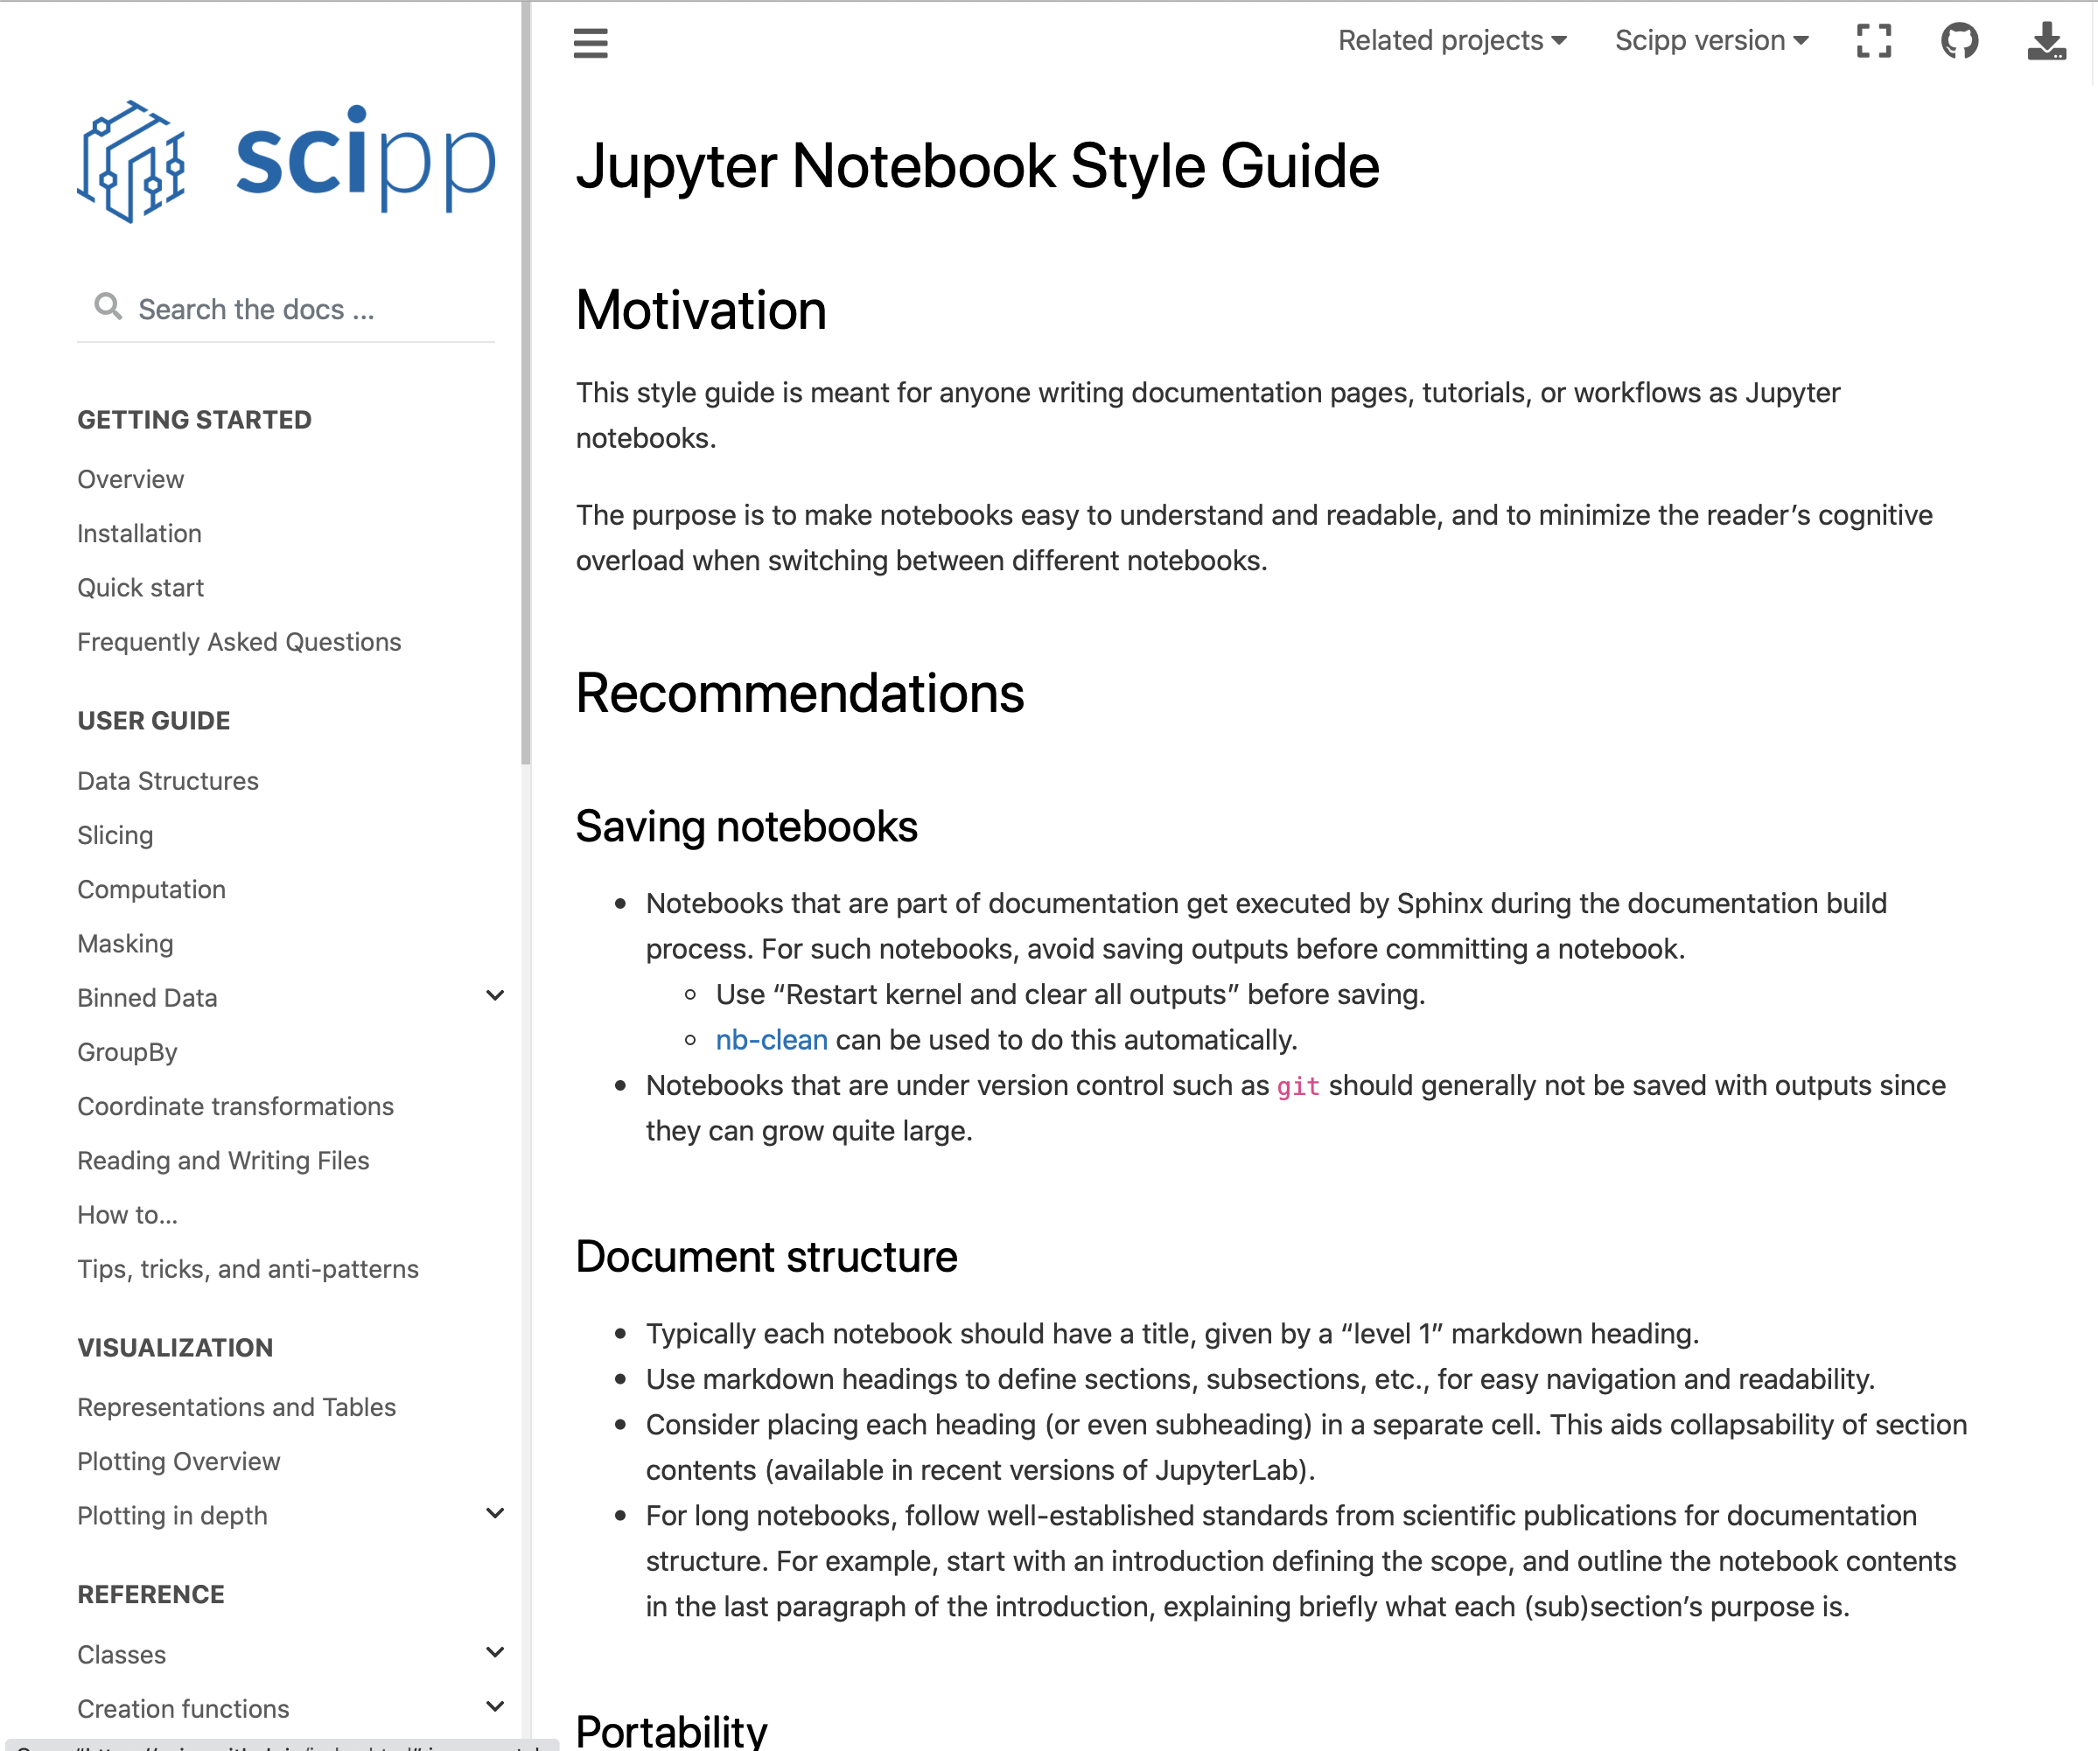
UX Part 4: CLI & Jupyter Notebooks
Jupyter Notebook Style Guide – Towards a common style across DRAM/DMSC
This style guide is meant for anyone writing documentation pages, tutorials, or workflows as Jupyter notebooks.
The purpose is to make notebooks easy to understand and readable, and to minimize the reader’s cognitive overload when switching between different notebooks

Slide 33
Part II
Planning - Work in progress

Slide 34
Planning
See STAP report spring 2022, section 2.2 and 2.3
Since last STAP worked on re-baseline. DRAM approach “bottom-up”
DMSC is currently, in conjunction with the Science sub-project, detailing how we will manage and track our project at the different levels of ESS, Science, DMSC, and DMSC groups.
The task is here to link the high-level plan and milestones for DMSC in the ESS project plan (P6) with roadmaps and the low-level and detailed tasks in JIRA or GitHub that the developers use for organizing their daily work.
This is work in progress. For this reason, we can at this point in time only report on very high-level milestones for DMSC. However, at the ESS level we monitor the following high-level milestones:
DMSC infrastructure ready for HC of 1st instruments; Q2-2024
DMSC infrastructure ready for 1st science; Q1-2025
DMSC infrastructure ready for SOUP; Q3-2026

Slide 35
Linking to ESS P6
Work in progress
DST
(JIRA)
SWAP
(JIRA)
DRAM (GitHub/JIRA)
DMSC internal project planning and tracking
DMSC
(JIRA)
ESS/NSS/Science
(P6)
Risk register
Science project planning and tracking

Slide 36
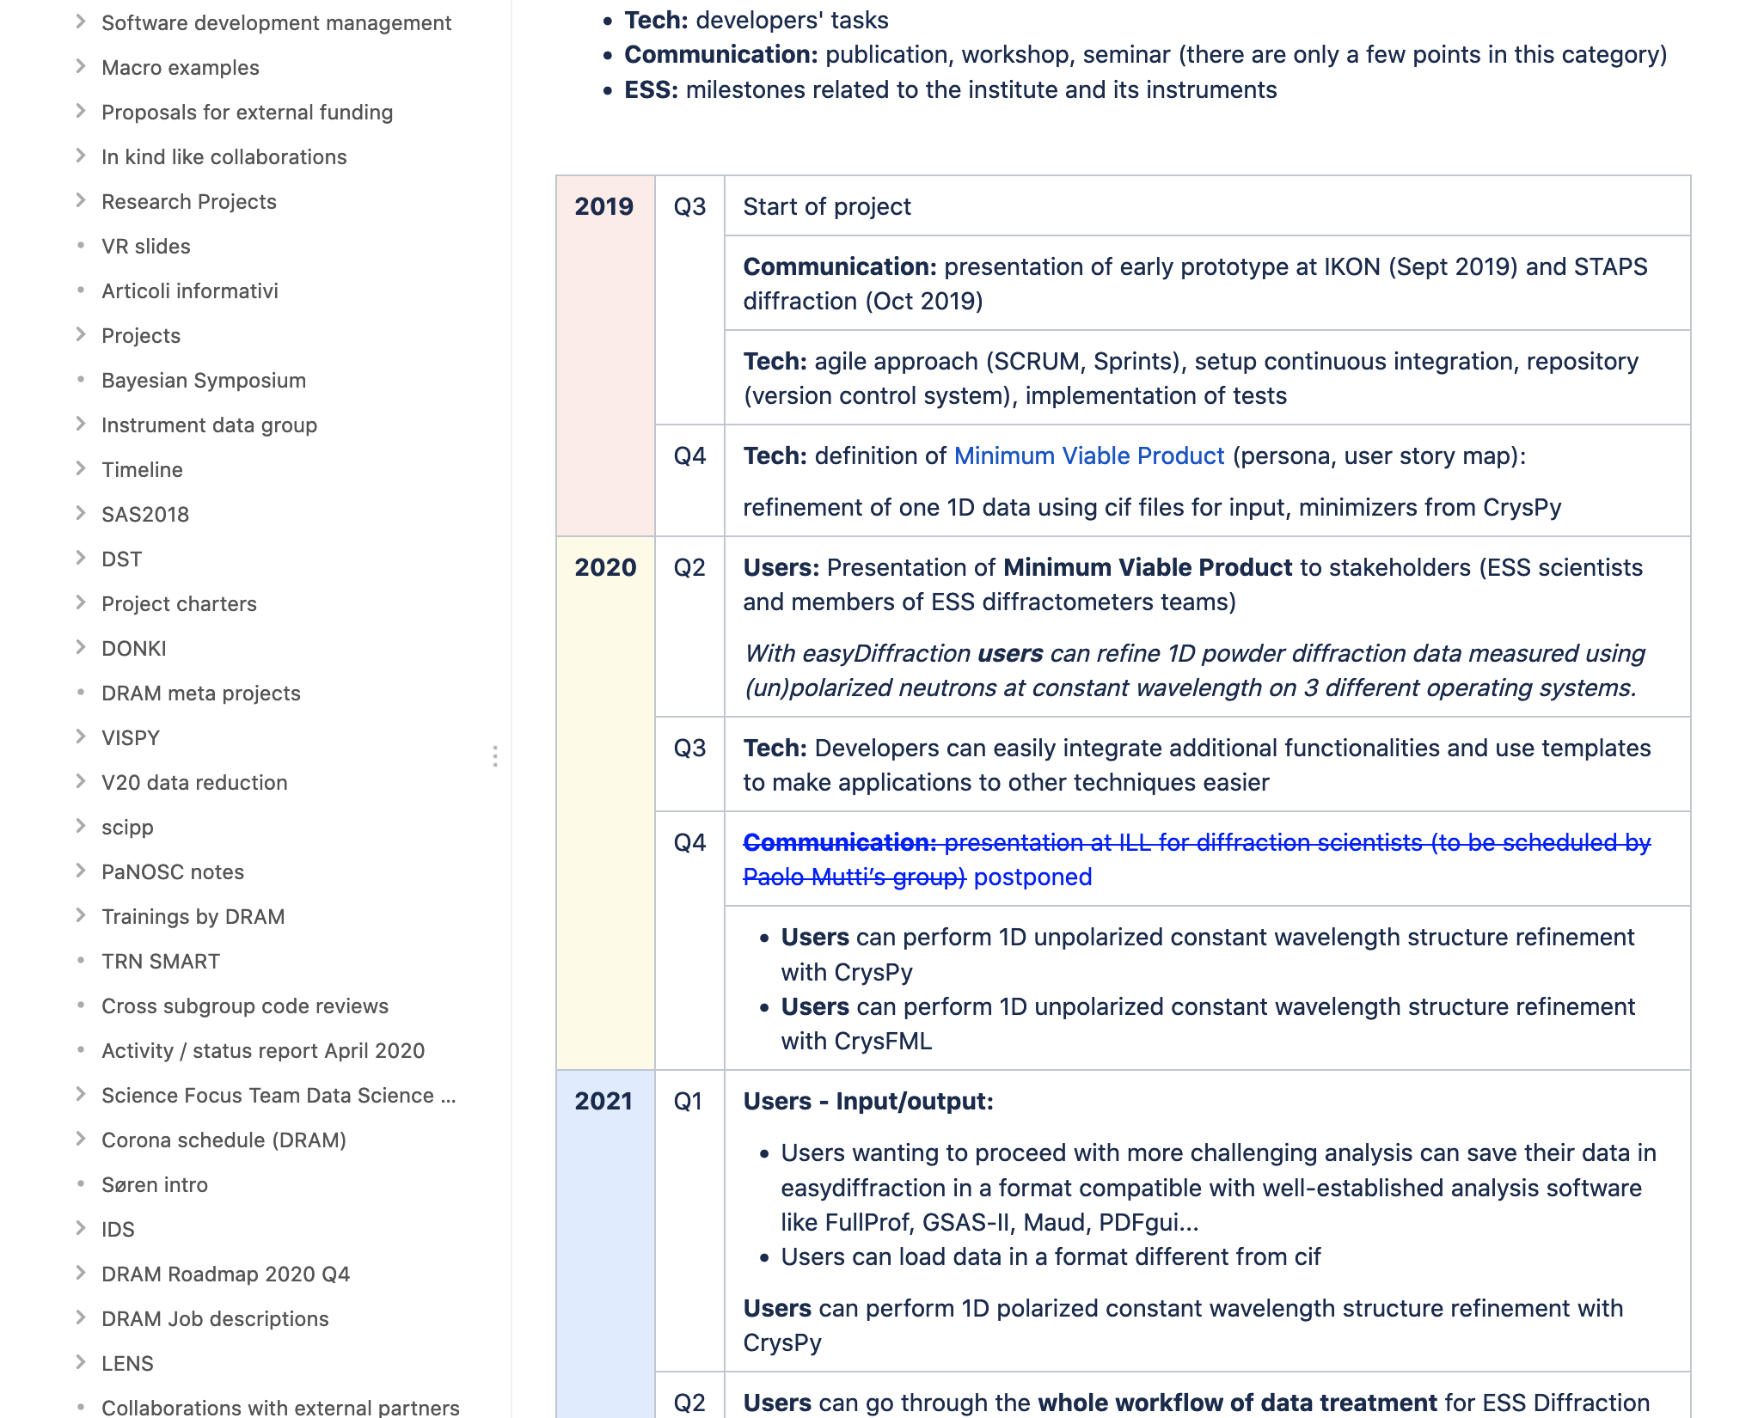
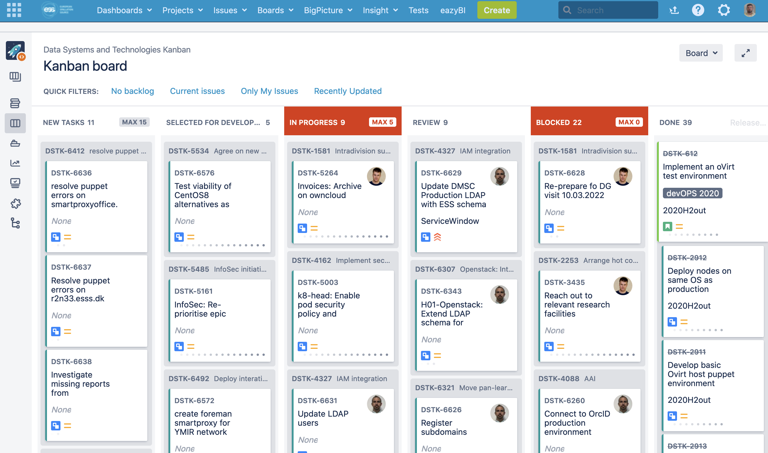
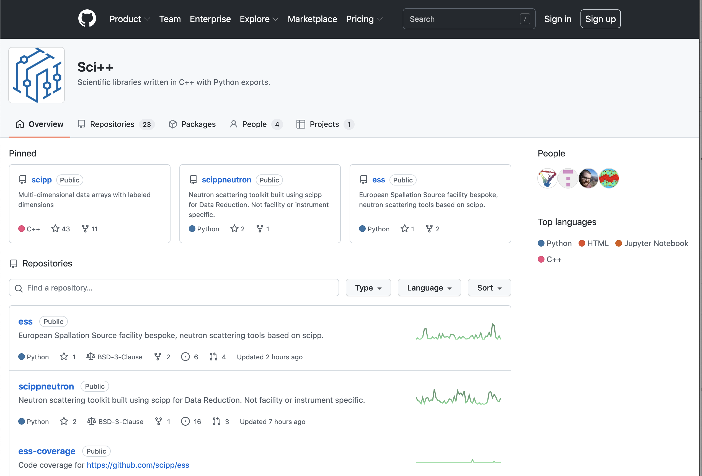
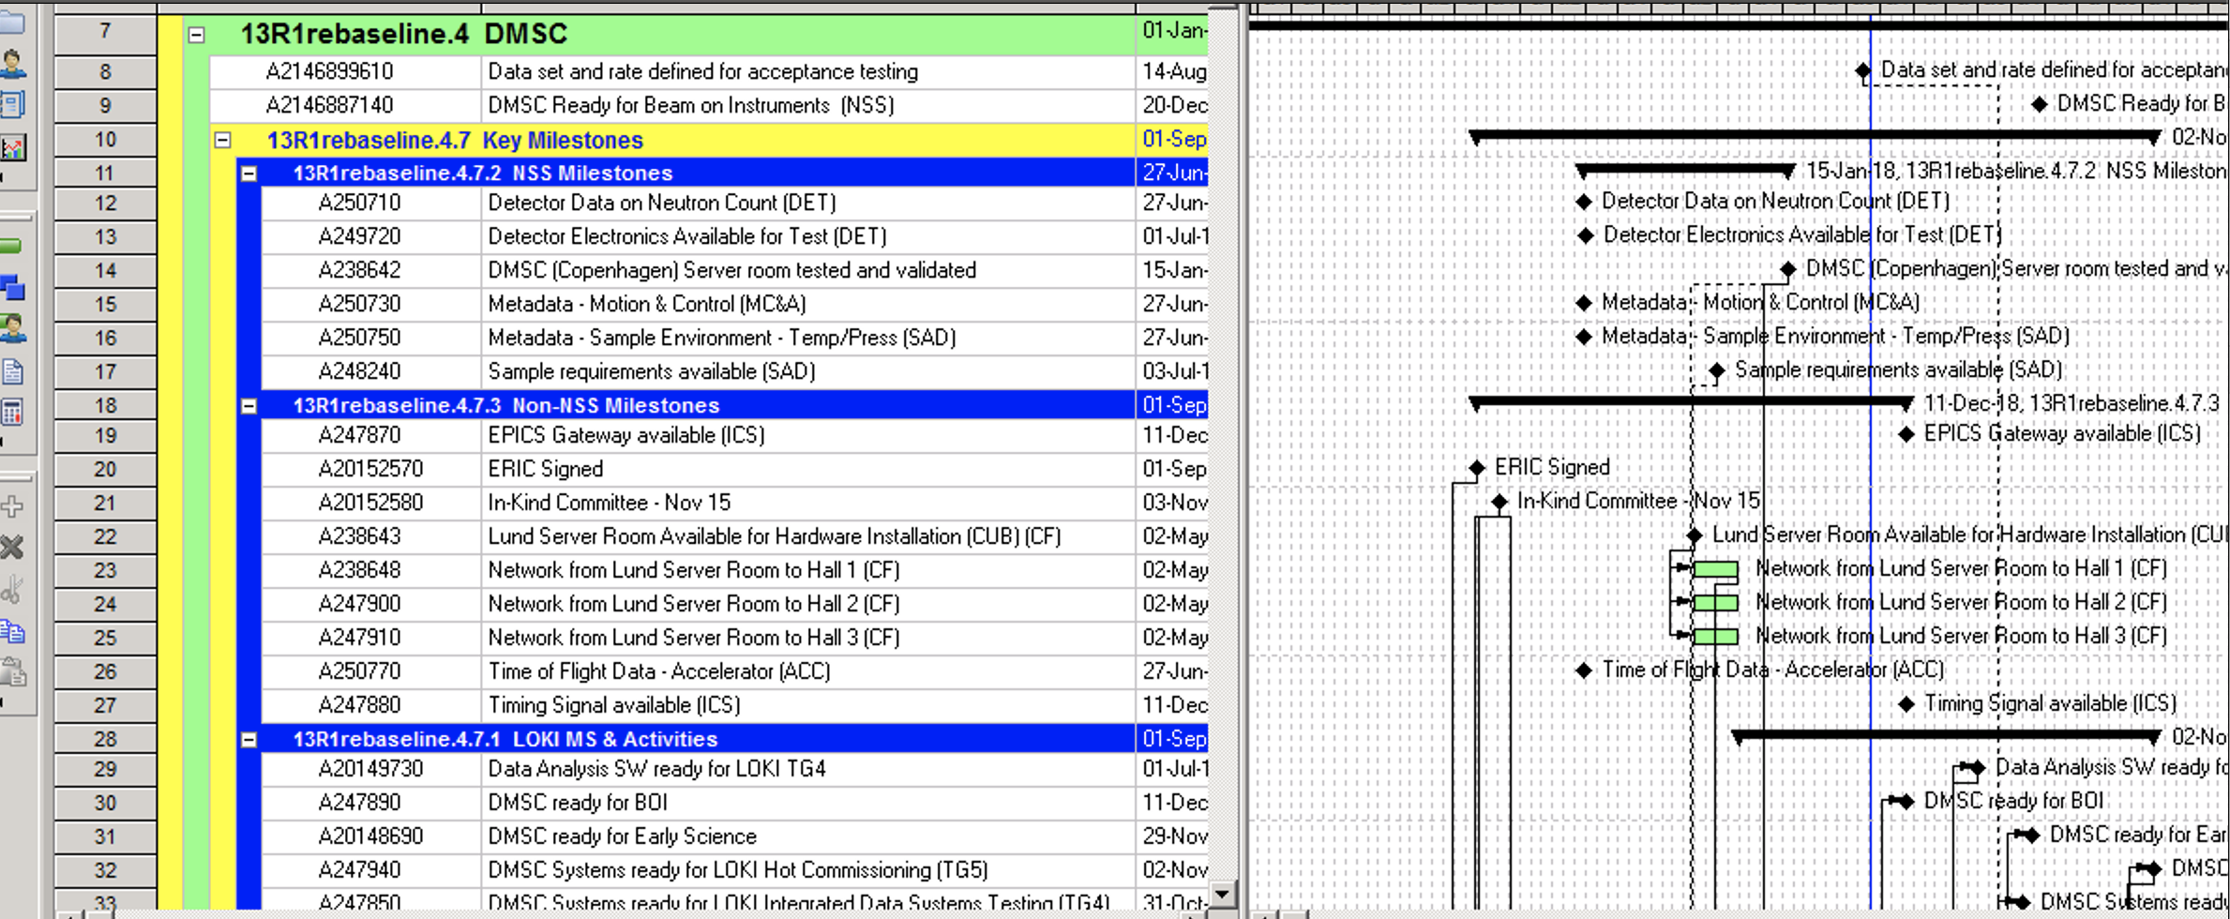
Agile scientific computing house
Use different project management tools than P6

Slide 37
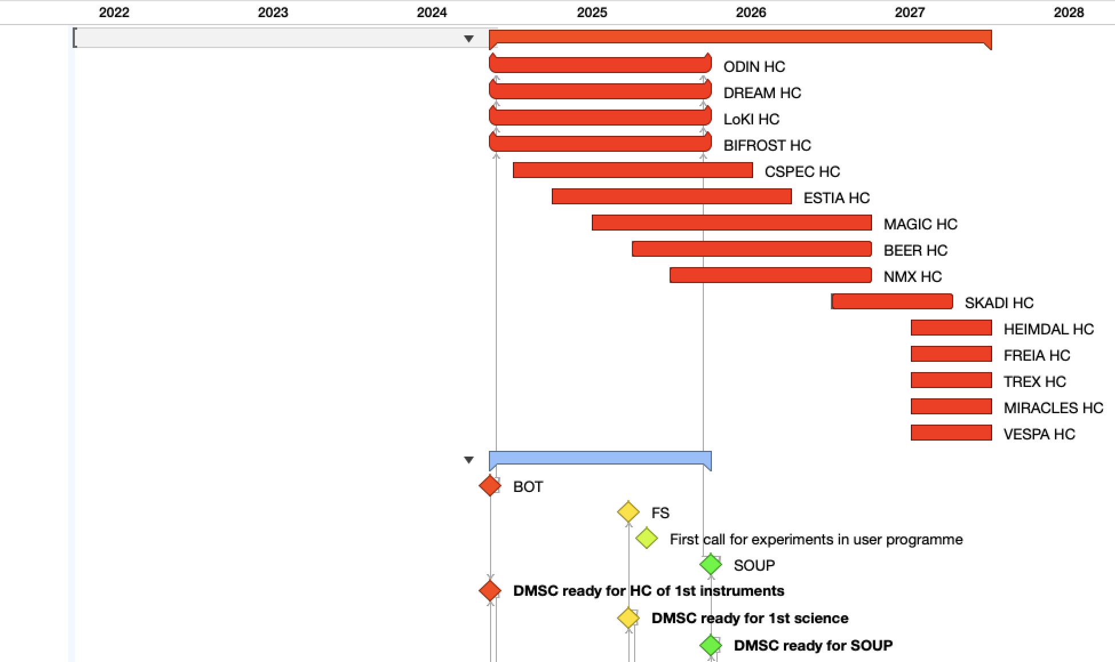
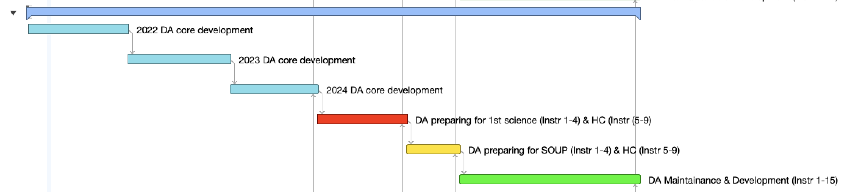
Overall instrument plan HC
+ e.g. Data Analysis

Slide 38
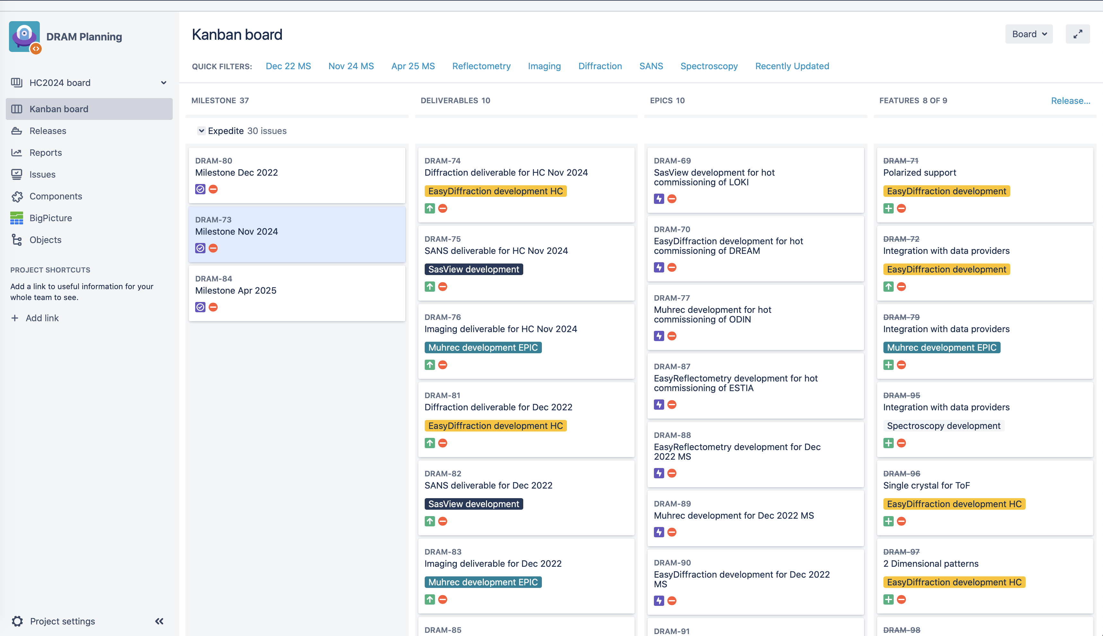
Planning & Overview
P6 & Jira

Slide 39
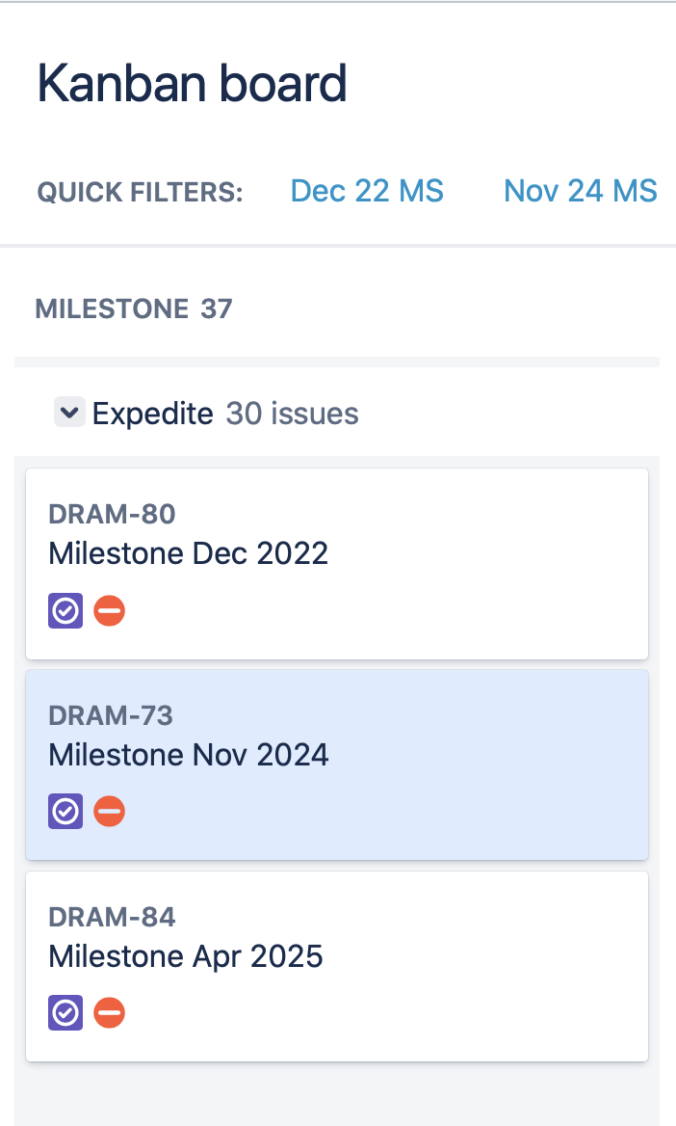
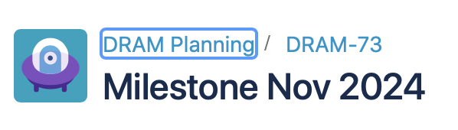
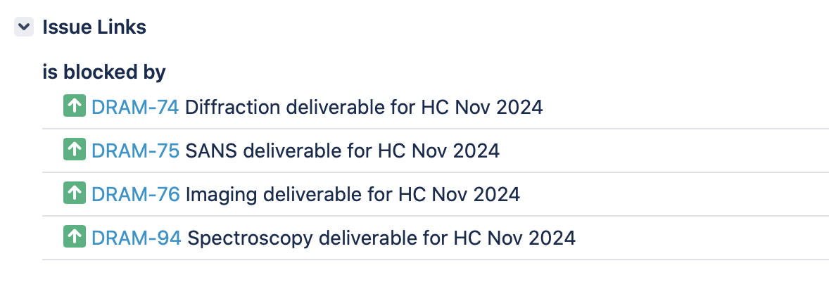
Example
DRAM read for HC November (DRAM-73)

Slide 40
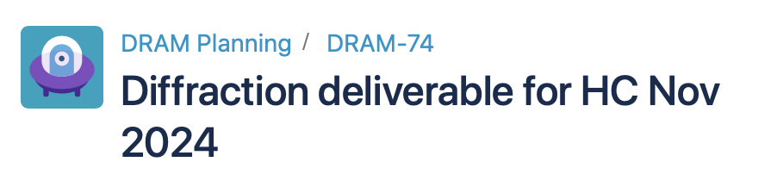
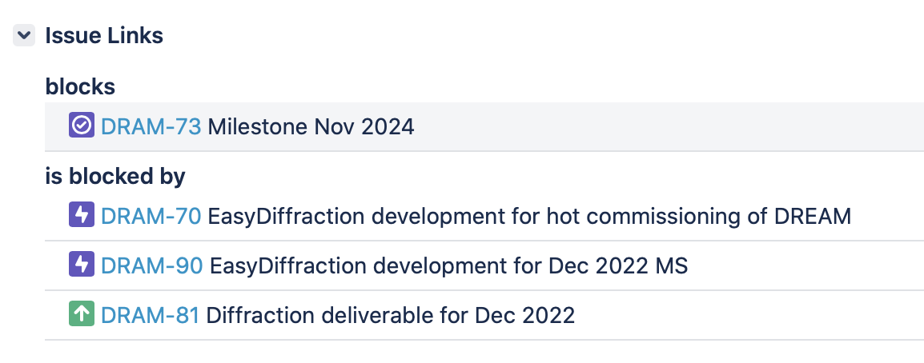
Example
DRAM-73 → DRAM-74 → DRAM-70 .. .. .

Slide 41
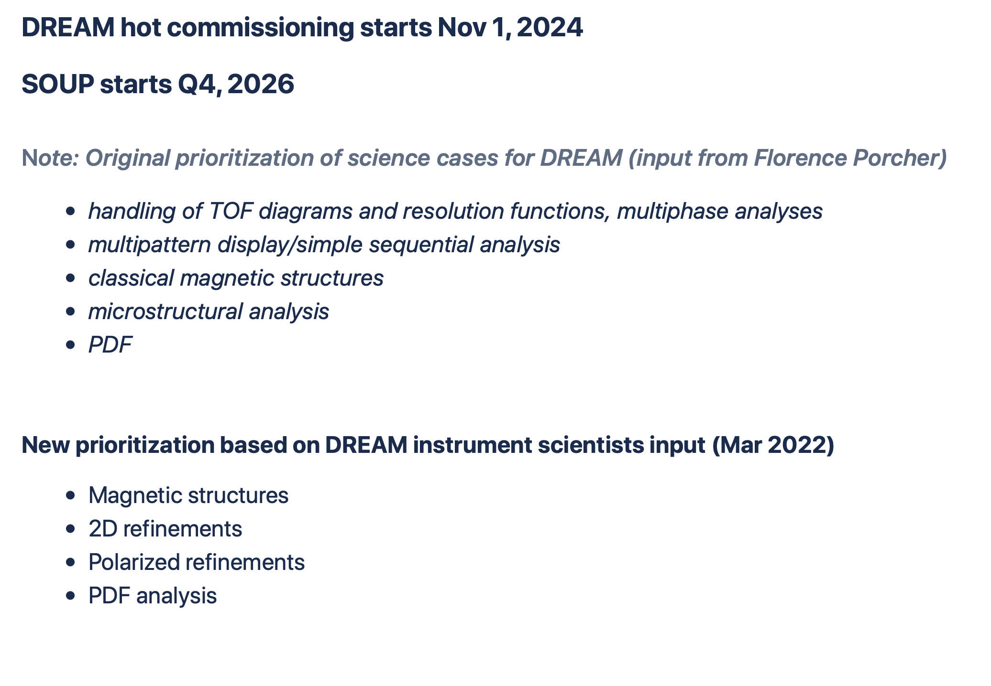
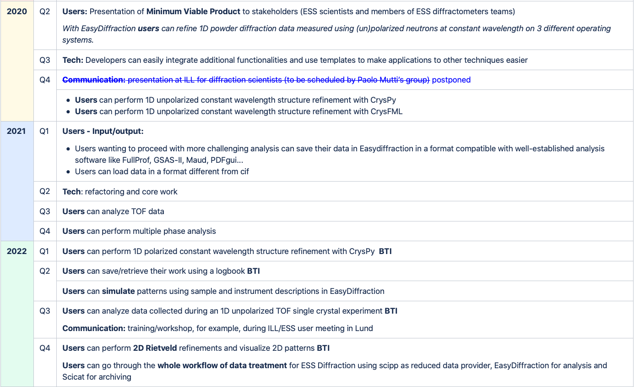
EasyDiffraction
See Confluence – high level deliverables

Slide 42
Finish presentation

